Slide 1
Nonlinear evolution for Pomeron fields in the semi classical
C. Contreras , E. Levin J. Miller* and R. Meneses
Departamento de Física - Matemática
Universidad Técnica Federico Santa María
Valparaiso Chile
*Lisboa Portugal
SILAFAE 2012 Sao Paulo Brasil

Slide 2
Outlook
Introduction
BFKL Pomeron Calculus and RFT
Semi classical approximation
Solution inside the saturation region
Application and Conclusion

Slide 3
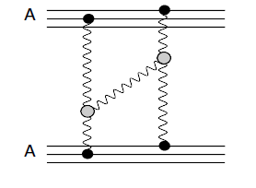
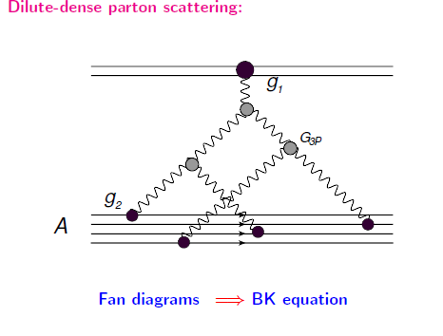
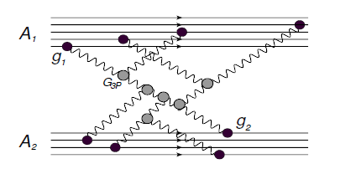
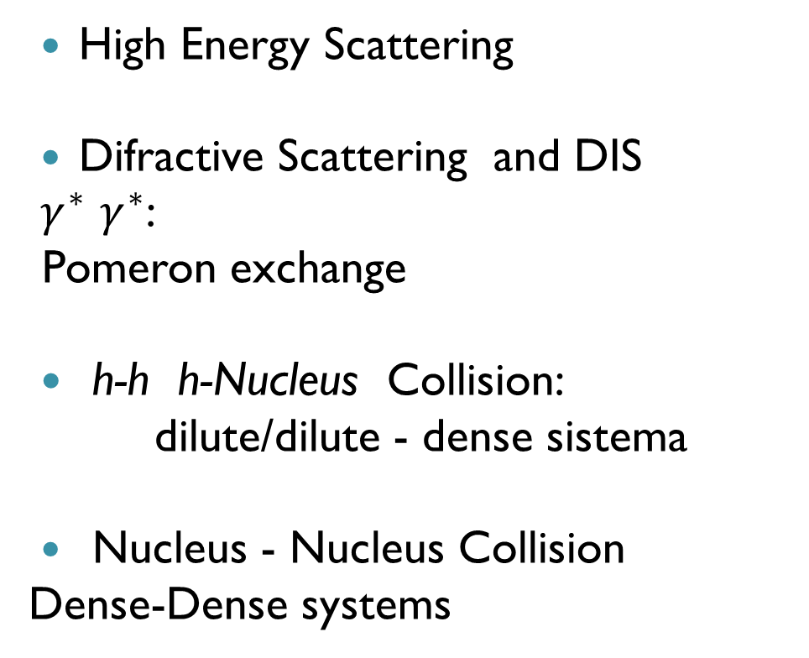
Introduction
High Energy Scattering
Difractive Scattering and DIS
$γ^{∗}$ $γ^{∗}$:
Pomeron exchange
h-h h-Nucleus Collision:
dilute/dilute - dense sistema
Nucleus - Nucleus Collision
Dense-Dense systems

Slide 4
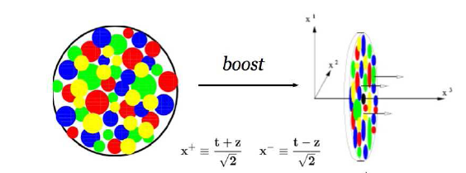
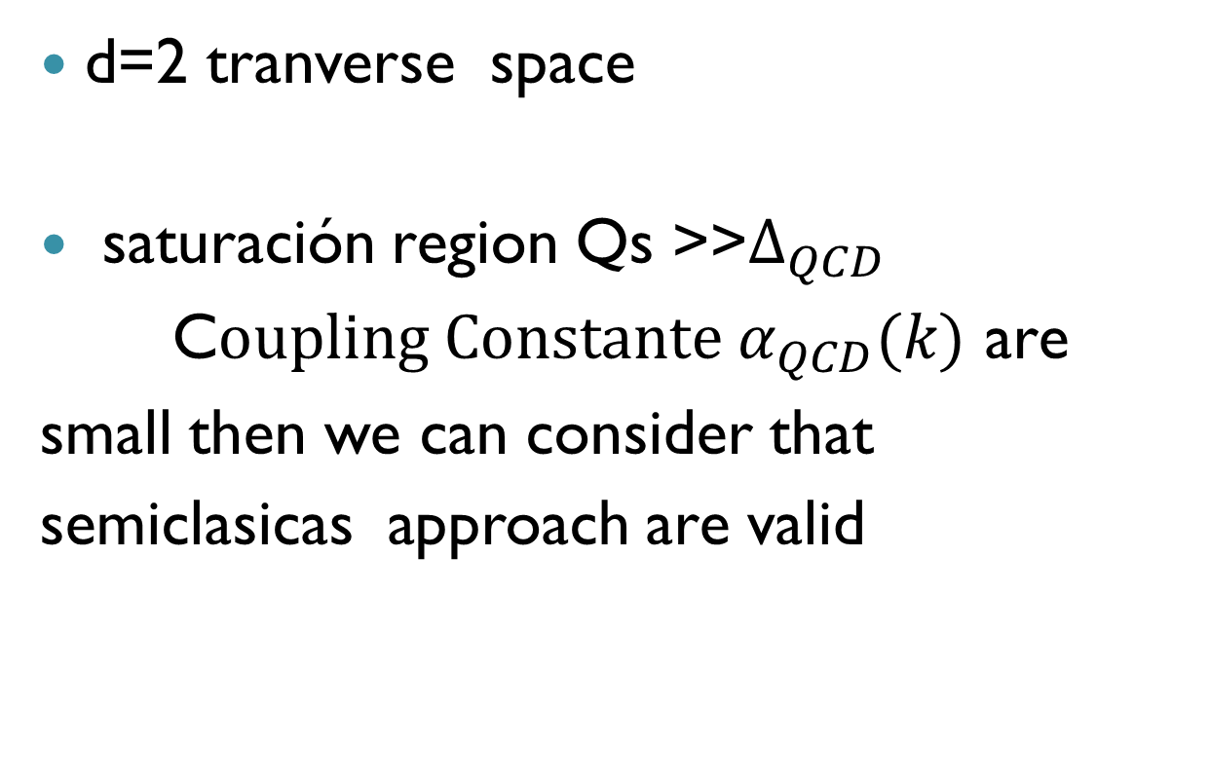
Scattering approach
d=2 tranverse space
saturación region Qs >>$∆_{QCD}$
C$oupling Constante α_{QCD}(k)$ are
small then we can consider that
semiclasicas approach are valid

Slide 5
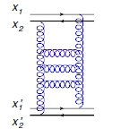

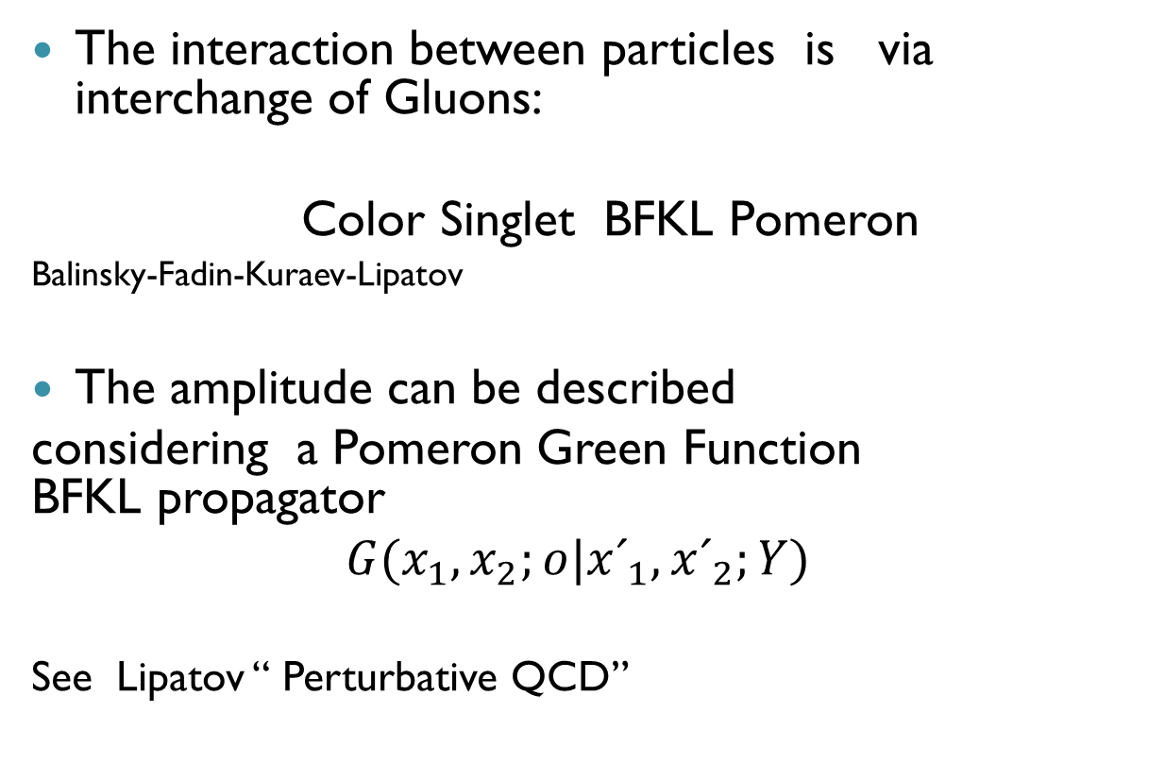
Description in QCD
The interaction between particles is via interchange of Gluons:
Color Singlet BFKL Pomeron
Balinsky-Fadin-Kuraev-Lipatov
The amplitude can be described
considering a Pomeron Green Function BFKL propagator
$$G{(x}_{1},x_{2};o|{x´}_{1},{x´}_{2};Y)$$
See Lipatov “ Perturbative QCD”

Slide 6
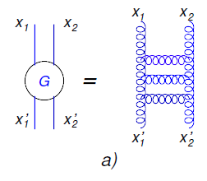
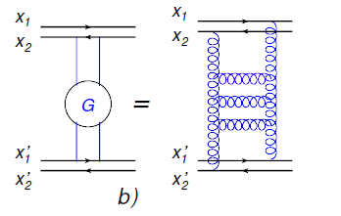

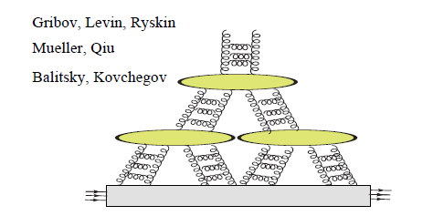
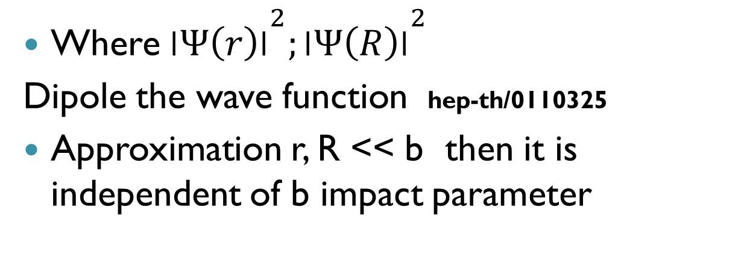
Where ${׀Ψ\left(r\right)׀}^{2};{׀Ψ\left(R\right)׀}^{2}$
Dipole the wave function hep-th/0110325
Approximation r, R << b then it is independent of b impact parameter

Slide 7
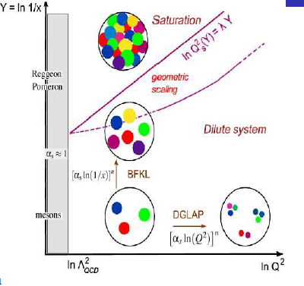
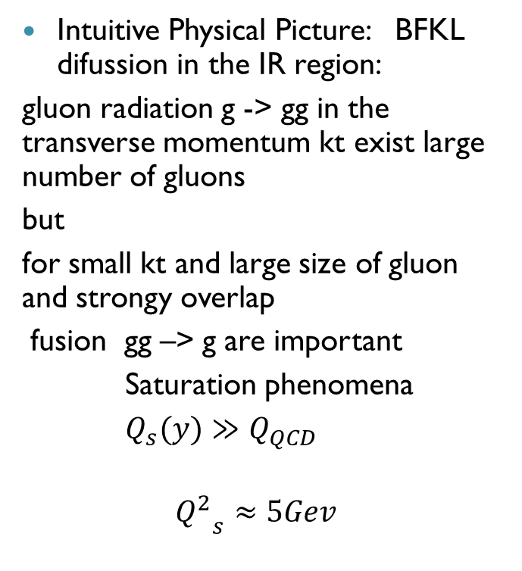
Balitsky-Fadin-Kuraev-Lipatov BFKL equation describe scattering amplitud in High Energy using a resumation LLA in pQCD (76-78)
BFKL evolution equation with respect to ln x , which are represented by a set of Gluon ladders
Intuitive Physical Picture: BFKL difussion in the IR region:
gluon radiation g -> gg in the transverse momentum kt exist large number of gluons
but
for small kt and large size of gluon and strongy overlap
fusion gg –> g are important
Saturation phenomena
$Q_{s}(y)≫Q_{QCD}$
$${Q_{}^{2}}_{s}≈5Gev$$

Slide 8
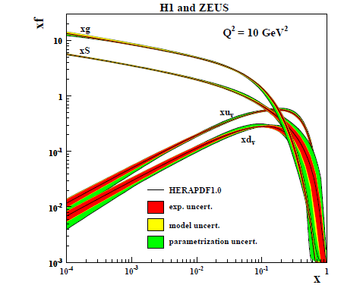
Experimental evidence in small-x

Slide 9
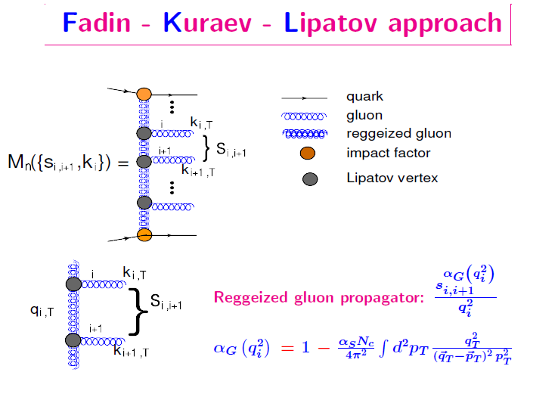
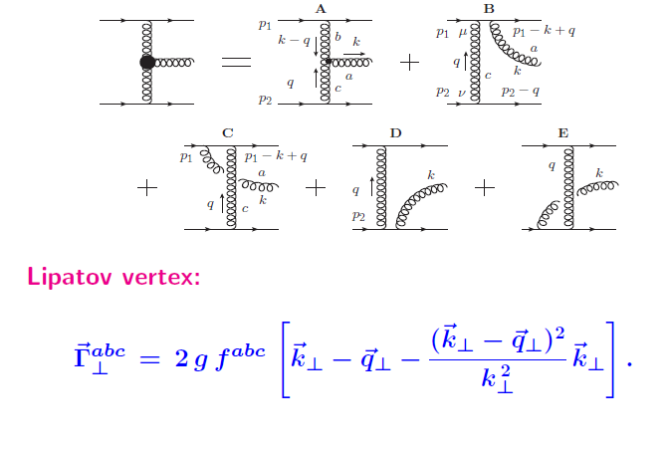

Slide 10
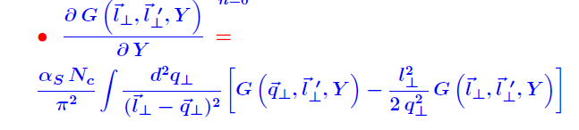
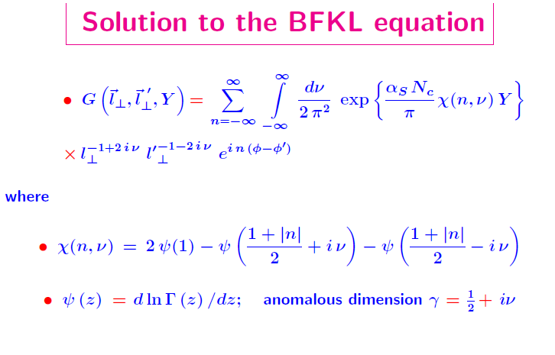

Slide 11
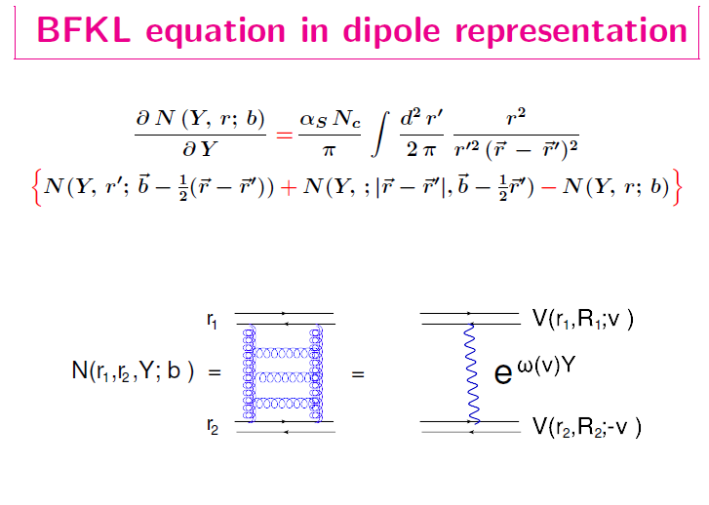

Slide 12
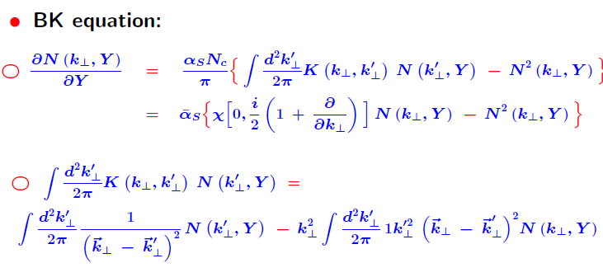

Slide 13
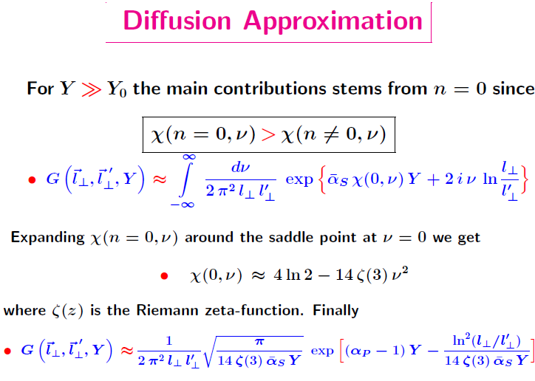

Slide 14
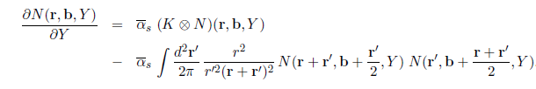
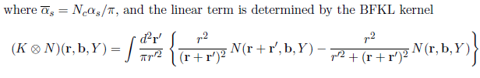
Approch to saturation
First: Modification of the BFKL
1983 GLR Gribov, Levin and Ryskin
1999 BK Balisky- Kovchegov:
include quadratic terms determined by three Pomeron Vertex
BK eq. evolution for Amplitude N(r,b,Y)

Slide 15
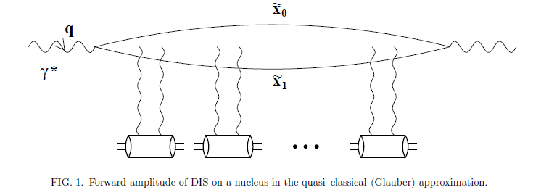

See hep.ph 0110325
BK equation DIS virtual photon on a large nucleus
LLA
$${\text{α}}_{S}≪1 ,\frac{{\text{α}}_{S}Ln1}{x}≪1, x≅\frac{Q^{2}}{s} and large{\text{N}}_{c}$$
Dipole approximation: photon splits in $q\overline{q}$ long before the interaction with nucleus degrees of freedoms
The dipole interacts independently with nucleons in the nucleus via two-gluon exchange

Slide 16
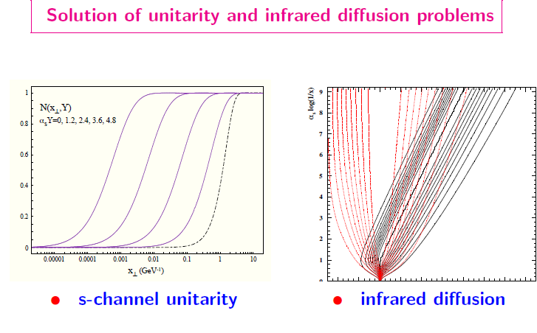

Slide 17
Approch to saturation II
Color Glass Condensate CGC
Clasiccal field for QCD with Weizsacker-Williams generalized Field
Muller and Venogapalan
JIMWLK / KLWMIJ Equation
J. Jalilian-Marian, E. Iancu, Mc Lerran, H. Weiger, A. Leonidovt and A. Kovner
Renormalization Group Approach in the Y-variable

Slide 18
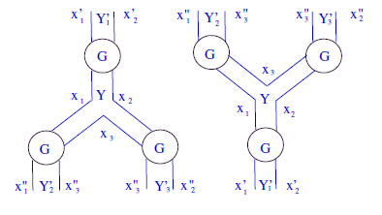
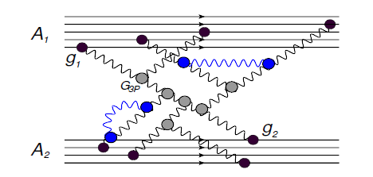
Generalization to Pomerones Interaction
1P → 2P
2P →1P
Loop de Pomerones

Slide 19
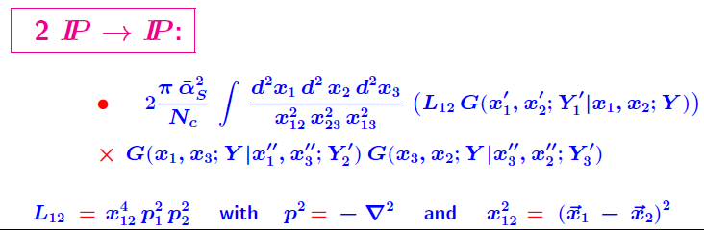
Pomeron Loops: See E. Levin, J. Miller and A Prygarin arXiv 07062944
For example: See Quantum Chromodynamic at High Eneregy
Y. Kovchegov and E. Levin Cambridg 2011
BK resums the fan diagrams with the BFKL ladders Pomeron splitting into two ladders (GLR-DLA)
Loops of Pomeron are suppresed by power of A atomic number of the nucleus A

Slide 20
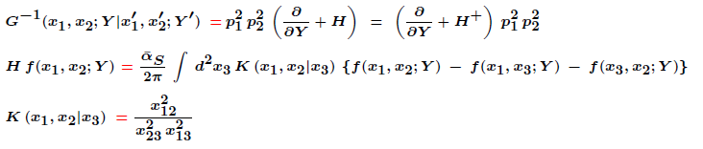

QCD results and effective action
Green Function
Definition of a Field Theory RFT
See M. Braun or E. Levin

Slide 21
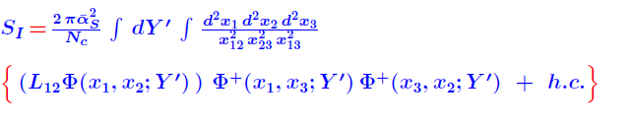
Funcional Integral Braun ´00-06

Slide 22


Interaction with nucleus
target / projectile $τ (ρ,\left(r,b\right), Y, T\left(b\right))$

Slide 23
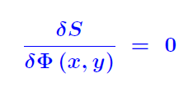
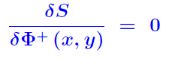
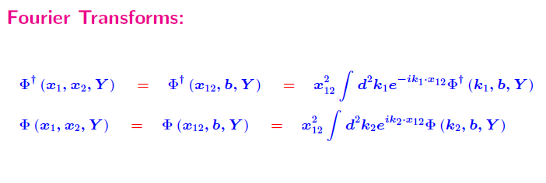
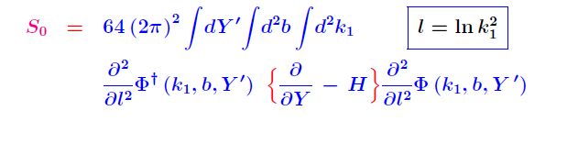
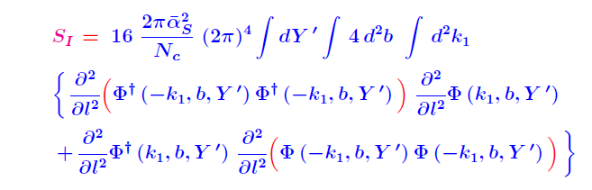
Solutions:
momentum representation

Slide 24

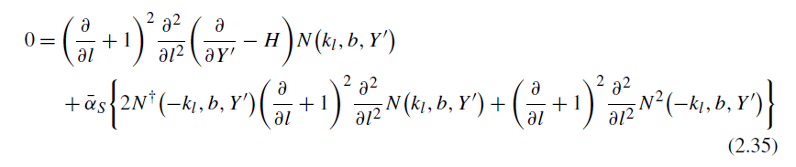
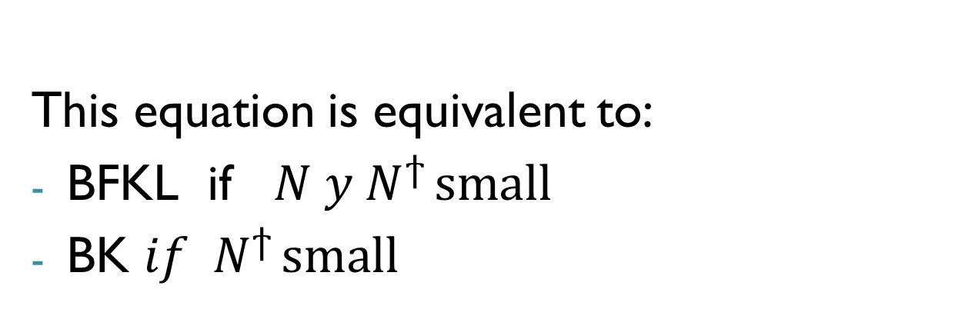
Equations and definitions
This equation is equivalent to:
BFKL if ${N y N}^{ϯ }small$
BK ${if N}^{ϯ }small$

Slide 25

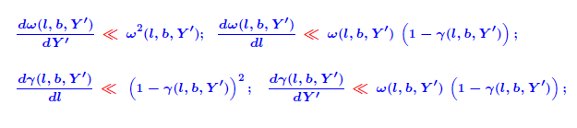
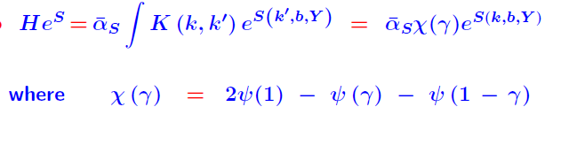
Semiclasical Approach

Slide 26

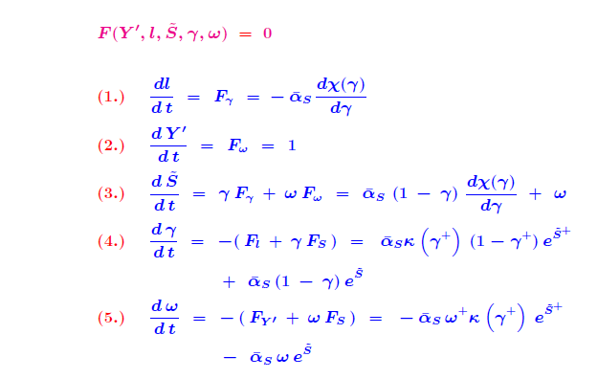
equations
Solution: Characteristica method

Slide 27




Using the relation BFKL Pomeron
L. Gribov, E. Levin and G. Ryskin Phy. Rep. 100 `83
One can show that
And that

Slide 28
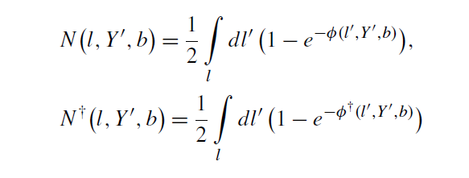
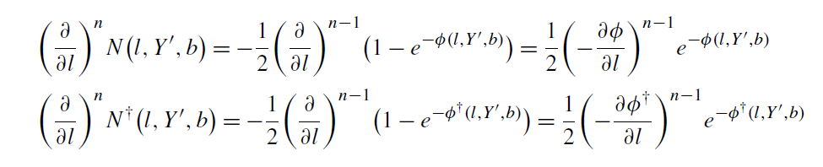
We introduce
And we use de condition

Slide 29
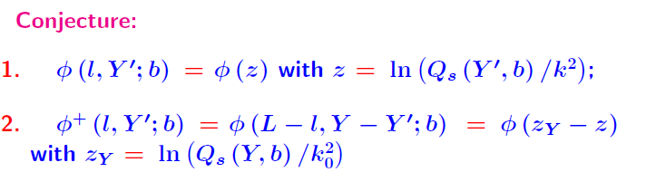
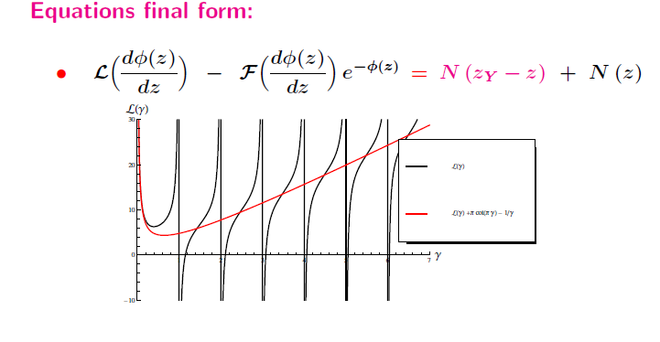
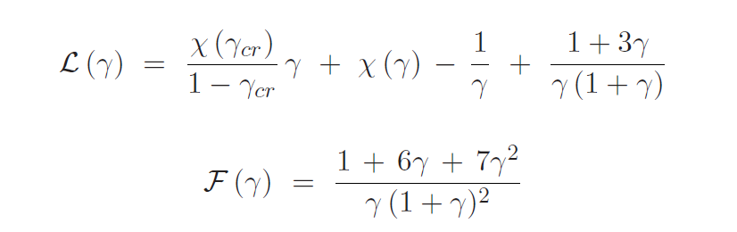

Slide 30
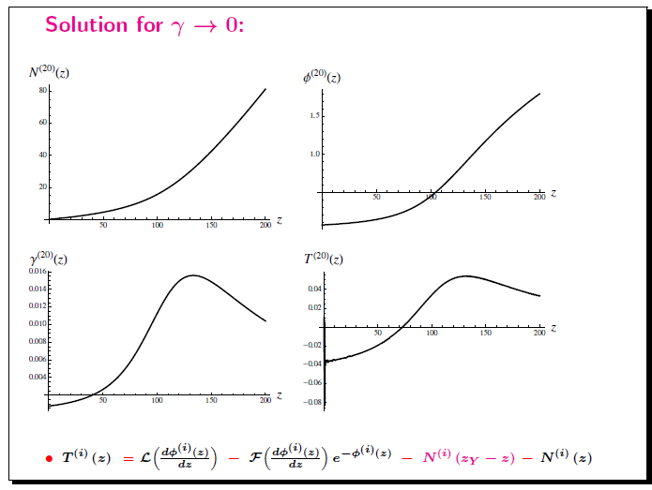
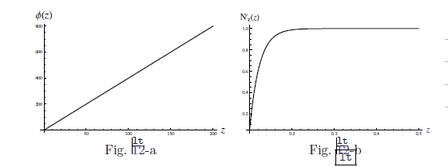

Solution
$γ →0$
$γ →n$
$γ≫1$

Slide 31




Numerical Solution
$$γ →0$$
Expanding around

Slide 32
Conclusion
Physical Condition to select solution
Extension to Y dependence
Aplication to Scattering dilute-Dense
Nucleus
Applications: Scattering amplitude
In a more refined analysis the b dependence should be taken into account
Running coupling effects sensitivity to IR region and landau Pole!
Solution in another regions

Slide 33

Preliminary Result

Slide 34

Kinematic Variables
Q → resolution Power
X → measure of momentum fraction of struck quark
F(x,Q)

Slide 35



General Behaviour
Bjorken Limites DGLAP
Regge Limite

