Slide 1

Current Status of the
Neutrinos Angra Experiment:
Monitoring nuclear reactors with antineutrino detectors

Slide 2
Motivations for ANGRA
Very interesting for the Brazilian science:
  Start experimental neutrino physics in Brazil
  taking advantage of existing antineutrino sources
  (Angra-I and II nuclear reactors).
  Possibility to do neutrino applied physics:
  . nuclear safeguards applications.
  . new detector technologies.
  Develop know how in experimental neutrino physics to be used in future projects.

Slide 3


ANGRA Collaboration:
Brazilian Institutions:
CBPF
J.C. Anjos, G.L. Azzi, H. Lima Jr, M. Vaz,
Collaborators:
Aridio Schiapazza
Rogério M. da Silva
Graduate Students: Marcelo Nascimento Souza (PhD)
Thamys Abrahão (MSc)
Marcio Nunes (PhD)
Rafael Gama (PhD)
Undergraduate Students: Upiratan Machado (UERJ)
Beatriz Santos (UERJ)
Igor Oliveira (IME)
Notes:
3

Slide 4







ANGRA Collaboration:
UNICAMP
E. Kemp, T. Bezerra, L. F. González, L. M Santos
UFABC
Marcelo Leigui, P. Chimenti
UFJF
Luciano M. Andrade, Rafael A. Nóbrega,
Augusto S. Cerqueira
UFBA
Iuri M. Pepe
Paulo Farias
UEFS
Germano P. Guedes
PUC-RJ
Hiroshi Nunokawa
Unifal
Gustavo Valdiviesso
4
Notes:
4

Slide 5
ANGRA PROJECT:
Nuclear Safeguards Applications
Notes:
5

Slide 6

ANGRA PROJECT:
DESIGN GUIDELINES:
Follow recommendations of the
2008 IAEA Expert’s Workshop
6
Notes:
6

Slide 7
DESIGN GUIDELINES:
Focused Workshop on Antinu-e
Detection for SG Applications (2008)
Notes:
7

Slide 8
Why IAEA may have interest in antineutrino detectors?
Antineutrinos can not be shielded and are produced in very large amounts in nuclear reactors
(~ 10²⁰ antineutrinos/s)
Antineutrinos coming from different isotopes have different energy spectrum: antineutrino measurement may reveal, in principle, fissile composition of nuclear fuel.
Non-intrusive, Real Time, Remote reactor monitoring: thermal power & fissile material
Search for new methods on safeguards verification

Slide 9
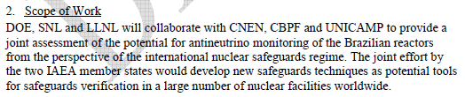
International Cooperation CNEN/DOE
2012 Agreement
Notes:
9

Slide 10
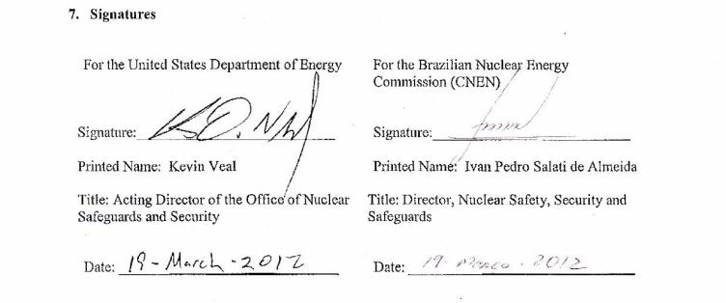
International Cooperation CNEN/DOE
2012 Agreement
Notes:
10

Slide 11
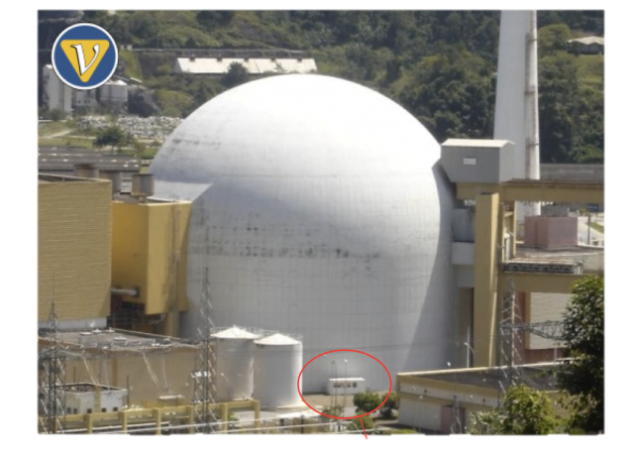
New challenge: neutrino detection above ground
Angra Neutrino laboratory: 40’ container

Slide 12
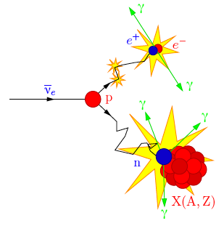
Angra detector facts: Water Cherenkov
Reactor power: 4 GWth
Target mass: 1 ton
Detector distance to core: ~25 meters
Inverse beta decay interactions per day: ~5,000
Prompt signal:
Positron
1 ~ 12MeV
Delayed signal:
γ’s from neutron capture
on Gd: 8MeV
Time interval:
Δt ~ 30μsec

Slide 13
Monitoring nuclear reactors with antineutrinos
ν flux from the reactor
Observed ν spectrum
Inverse β-decay
cross section
The observed energy spectrum is the result of the antineutrino flux emmited weighted by the antineutrino-proton cross section

Slide 14
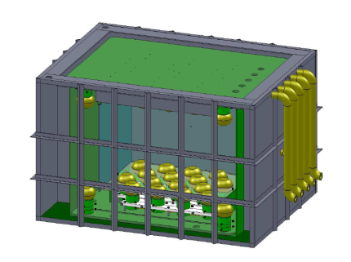
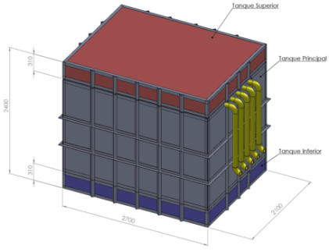
New Detector Design
Detector design (2011)
(detector + muon veto)
external water shieldTs
Central detector: water tank with 32 PMTs to detect Cherenkov radiation
14
Notes:
14

Slide 15
The neutron detector:
260 l prototype for neutron detection in Gd loaded water ( 1 PMT)
²⁵²Californium Source arrived at CBPF in June 2012
Instalation of a small laboratory in the old CBPF linear accelerator tunnel;
Authorization to use the neutron source given by CNEN in 2011;
Instalation of water purification station concluded;
Experimental measurements started with pure water:
Calibration with Cosmic muons finished;
Next step: add Gadolinium in the water

Slide 16
ELECTRONICS STATUS

Slide 17
Eletronics Design - (conceptual diagram 2007)
DAQ diagram
FPGAs
PMT
trigger logic
control and status registers
Front-end electronics
signal conditioning
ADC
125 MHz
10 bits
leading-edge
discriminator
stop
TDC
81 ps
28 bits
time encoding
data builder
DC level-1
trigger
start*
FIFO
control
addr
data
* trigger pulse from previous event
VME bus
Notes:
17

Slide 18
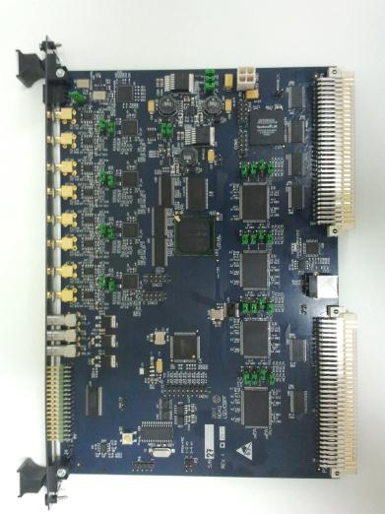
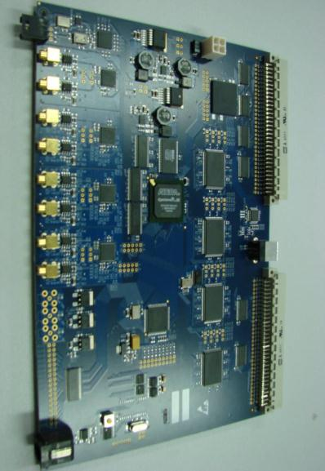
VME 6U Board:
DAQ: waveform digitizer
+ time stamp
Eletronics Design - (present status 2012)
Lay-out of VME board developed in collaboration with Brazilian industry CADSERVICE
Components mounted by CADSERVICE (Campinas, SP)
Notes:
18

Slide 19
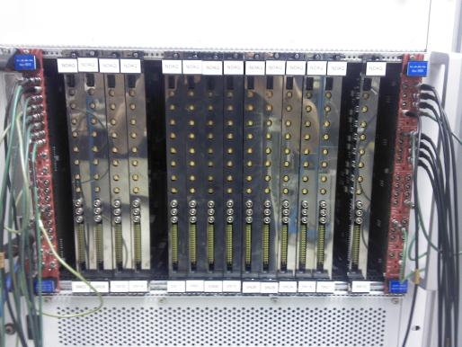
VME 6U Board waveform digitizer
+ time stamp
Eletronics Design - (present status 2012)
30 units produced and tested.
Data acquisition with several
modules being tested
Notes:
19

Slide 20
Data Acquisition
Data readout (software)
Readout software code developped in C and ADA
3 fully working systems, each one with one ROPs + NDAQs (2 at CBPF e 1 at Unicamp)
Last firmware and DAQ software version is very stable, working without problems for few days continusly in lab tests.
All software is SVN version controled.
Last implemented code has a check of the serial number and firmware version at the startup in the DAQ-level.

Slide 21
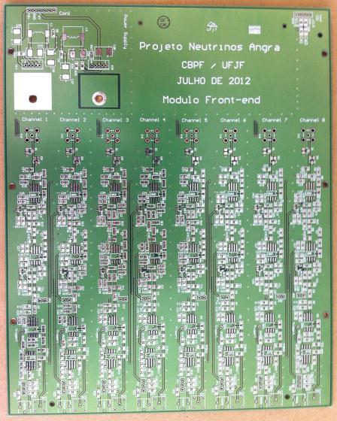
Front-end Electronics - UFJF
4 stages operational amplifier
8 channels circuit using NIM standard module.
5 boards (PCB) built in July/2012 and are now been mounted.

Slide 22
Optimized Digital Detection for the Trigger System.
Luciano M. de A. Filho (UFJF)
Augusto Santiago (UFJF)
A. F. Barbosa (CBPF)

Slide 23
Proposal
Digital Filter to maximize signal/background ratio before the trigger.
Implementation → Filter FIR.
Two methods tested
  Matched Filter.
  Optimized Filter for amplitude estimate.
Similar results for both filters.
Optimized filter has advantage of output in Volts.
Central FPGA of NDAQ
ADC
Digital
Filter
Trigger
Decision
Increase signal/background
ratio
23

Slide 24
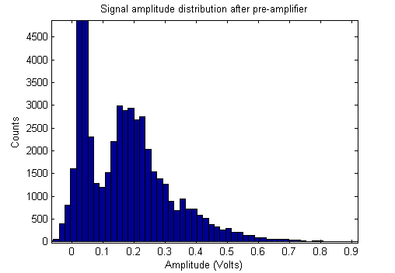
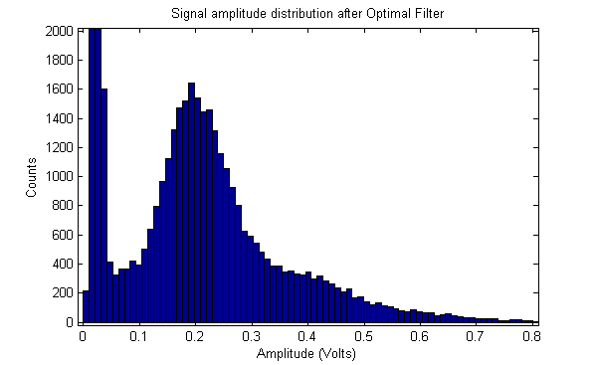
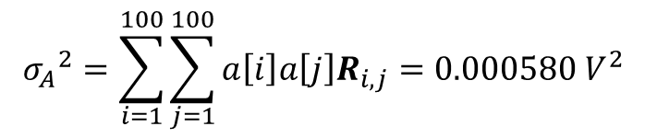

Results
Peak/Valley = 2.5
Peak/Valley = 5.0
ANTES
DEPOIS
Variance of the measurement:
Error in the measurement:
24

Slide 25
Detector Simulation Studies

Slide 26
Data Analysis: simulation of expected signal and background
Signal and background Simulation:
Positrons (from neutrino interaction)
Neutrons (from neutrino interaction)
Cosmic ray induced background

Slide 27
Signal and cosmic background frequency
Table 2: Particles from cosmic background
Particles | Frequency (HZ)
Muons | 210±6
Neutrons | 20±1
Protons | 2.0±0.2
Pions | 0.40±0.01
Photons | (8 ± 1)×10³
Positrons | 257±61
Electrons | 242±140
Table 1: Particles from antineutrino signal
Particles | Frequency (HZ)
Positrons | 0.060±0.001
Neutrons | 0.060±0.001

Slide 28
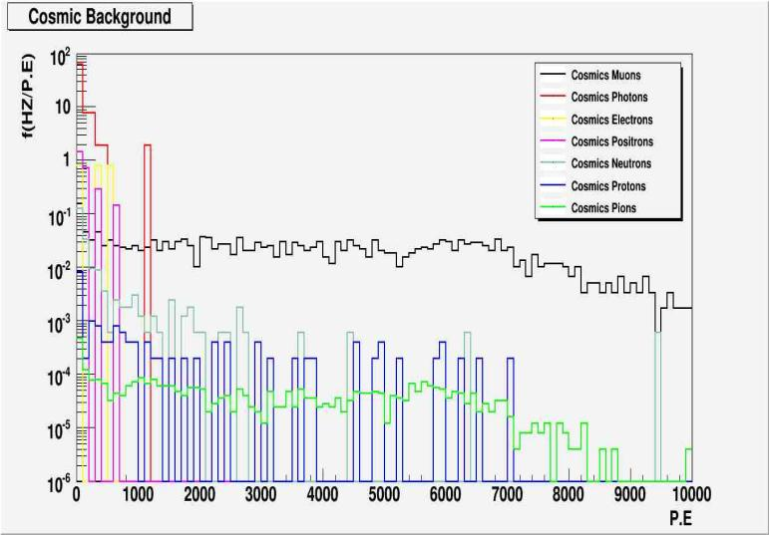
Muons, neutrons, protons, pions, photons, positrons and electrons

Slide 29
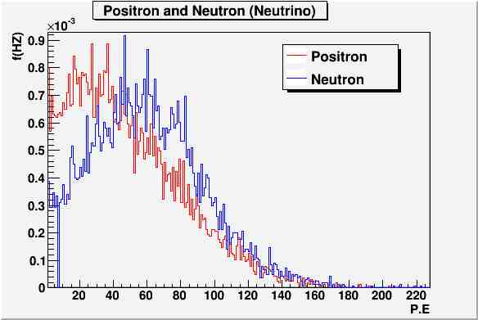
Particle frequency density from antineutrino signal

Slide 30
Signal and cosmic background frequency
(10-200 P.E)
Table 2: Particles from cosmic background
Particles | Frequency (HZ) 10-200 P.E
Muons | 12±1
Neutrons | 13±1
Protons | 0.44±0.09
Pions | 0.048±0.004
Photons | (5.7 ± 1.1)×10³
Positrons | 158±48
Electrons | <186 (90% C.L)
Table 1: Particle from antineurino signal
Particles | Frequency (HZ) 10-200 P.E
Positrons | 0.050±0.001
Neutrons | 0.050±0.001

Slide 31
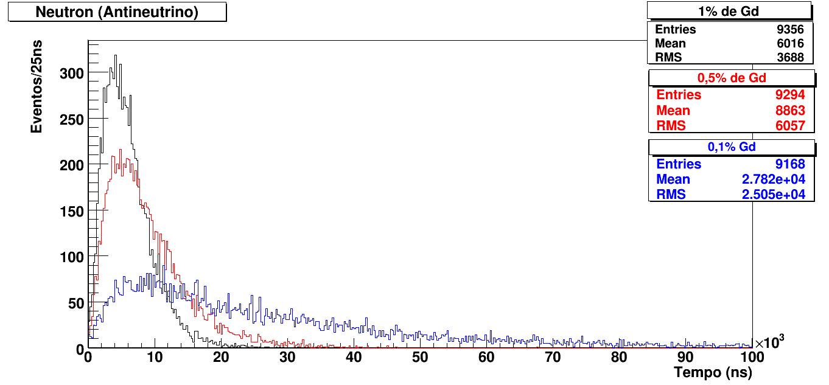
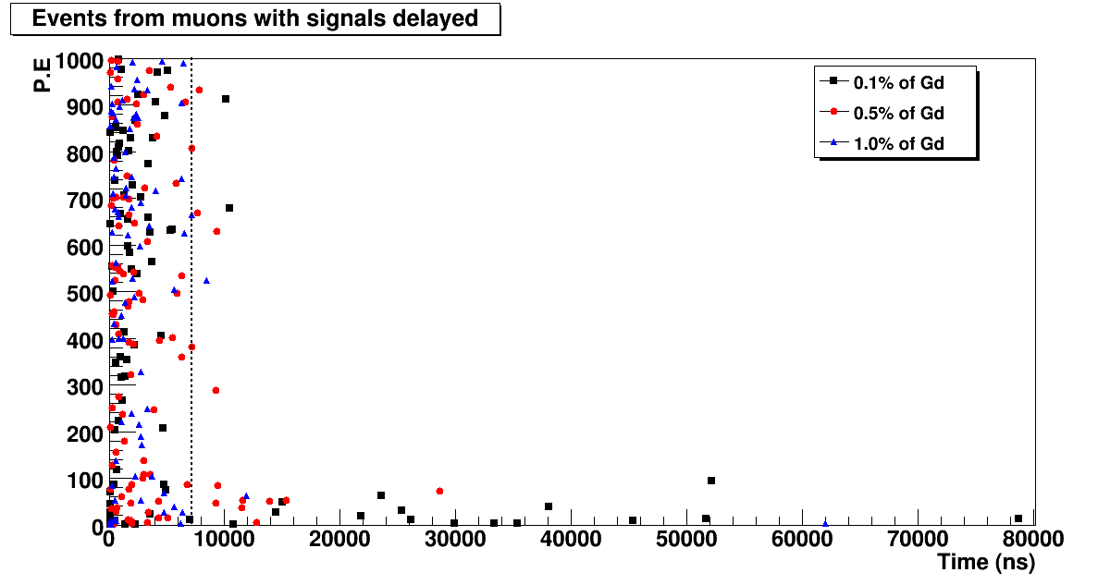
Study of Gadolinium concentration
Delayed coincidence for 0.1, 0.5 and 1.0% Gd
Stopping muons and spallation neutrons for 0.1, 0.5 and 1.0% Gd

Slide 32
Study of shielding
Table 1: Cosmic neutron events
Shielding | Neutrons simulated
Polyethylene | 10.000
Water | 10.000
Neutrons detected | Neutrons with signal delayed
299 | 153
282 | 98
Table 2: Cosmic muons events: 10,000 generated
Shielding | Muons signal delayed
Polyethylene | 56
Water | 59
Spallation neutrons | Muons with multi-neutrons
28 | 5
17 | 1
Table 3: Muons events
Shielding | Fake signals
Polyethylene | 8
Water | 6
Frequency (Hz)
1.3±0.5
1.0±0.4

Slide 33
Data acquisition simulation
EXPECTED RATES AT THE DETECTOR
Neutrino interactions: ~ 5,250/day ( ~ 0.06 Hz)
Muon rate at target: ~ 350 Hz
Cosmic ray induced neutron rate: ~ 70 Hz (no shielding)
Cosmic neutron background: ~ 4 Hz (30cm polyethylene)
⇒ background rate must be reduced by factor ~10⁴
  Generated events per day:
  Muons ~ 30,000,000
  Cosmic neutrons ~ 340,000
  Positrons from inv. Beta decay ~ 5,250
  Neutrons from inv. Beta decay ~ 5,250
Simulated data for one day of data taking and data reduction by each selection criteria

Slide 34
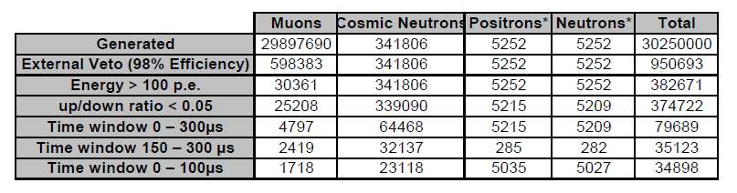
Data acquisition simulation
  Selection criteria:
  Muon identification by external veto: 98% efficiency
  Energy cut > 100 photo electrons (p.e.)
  Up/down photo electron ratio < 0.05
  Time window between events 0 – 300 µs
  Time window between events 150 – 300 µs (background fit)
  Time window between events 0 – 100 µs (signal fit)
Simulated data for one day of data taking and data reduction by each selection criteria

Slide 35
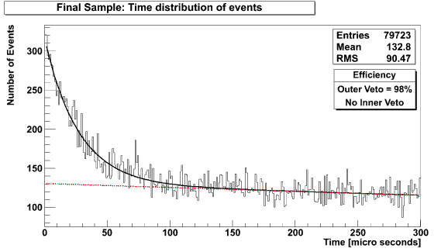
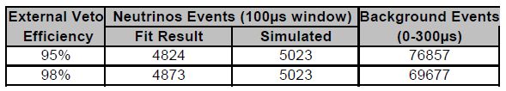
Data acquisition simulation
Fit functions:
Background: linear fit in time interval 150 – 300 µs
Signal: exponential (0 - 100 µs ) + linear (background)

Slide 36
DETECTOR STATUS

Slide 37
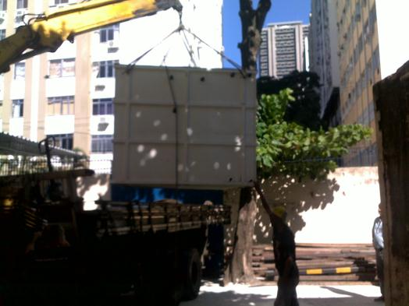
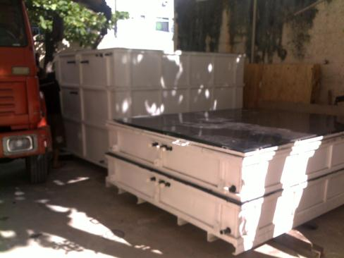
DETECTOR STATUS
Arrival of water shielding
vessels at CBPF
July 2012

Slide 38
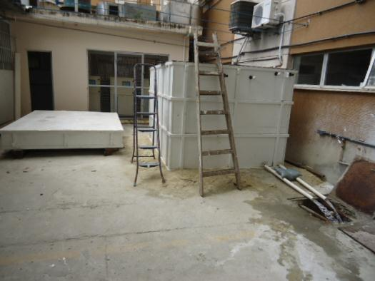
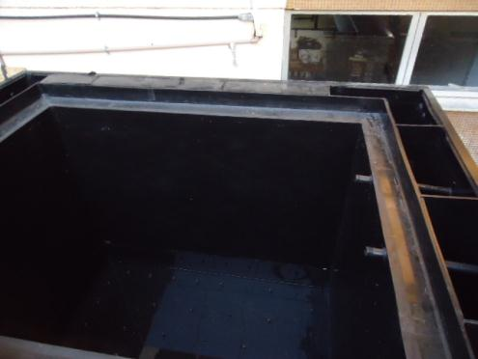
DETECTOR STATUS
Checking detector vessels
Starting tests at CBPF

Slide 39
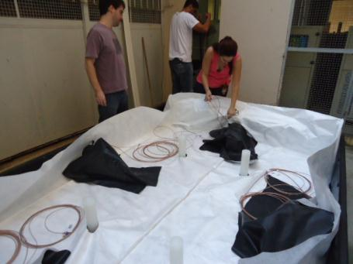
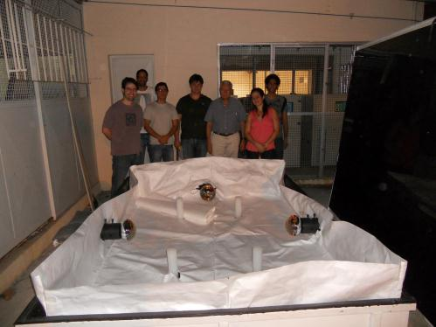
DETECTOR STATUS
Mounting Active shielding
Covering internal walls with Tyvek
and installing PMTs

Slide 40
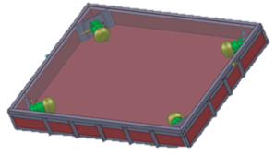
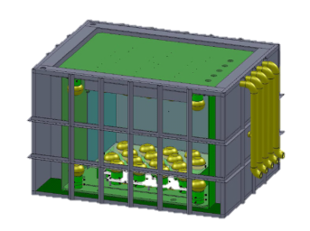
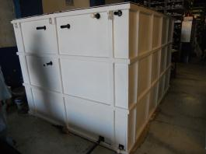
Status of the Neutrinos ANGRA project
New 40’ High Cube container: deployed in Angra
Geant4 simulation of detector response to
signal and background events: working
- Neutrino signal extraction – simulated
New detector design: active water shield
Water shielding and target vessels: built
Front-end electronics: been tested
Electronics for DAQ: ready
Data acquisition software: ready
Detector test at CBPF: July 2012
- Deployment in Angra: begining 2013

Slide 41
ANGRA PROJECT
New Detector Technologies
Notes:
41

Slide 42
New proposal:
Neutrino coherent scattering
detection at Angra
42
Notes:
42

Slide 43
Coherent neutrino-nucleous interaction
is a fundamental interaction predicted by
the standard model whose X-section, for E_{ν} ^{< 50 MeV, is expressed by}
N² → σtot Very High
It has never been observed !!
43
Notes:
43

Slide 45
Hard to observe process
Detector should:
1) be able to distinguish nuclear recoil
2)present extremely low electronic noise
CCD (Charged Coupled Device)
are silicon detectors that convert photons in
electrons generating a current that can be
quantified by an ADC
CCD detectors present low electronic noise
and can register nuclear recoil!
45
Notes:
45

Slide 46
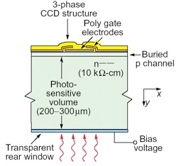
CCD detectors have been used in dark energy and
dark matter experiments like DES (Dark Energy
Survey) and DAMIC (Dark Matter in CCD).
DAMIC CCD:
- CCD are readout serially
(2 output for 8 million pixels)
- Very low noise level ~7.2 eV
- 1 g per CCD
- 18 cm²
- 250 μm thick
CCD detectors are potential candidates
for experiments aimed at observing
coherent neutrino-nucleous interactions.
46
Notes:
46

Slide 47

How radiation shows in CCDs
MUONS
ELECTRONS
DIFFUSION LIMITED HITS
Nuclear recoils produce diffusion limited hits
47
Notes:
47

Slide 48

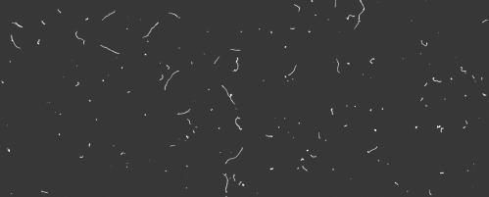
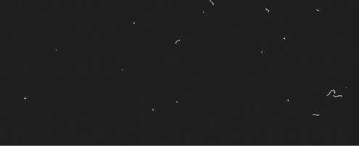
Lab-A (Fermilab)
MINOS cave (100 m
underground)
MINOS + lead shield
48
Notes:
48

Slide 49
CONNIE FACTS
Number of CCD detectors: 10
Total mass: 10 g
Reactor thermal power: 4 GW
Detector distance from reactor core: 30 m
Anti-neutrino flux at the detector: ~7 x 10¹² cm⁻² s ⁻¹
Event rate : ~1 event every 4 days
Shielding and noise reduction are the critical factors.
Development of noise reduction techniques in the core of the project.

Slide 50
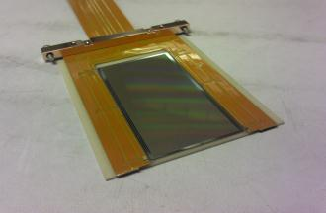
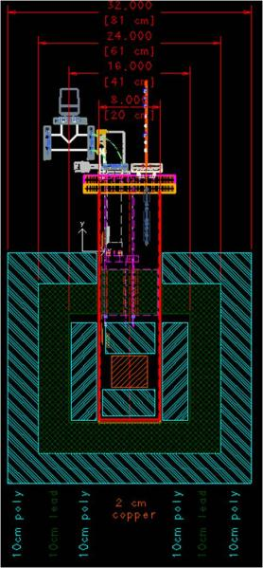
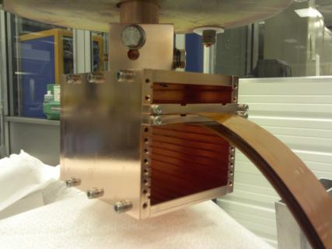
CCD – Angra detector
Box with 2 CCD for the
CONNIE experiment
Vessel design with shield

Slide 51
Final remarks
Most of the CONNIE detector ready at FERMILAB.
R&D needed to reduce noise. Two possible techniques under
consideration to be used in the project ( G. Cancelo):
  Digital signal processing techniques for noise reduction
  New CCD architecture (Skipper CCD)
Angra-CCD neutrino detector will first be assemble at CBPF,
tested and only then reassembled in Angra.
CBPF-Angra link (for remote data acquisition) working.
Ge detector + associated equipment and lead shield available at
CBPF for all background studies needed.
Good opportunity to develop new detector technology and advance CCD detectors technology.
51

Slide 52
ANGRA PROJECT
Developing Know How for
Future Experiments
Notes:
52

Slide 53
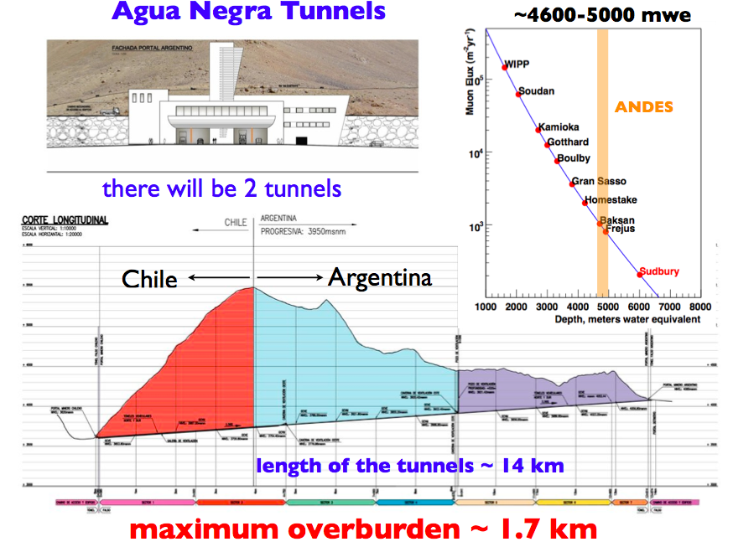
ANDES UNDERGROUND LABORATORY

Slide 54
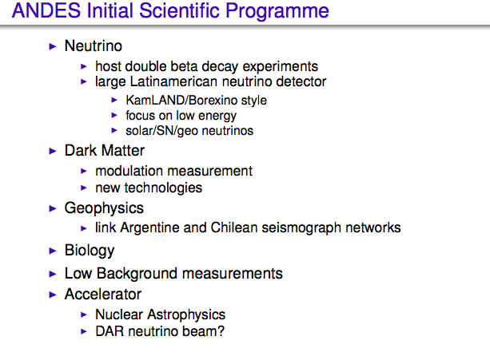

Slide 55
THANK YOU

Slide 56
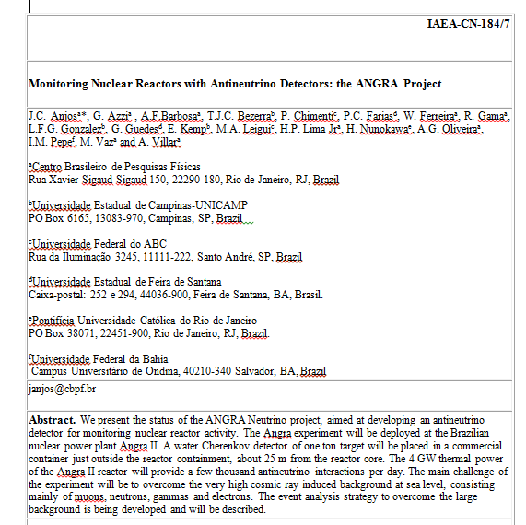
Publicações

Slide 57
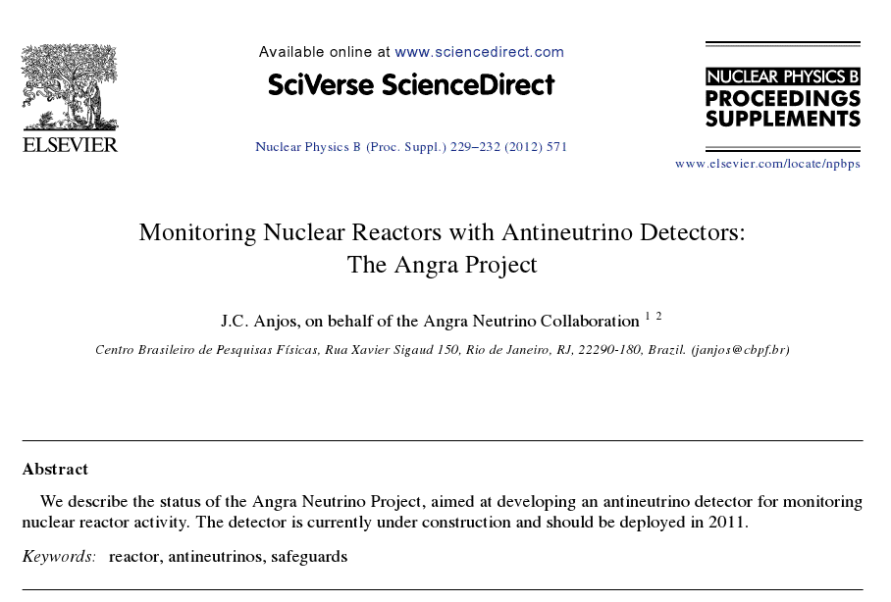
Publicações

