Slide 1
1. Solar Neutrino Experiments
Yifang Wang
Institute of High Energy Physics, Beijing
INSS 2015, São Paulo

Slide 2


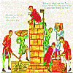
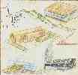
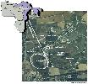
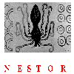
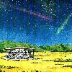






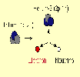





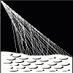
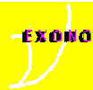




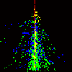

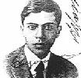



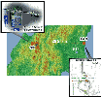

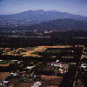
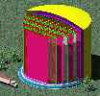
Neutrino Industry

Slide 3
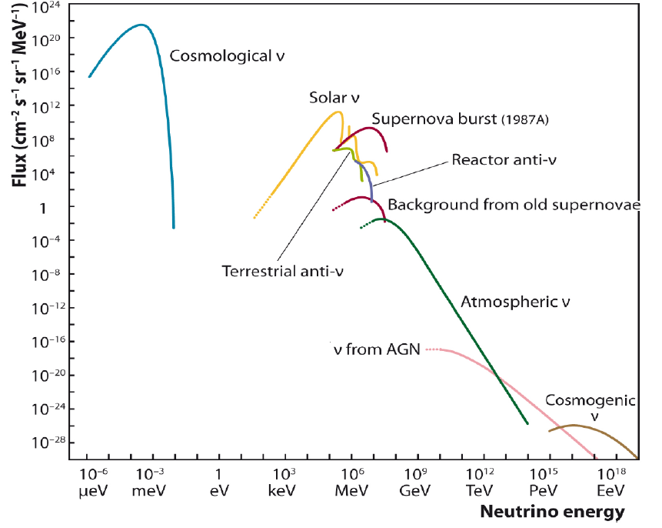
Neutrino Spectrum
arXiv: 1207.4952

Slide 4
Neutrino Physics：Problems and Methods
Magnetic moments
Oscillation
/sterile
neutrinos
Mass
Dirac/
Majorana
Astronomy
Cosmology
Geology
Radioactive sources
Atmos-pheric
Solar
Astro-objects
Relic-neutrino
Reactor
Accelerator
Earth
Semiconductor/crystals/gaseous/scintillator
Liquid scintillator
Liquid Argon
Water
Cerenkov
Nuclear chemistry
Sampling detector
Emulsion

Slide 5
Neutrino Interactions with Matter
Charge current interactions
    ν_{e} + ^{Z-1}A → e⁻ + ^{Z}A
    ν_{e} + p → e⁺ + n
    ν_{e} + N → N’ + e⁻
    ν_{μ} + N → N’ + μ⁻
Neutral current interactions(mostly backgrounds)
  ν_{μ}+ N ◊ ν_{μ} + N’ + x
  ν_{e}+ N ◊ ν_{e} + N’ + x
Both
  ν + e scattering
Low energy ( ~ MeV)
High energy ( ~ GeV)
ν_{e}
ν_{x}
ν_{x}
e⁻
CC
W
NC
Z
e⁻
ν_{e}
e⁻
e⁻

Slide 6
Characteristics of Neutrino Experiments
Very strong neutrino sources
Very large target mass
Very low radioactive backgrounds
  Sources: cosmic-rays, detector materials, environment
  Method: underground, active & passive shielding, special materials selection and/or purification
Usual difficulties：
  Large detector VS underground & low background
  High resolution VS low background
  Ultra low backgrounds：
    Environmental：dust, air, water, shielding materials
    Internal：Ge、CsI、LS…
    Activation by cosmic-rays

Slide 7
Solar neutrinos

Slide 8
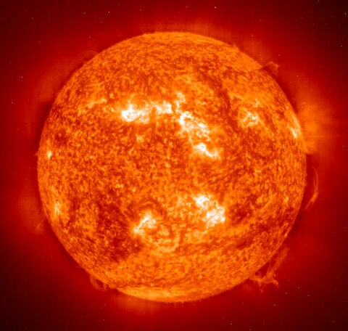
Basic Facts of the Sun
Mass 1.99 x 10³⁰ kg
Luminosity 3.842 x10³³ erg/sec
Radius 6.9598 x 10⁸ m
Age 4.57 x 10⁹ years
metals/hydrogen ratio: 0.0229
Temperature：
  Central: 15×10⁶ K(~ keV)
  At surface: 6000 K
Density at the center: 150gr/cc
Central H abundance: 0.34
Where the energy comes from and how long it will last ?

Slide 9
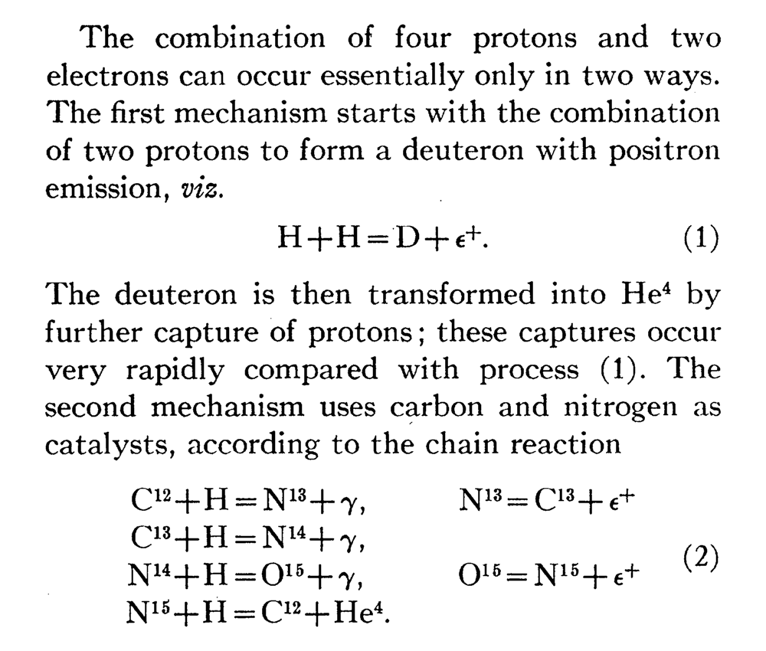
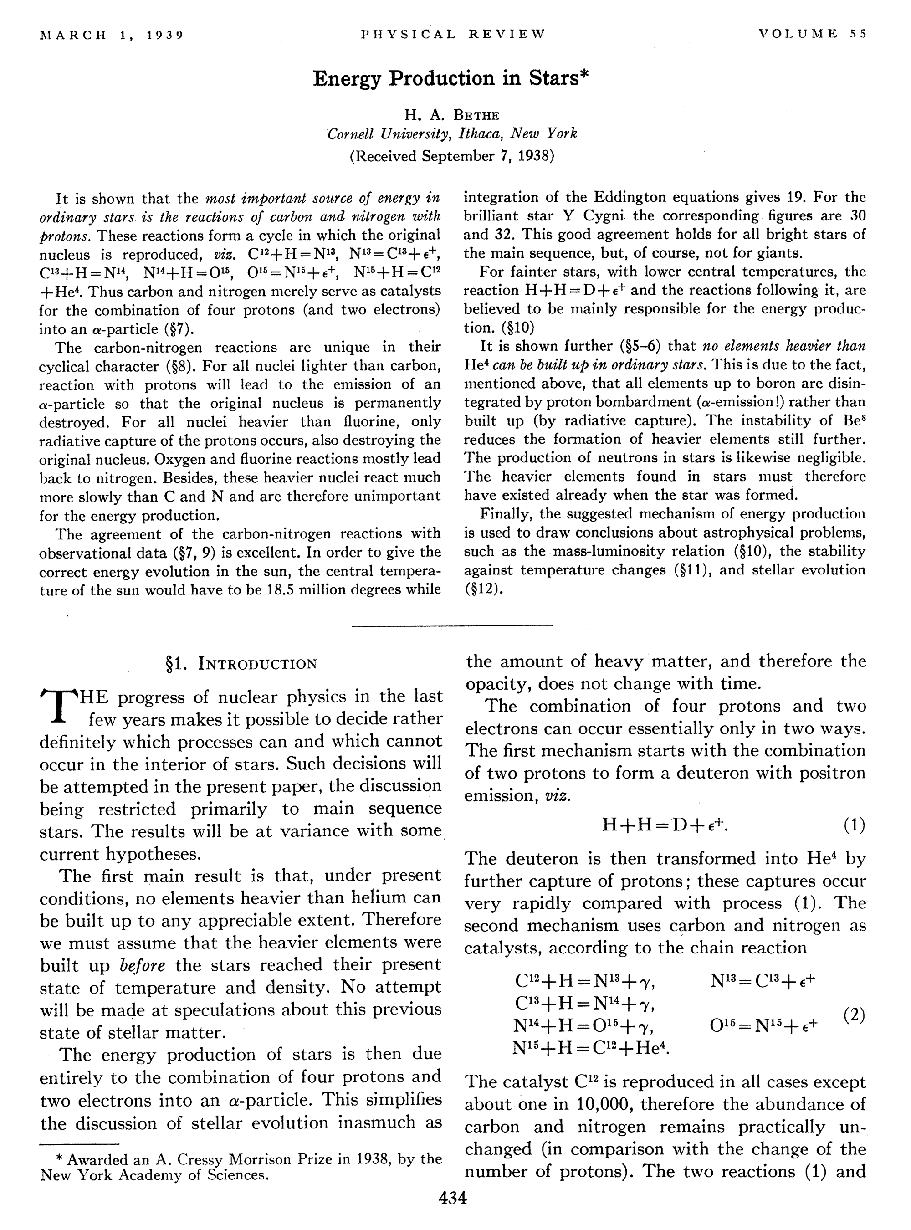
Energy Production in Stars
Bethe 1939
pp chain
CNO cycle
Almost true
But no neutrinos

Slide 10
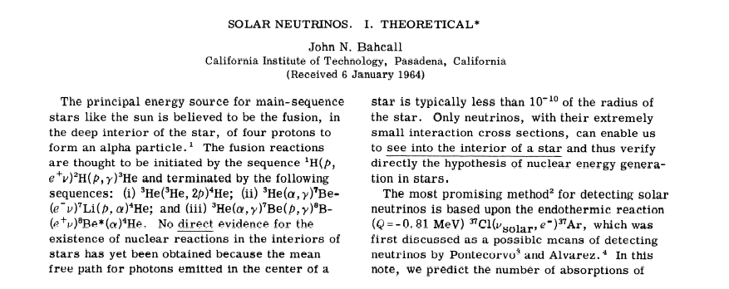
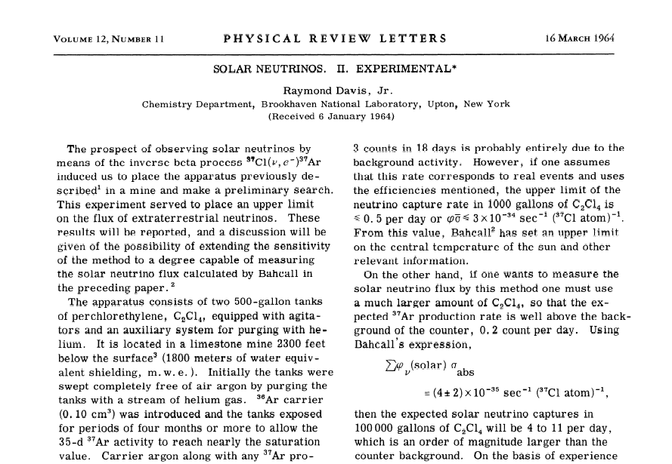

Detection of Solar Neutrinos
Bahcall, Davis 1964

Slide 11
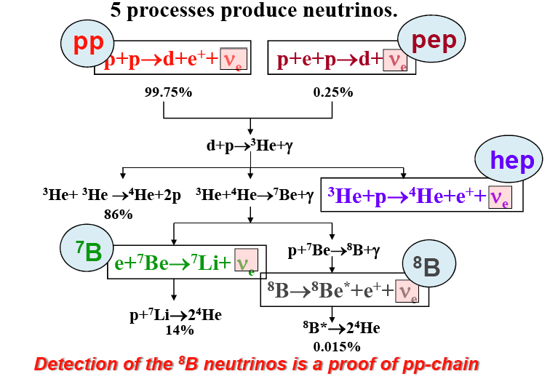
PP-chain

Slide 12
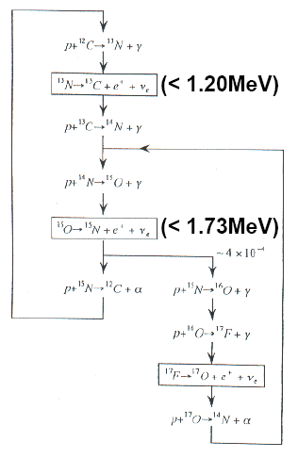
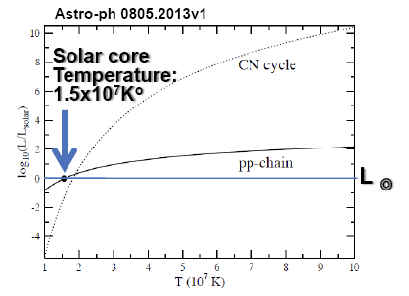
CNO cycle
Relatively low energy neutrinos ➔ SK/SNO can not see them but Borexino could
Only 1% solar energy now

Slide 13
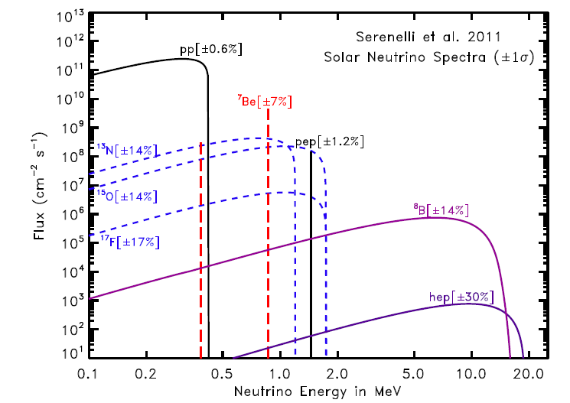
Solar Neutrino：PP-chain and CNO cycle
PP-chain: mostly seen and dominant
CNO: to be seen

Slide 14

Solar Neutrino Experiments
LS: Borexino, SNO+, …
Water Cerenkov: Kamiokdande, SNO, SuperK
Ga: Gallex & SAGE
Cl Homestake

Slide 15
History of Solar Neutrinos
First indication of neutrino deficit by Homestake exp. (70’s-90’s)
Confirmed by many Exp.s ➔ multiple solutions of θ₁₂ & ΔM²₁₂
Solar neutrino oscillation established(00’s):
  SuperK: indication of LMA-MSW
  SNO：missing ν_{e} appeared as ν_{μ}+ν_{τ}
  KamLAND：determination of θ₁₂ & ΔM²₁₂
  Standard Solar Model firmly established
Current experiments:
  Borexino
  SuperKamiokande
Future experiment:
  SNO+, LENA, JUNO…

Slide 16
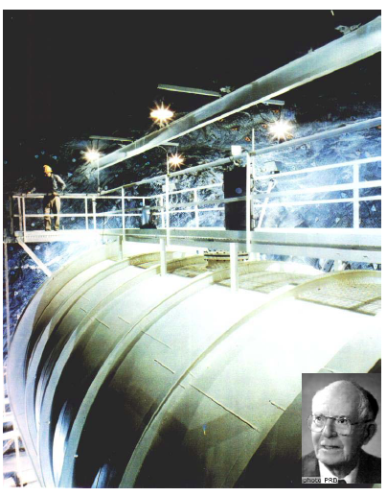
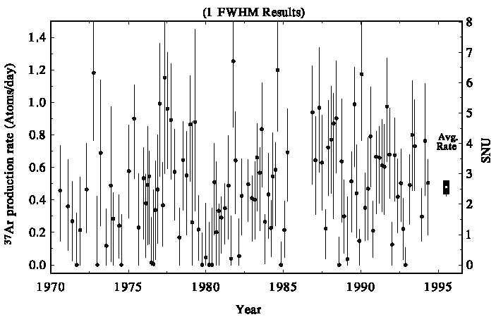

Homestake Experiment
1949 L. Alvarez: neutrino detection by ν_{e} + ³⁷Cl → ³⁷Ar + e⁻
Real proposal by J. Bahcall & R. Davis
Experiment by R. Davis since 1964
615t C₂Cl_{4 ,} Overburden: 1500 m
E_{th}>817 keV, sensitive to ⁸B and ⁷Be
Extract and count ³⁷Ar every 3 months
A total of ~2000 neutrinos over 30 years
Theoretical Predictions
“Solar neutrino problem”: Solar Model ? Experiment ? Neutrino oscillation ?

Slide 17
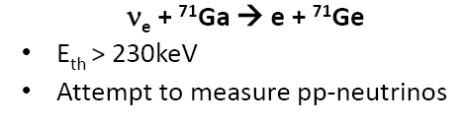
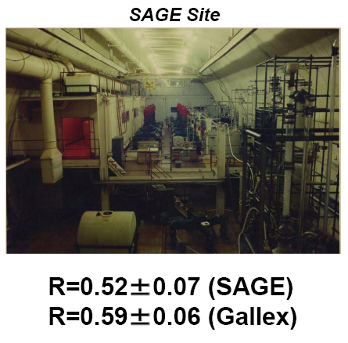
Confirmation by GALLEX & SAGE
Proposed by V.A. Kuzmin and G.T. Zatsepin in 1966
SAGE in Baksan (1990~):
  60t Metallic Ga
GALLEX in Gran SASSO(1991~)
  60t GaCl3
Chemical extraction of ⁷¹Ge

Slide 18
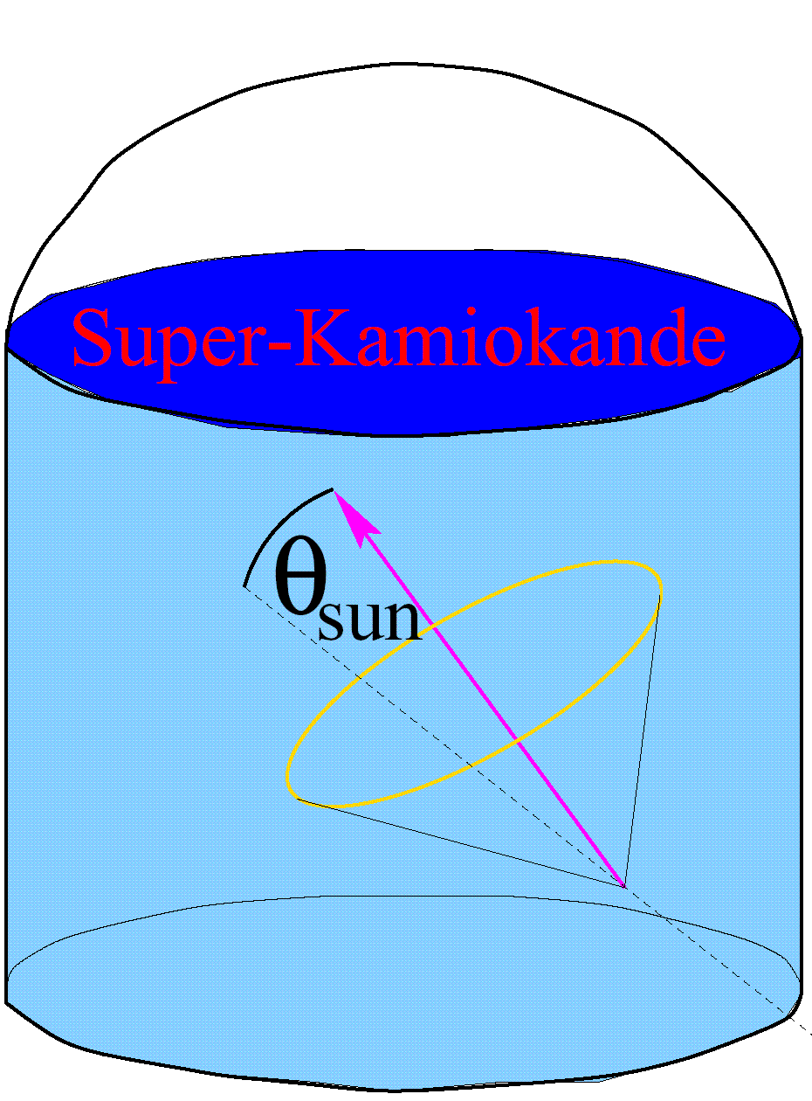

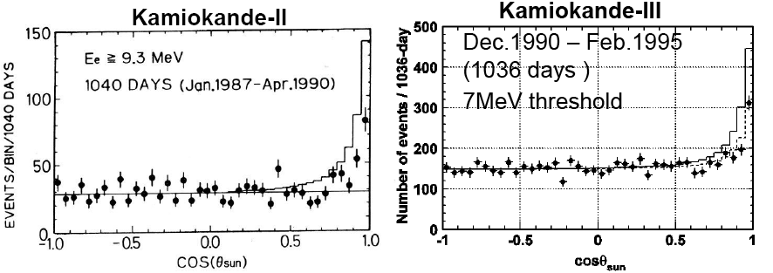
Confirmation by Kamiokande & IMB
Kamiokande
  4500t (680t fid.) water
  ν_{e} + e → ν_{e} + e
  E_{th}=7 MeV(only ⁸B)
  Directional
  Evidence of ⁸B neutrinos

Slide 19
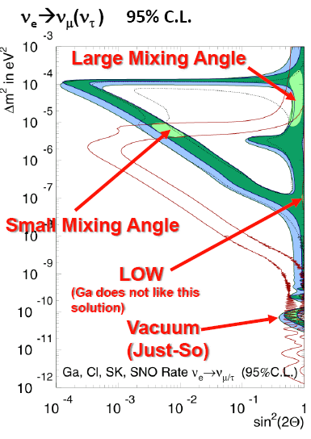
Problems:
These R’s gave four possible solutions to neutrino oscillation
Standard Solar models (SSM) reliable ?

Slide 20
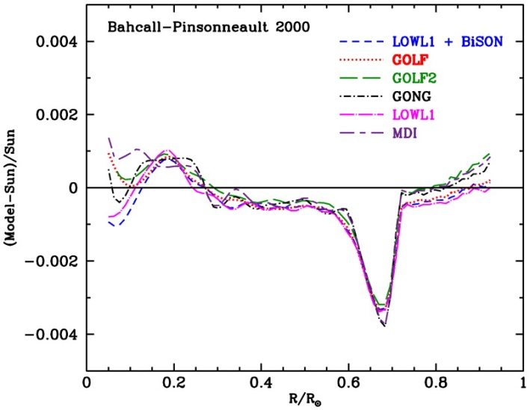
Success of the Standard Solar Model
Input parameters: mass, age
Quantities to match: luminosity, radius, metals/hydrogen ratio
Free parameters: mixing length, chemical composition
Output: neutrino fluxes, chemical & electron/neutron profile, density & sound speed, helium abundance at surface, …
Construct a 1 M⊙ initial model with X_{ini}, Z_{ini}, (Y_{ini} = 1 −–X_{ini} − Z_{ini}) and a_{MLT}
evolve it for the solar age t⊙
match (Z/X)⊙, L⊙ and R⊙ to better than one part in 10⁵
One example:
Relative sound-speed difference between observation (through helioseismological model) and standard solar model
Better than 0.5% !!
Adapted from A. Serenelli’s lectures at Scottish Universities Summer School in Physics 2006

Slide 21
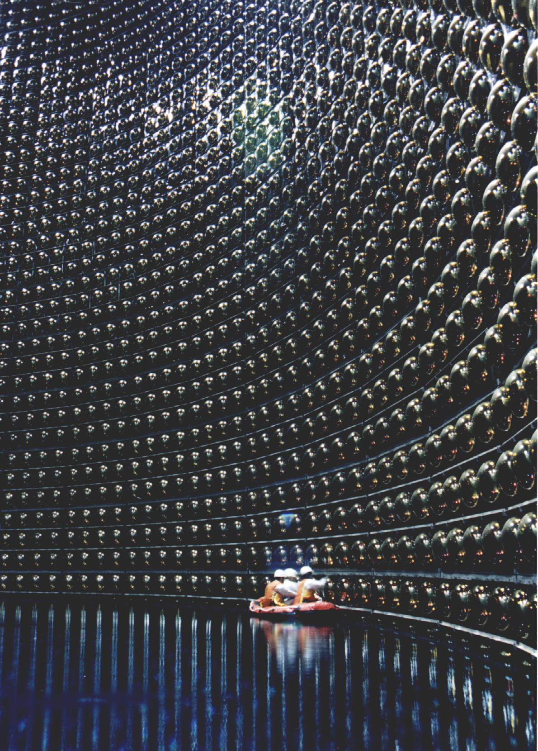
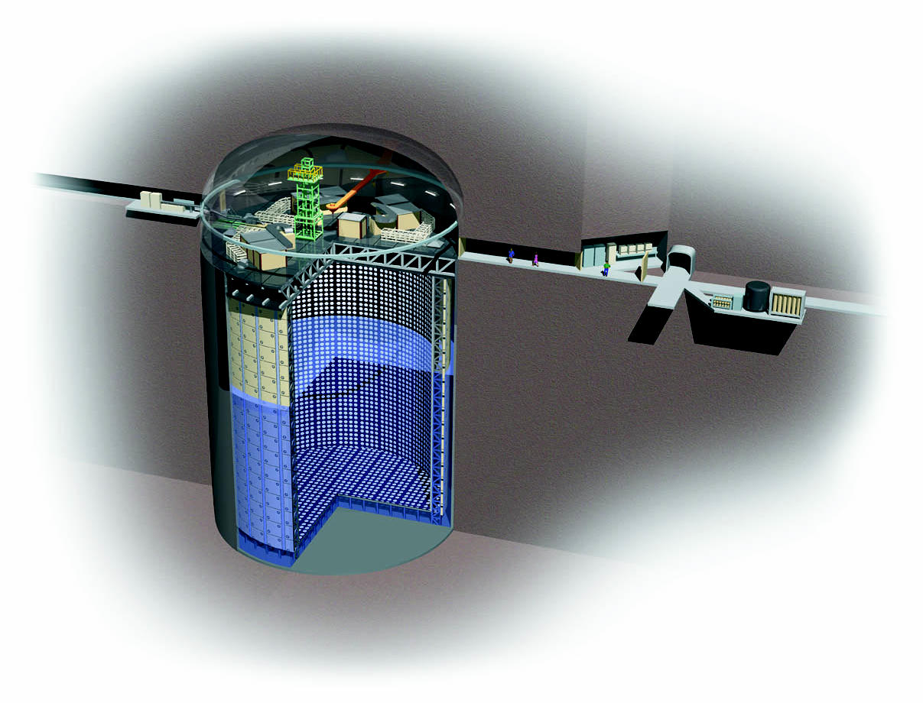
SuperKamiokande Experiment
50 kt water water Cereknov detector; 22.5 kt fiducial volume
40 m diameter and ~ 50 m high
Operational since May 31st, 1996

Slide 22
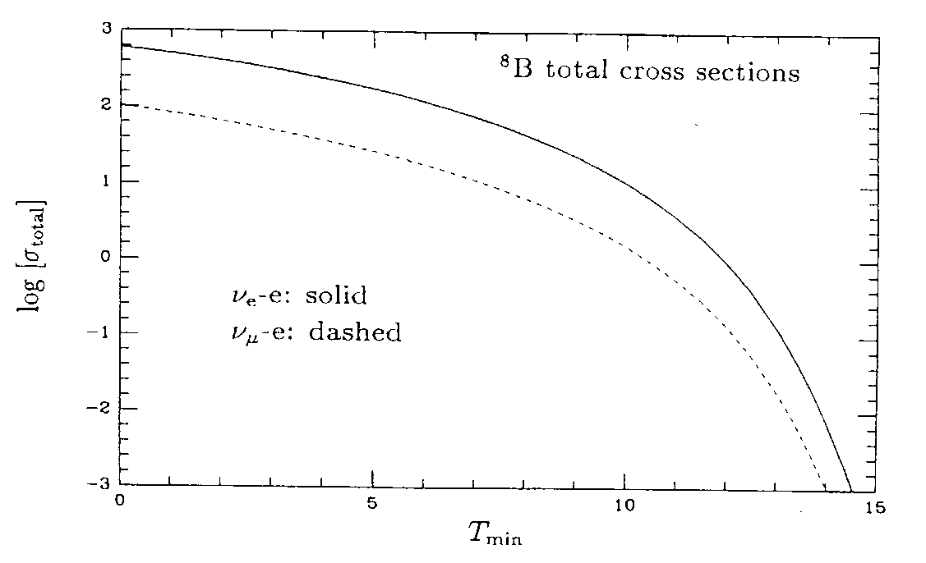
Solar Neutrino detection at SuperK
Neutrino interactions
10⁻⁴⁶cm²
dσ/dT for 10 MeV ν
ν_{e}-e
ν_{μ(τ)}−e
ν_{e}e⁻
ν_{μ(τ)} e⁻
=Te

Slide 23
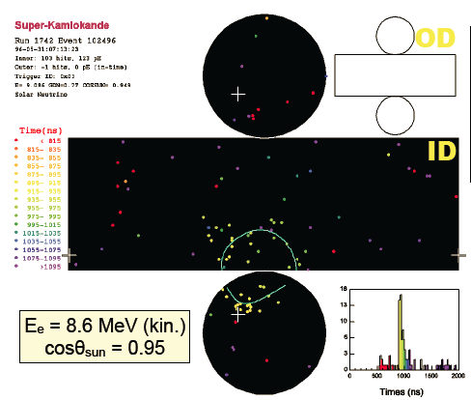
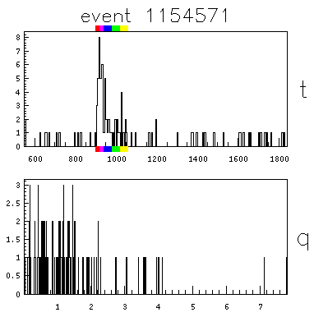
Signal: Electrons Scattered by Neutrinos
Timing information ➔ vertex
Ring pattern ➔ direction
PMT hits ➔ energy
time(ns)

Slide 24
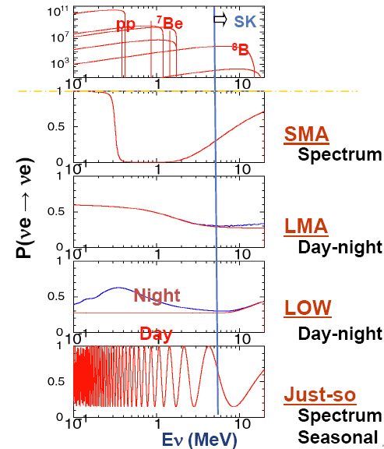
What SuperK can do ?
Flux independent analysis:
  Day-night effects
  Seasonal variation
  Spectrum distortion

Slide 25
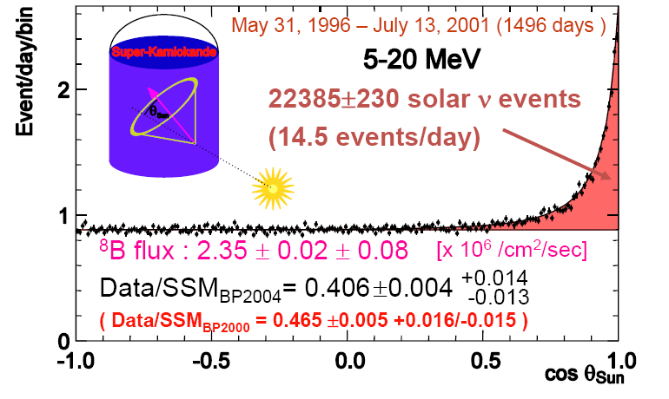
SuperK Results(SK-I)

Slide 26
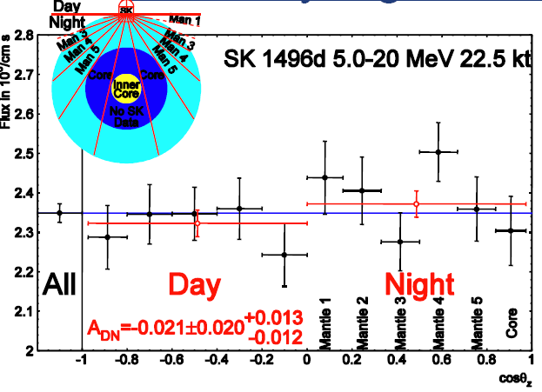
SuperK results
No sizable day/night effect
No sizable seasonable effect
No sizable spectrum distortion
Disfavor SMA & VO solution
Mixing angle could be large !

Slide 27
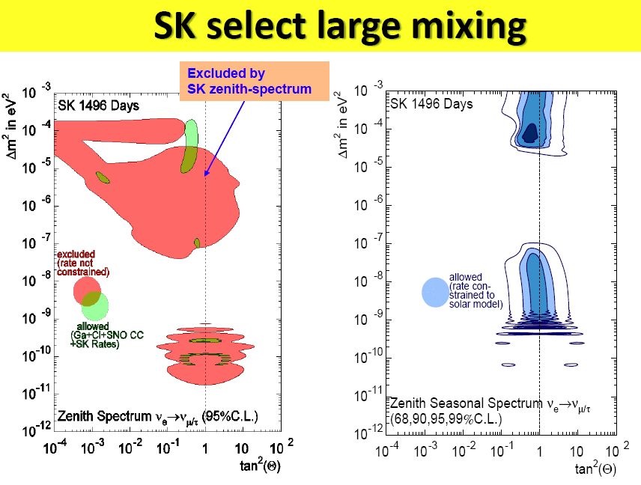

Slide 28
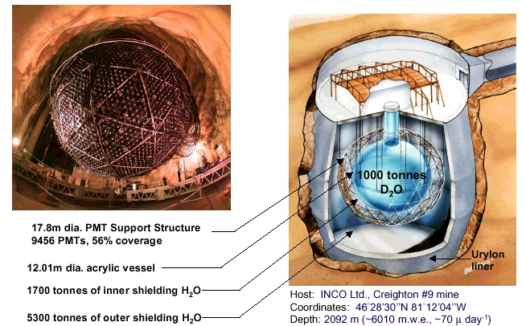
SNO Experiment
Nucl. Inst. and Meth. A449, p172 (2000)

Slide 29
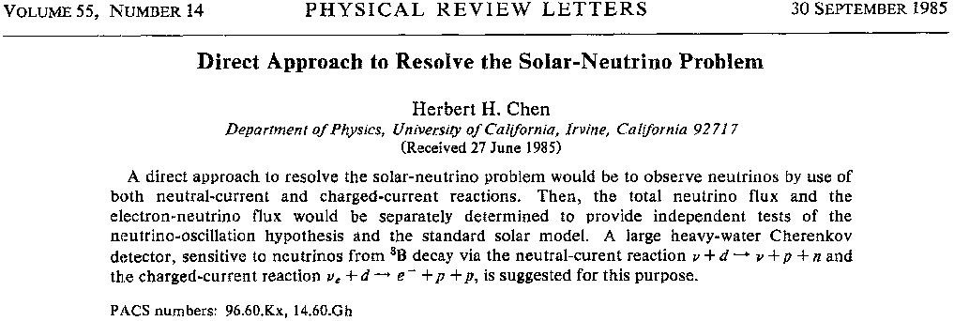

l

Slide 30
Neutrino Detection in SNO
Charged-Current (CC)
ν_{e}
ν_{e} + d e⁻ + p + p
Ee~E_{ν}, ~isotropic
Neutral-Current (NC)
ν_{x}= ν_{e}+ν_{μ}+ ν_{τ}
ν_{x} + d ν_{x} + n + p
n + d → t + γ , E_{g} = 6.25 MeV
Elastic Scattering (ES)
ν_{x} + e⁻ ν_{x} + e⁻
Forward Peaking
ν_{x}= ν_{e}+(ν_{μ}+ ν_{τ})/6

Slide 31
Shape Constrained Signal Extraction Results
CC
1967.7
+61.9
+60.9
ES
263.6
+26.4
#EVENTS
+25.6
NC
576.5
+49.5
+48.9

Slide 32
SNO observation: ν_{μτ} Flux
Φ_{ssm} = 5.05
+1.01
Φ_{sno} = 5.09
+0.44
+0.46
-0.81
-0.43
-0.43
Strong evidence of flavor change ν’s

Slide 33
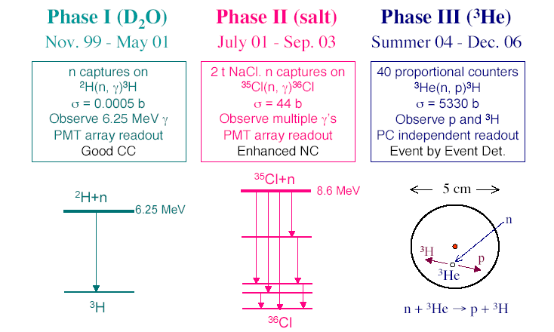
Three neutron detection methods

Slide 34
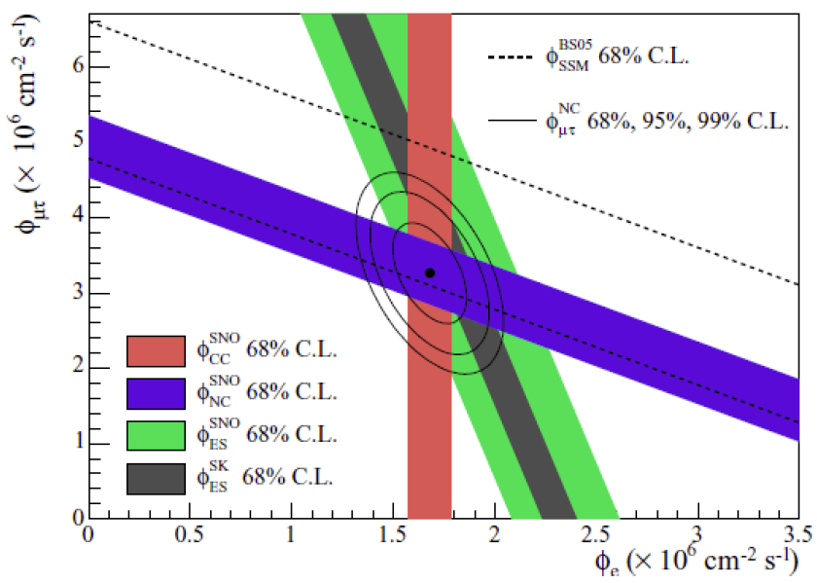
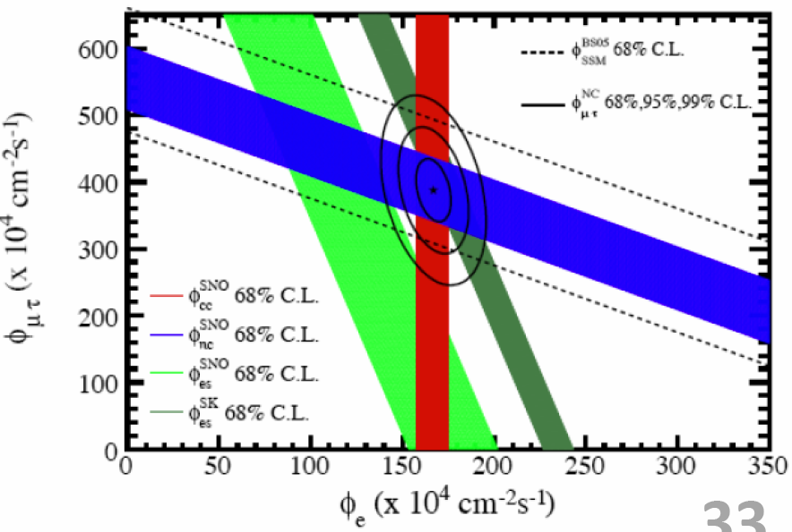
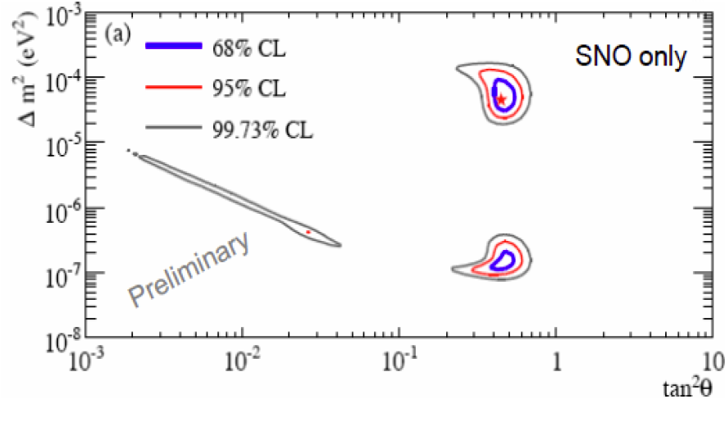
Phase I
Phase II
SNO only, Phase I+II+III
Phase III

Slide 35
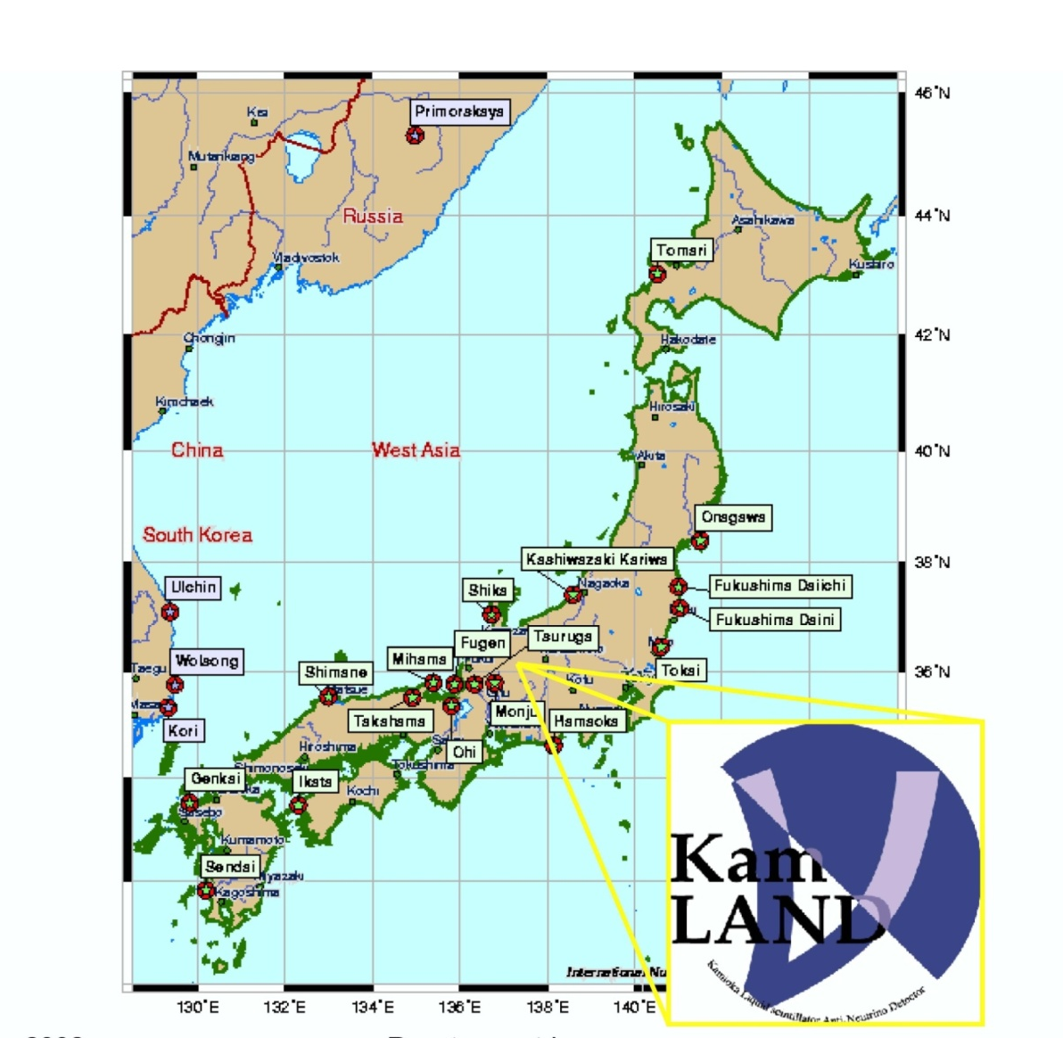
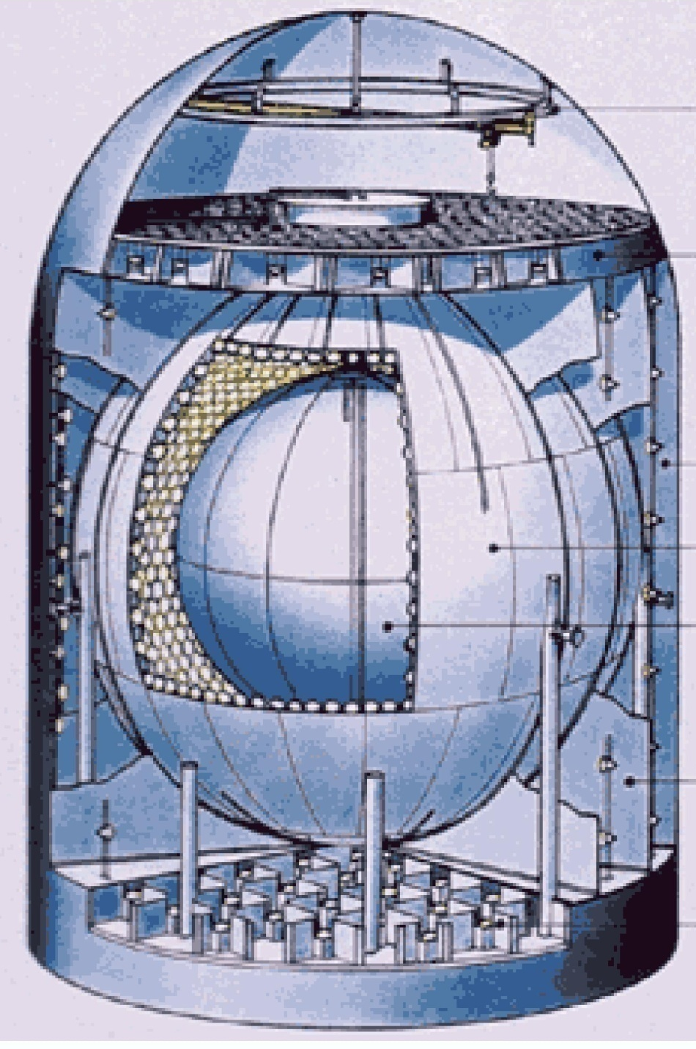
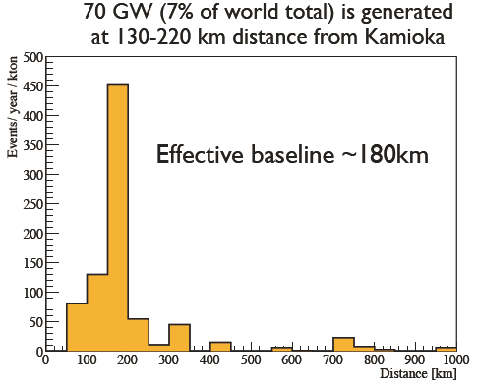
KamLAND
1000t scintillators
Shielding: 3000 MWE/3m Water
Signal: ~0.5/day
BK:
  correlated: ~0.001/day
  Uncorrelated：~0.01/day

Slide 36
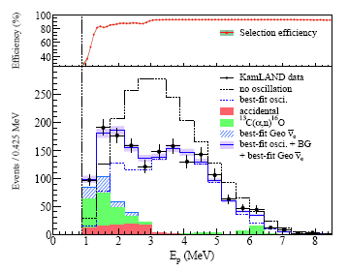


Oscillation signal
Rate
Energy spectrum
L/E plot

Slide 37



KamLAND Results
PRL90(2003)021802
PRL94(2005)081801
PRL100(2008)221803
LMA firmly established

Slide 38
Final Results
KamLAND+SOLAR
arXiV: 1409.4515

Slide 39


New：Day-Night Effect & Spectrum Distortion
  Day-Night flux asymmetry is an indication of the regeneration of ν_{e} as they travel through earth matter(earth matter effect)
A ~ 2.8 σ asymmetry is observed.
In agreement with expectation (1 σ tension)
Spectrum “upturn” is an indication of MSW effect in the sun (solar matter effect)
MSW is disfavored by SuperK at 1.7 σ
SuperK and SNO are complementary to constrain the shape. MSW is consistent with all the data at 1 σ
Phys.Rev.Lett. 112 (2014) 091805

Slide 40

Borexino
Overburden: 3800 MWE
Extremely low background
  Use ν_{e} + e → ν_{e} + e
  Scintillation light 500 PE/MeV
  No directionality
  Threshold: 60 keV for pp ν
Target liq. Scint.: 270t
Fiducal volume: 100 t
Buffer liq.: 890t
No. of PMT: 2214
Balloon: 150 μm Nylon
Material selection & purification
Cleaning and washing
Gas tight and ultrapure N₂ flushing
Underground material storage and usage
Active tagging
Energy threshold
Vertex cut
Timing & Chain reactions
Spectrum fitting and subtraction

Slide 41

The Cleanest Neutrino Experiment

Slide 42

PP Neutrinos
Real time observation for the first time by a spectral fit using well known signal and background shapes
90% of solar neutrinos
Unique probe of the center of the Sun
Zero pp neutrinos excluded at 10σ
Further approval of the Standard Solar Model(SSM)
Nature 512（2014）383

Slide 43

Confirmation of the Solar Model and the Neutrino Oscillation
Accomplished:
  ⁷Be flux
  ⁸B flux down to 3 MeV
  pep flux & limit on CNO
  pp neutrinos
Future:
  CNO
Nature 512（2014）383

Slide 44
Future
Better oscillation measurements
  Seasonal variations
  Spectrum distortion
  Day-night effect
Non-standard interactions
  Flavor changing NC
  Sterile neutrinos
  Mass varying neutrinos
Solar physics:
  Understand the stellar formation by measuring the metallicity of the Sun’s core
    Precision 8B flux
    CNO flux
SuperK
Borexino
SNO+
XMASS
JUNO
HyperK
LENA
…

Slide 45


SNO+
Construction almost finished, to be operational soon
  780t liquid scintillator(LAB-based)
  9500 PMTs
  Water shielding
  Hold down rope net on the 12 m diameter Acrylic vessel
Physics:
  Solar neutrinos
    Better measurement of pep & ⁸B neutrinos
    Look for CNO neutrinos
  Geoneutrinos
  Supernova neutrinos
  Double beta decays
McDonald@Neutrino’12

Slide 46

Future experiment: LENA
arXiv:1104.5620
The detector:
  50 kt liquid scintillator(LAB)
  30,000 12” PMT with Winston cone, 30% coverage
  Water Veto with 4000 8” PMT
Physics
  Solar neutrinos
    CNO neutrinos for solar metallicity
  Burst Supernova neutrinos
  Diffused Supernova neutrinos
  Geo-neutrinos
  Short baseline neutrino oscillation experiment using radioactive sources: sterile neutrinos

Slide 47

JUNO
Muon detector
Steel Tank
20 kt LS
Water seal
20kt water
Acrylic tank：Φ34.5m
Stainless Steel tank ：Φ37.5m
6kt MO
~15000 20” PMTs
coverage: ~80%
1500 20” VETO PMTs
See more in the Reactor neutrino section

Slide 48
Summary
Solar neutrinos gave us the first hint of the neutrino oscillation
Neutrino mixing parameters, θ₁₂ and ΔM²₂₁, are determined by the SuperK, SNO and KamLAND experiments
Approved the Standard Solar Model
More to learn
More experiments in the future

