Slide 1
Detecting and tracking cell assemblies
Adriano Tort
Brain Institute, Federal University of Rio Grande do Norte (UFRN)
School on Complex Networks and Neuroscience
Unesp, São Paulo, October 2015

Slide 2
Overview
General introduction to in vivo electrophysiology
Detecting cell assemblies
Cell Assemblies by PCA
Cell Assemblies by ICA
Hands-on programming!

Slide 3
A role for computational math in neuroscience?

Slide 4
Research Field Overview and Framework
Elaboration of new mathematical tools for the analysis of EEG and neuronal activity
Experimental Research:
EEG and unit analysis
(through computational tools as MATLAB)
Theoretical/Computational Research:
Models of Neurons and Brain Rhythms
How does the brain work?

Slide 5
Computational analyses of electrophysiological signals

Slide 6
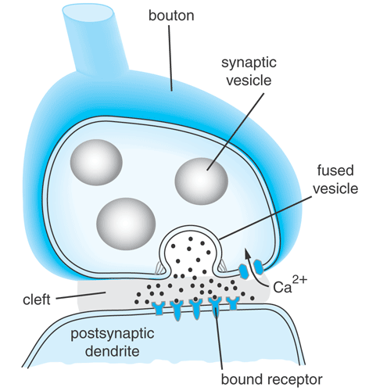
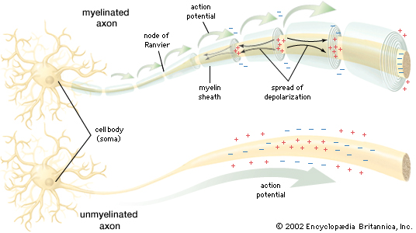
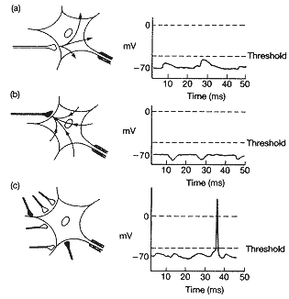
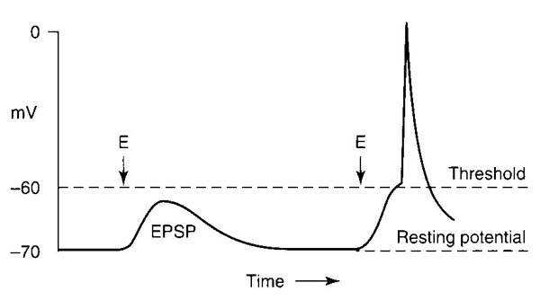
Neurons produce electrical activity
Main sources of electrical activity in the brain
Synaptic Potentials and Action Potentials

Slide 7
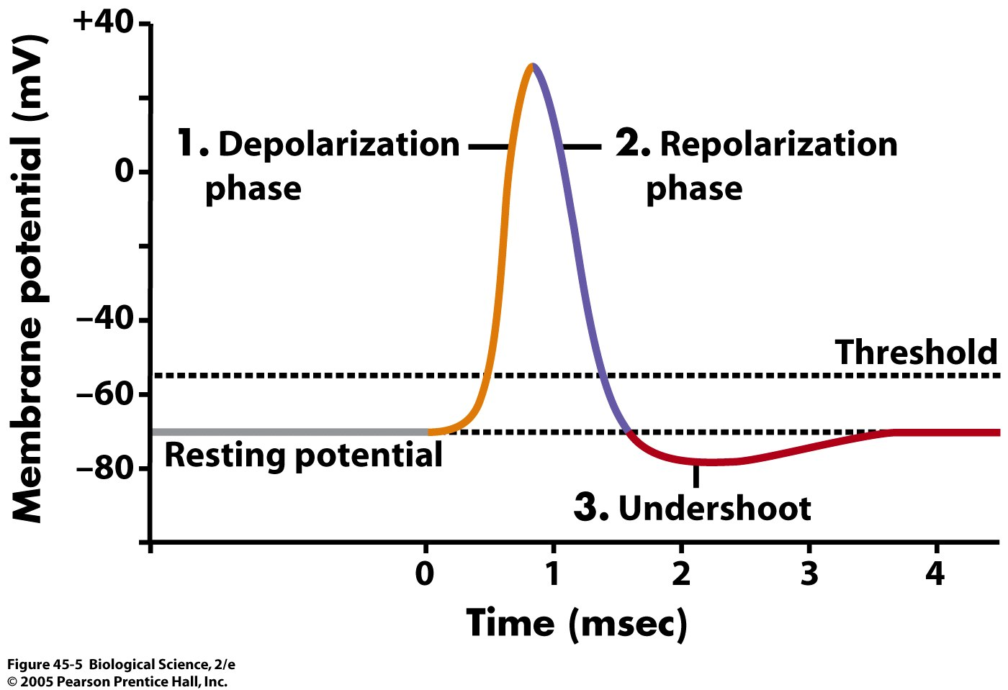

Slide 8
Getting data:
Units (= neurons)
LFP (= EEG)

Slide 9
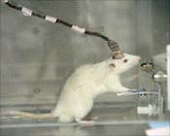
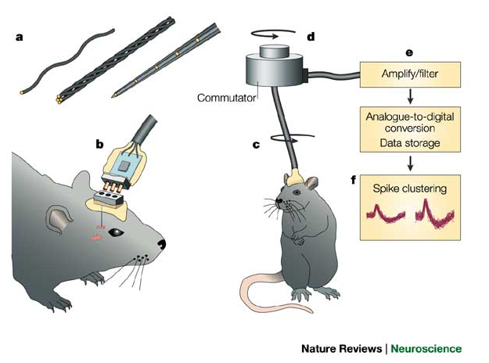
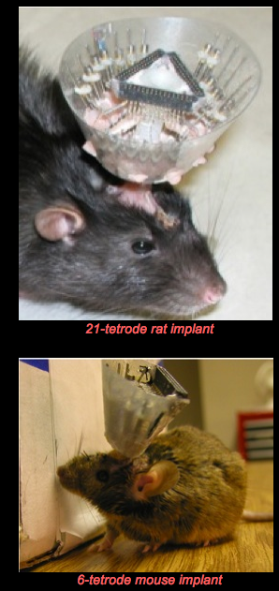

Slide 10
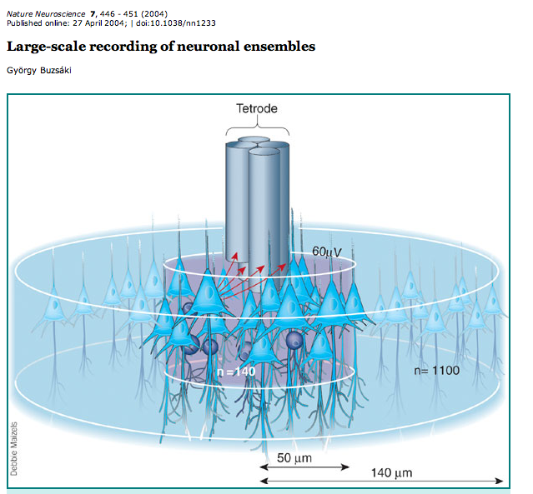

Slide 11
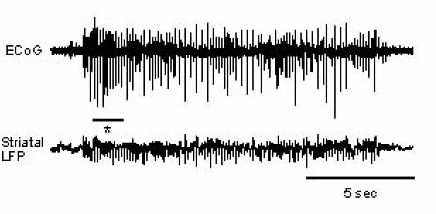
The brain: dynamic, complex, plastic...
ephys: excellent tool to study brain activity in vivo; presents a high temporal resolution as well as a good spatial resolution
Notes:
11

Slide 12
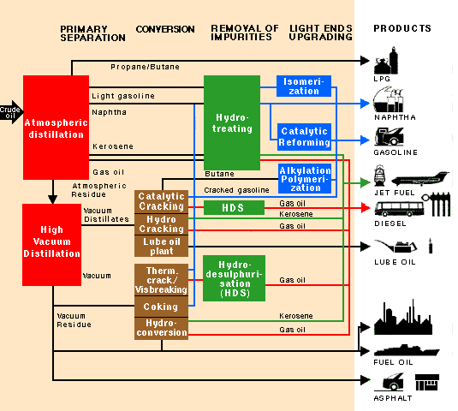

Slide 13
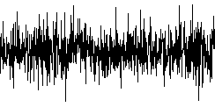
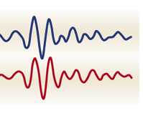
>500 Hz
Neuronal Units
(spike times)
Filter (High Pass)
High Frequencies
Raw signal
< 500 Hz
delta
Filter (Low Pass)
Low Frequencies
Brain Rhythms of different frequencies
theta
alpha
beta
gamma
Local Field Potential
(LFP)
Filter (Band Pass)
Frequency Bands
Notes:
13

Slide 14
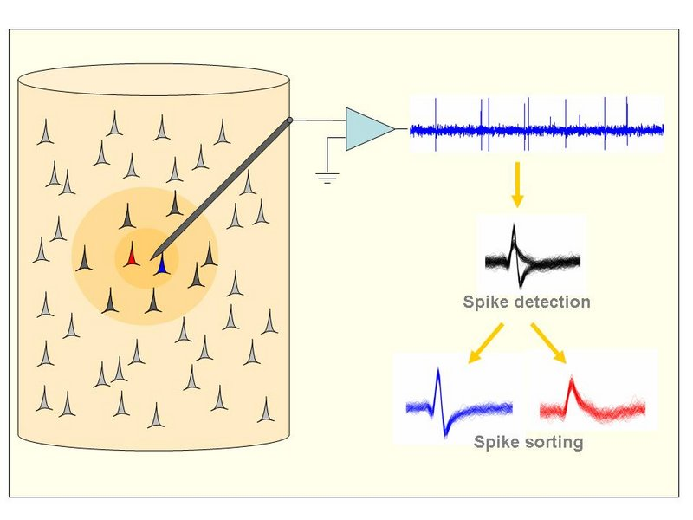
Obtaining spike times
Quiroga

Slide 15
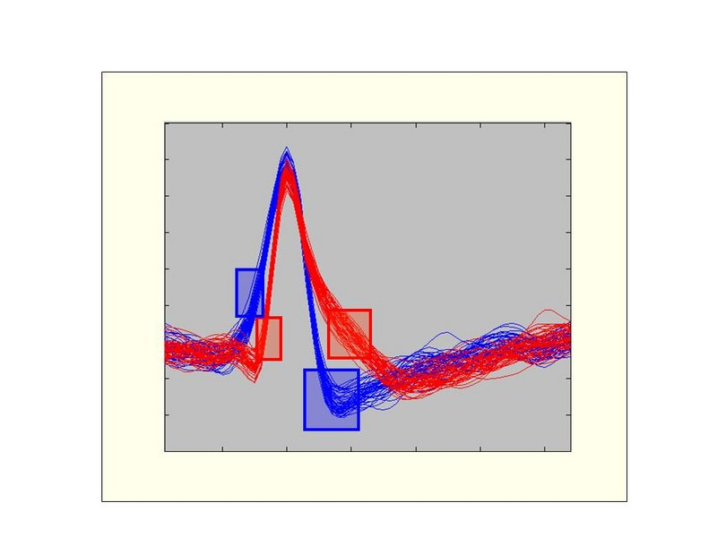
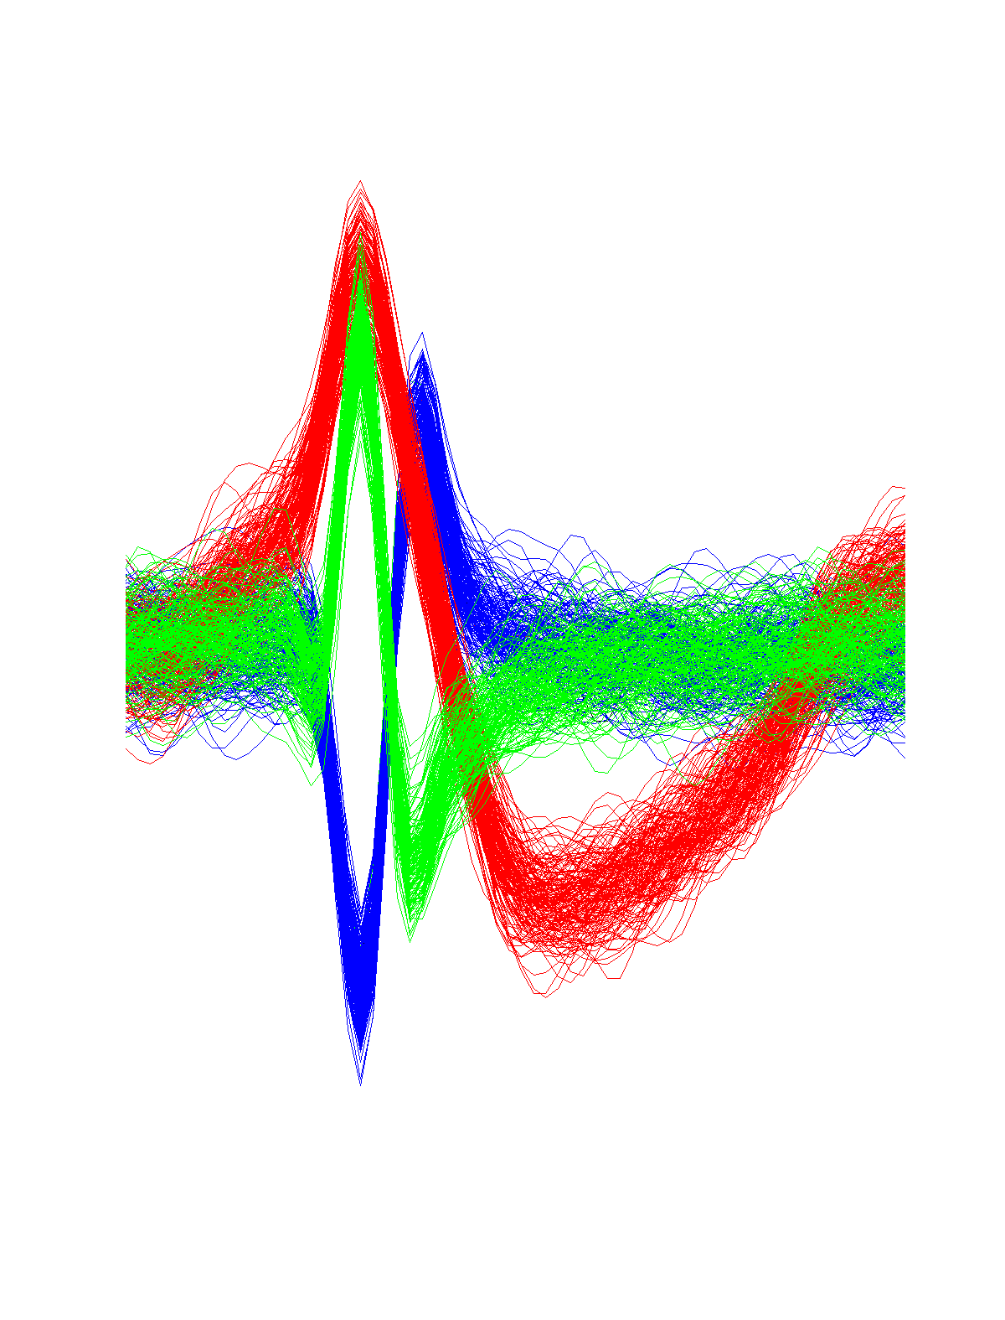
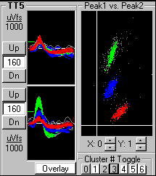
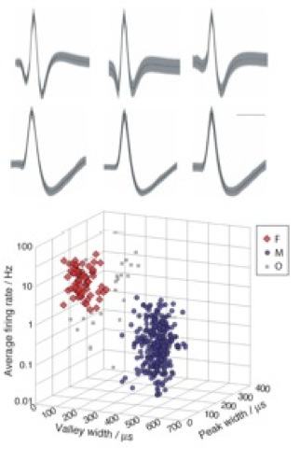

Slide 16
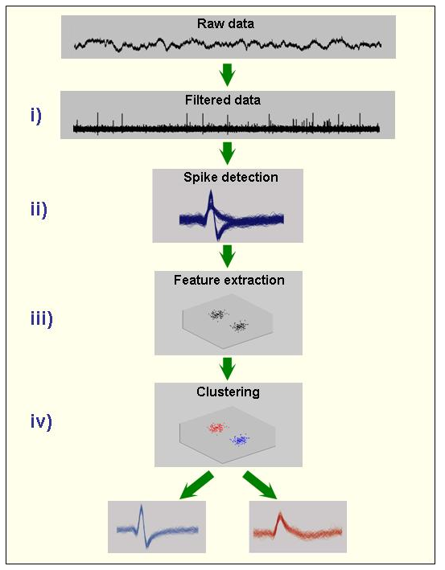
Quiroga

Slide 17
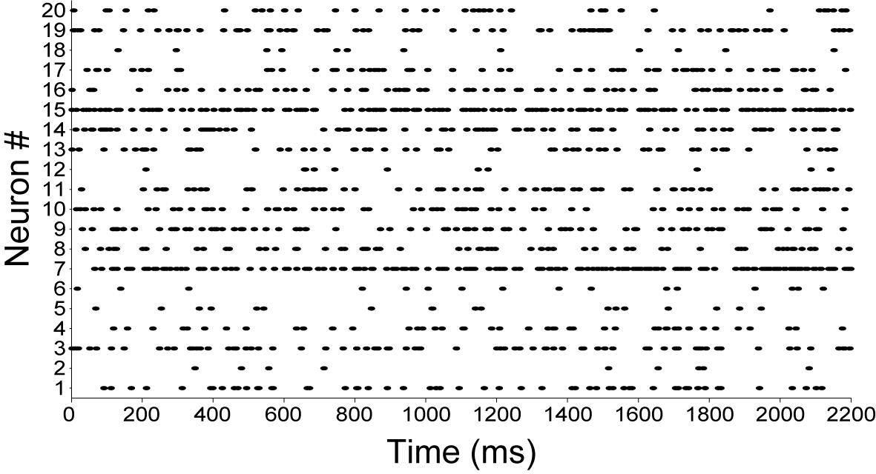
The spike rastergram:
Spike train = (t₁,t₂,t₃,…,t_{N})
[or (t_{x,1},t_{x,2},t_{x,3},…,t_{x,N(x)}), x=1…K cells]

Slide 18
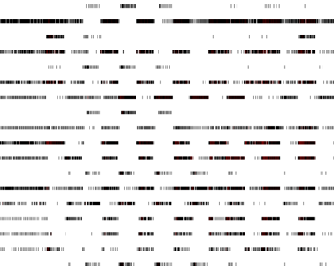
The Neural Code
The Holy Grail of Neuroscience

Slide 19
Examples of Results

Slide 20
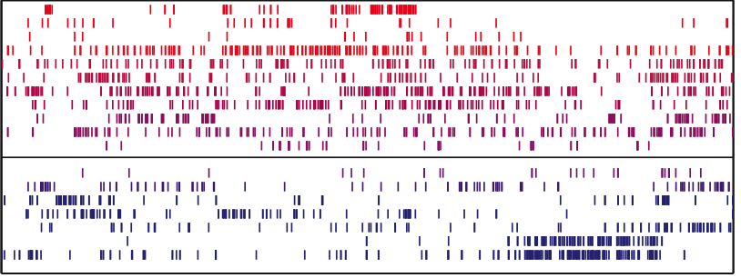
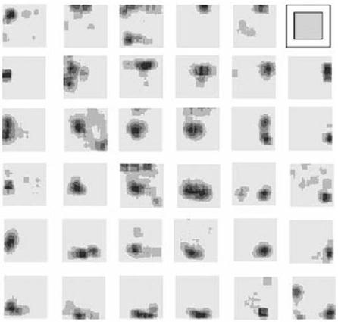
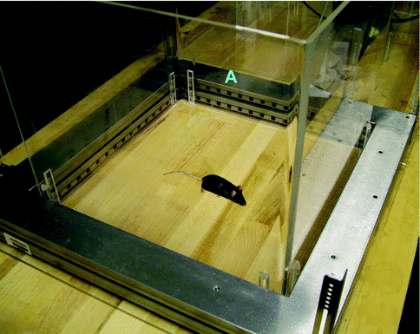
A classical result
“Place Cells”
Open Field:

Slide 21
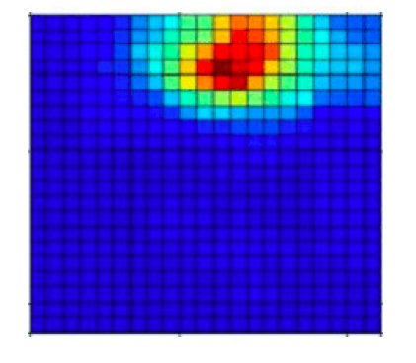
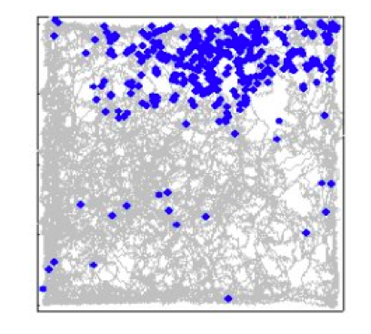
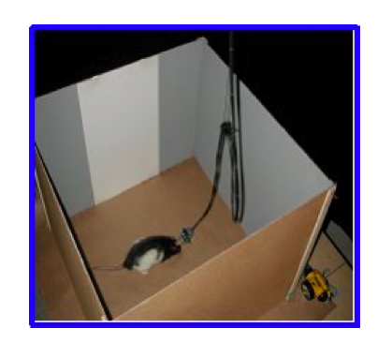
Place Fields

Slide 22
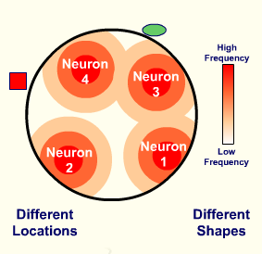

Slide 23
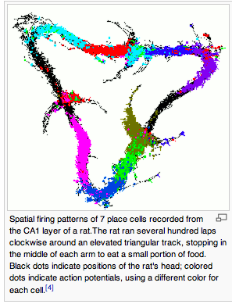
Place cells
Notes:
Vídeo Place Cells

Slide 25
How does the brain work?
We don’t know, but it seems that the hippocampus has to do with spatial navigation

Slide 26
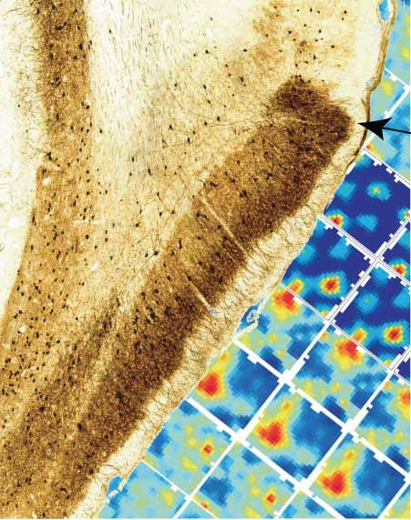
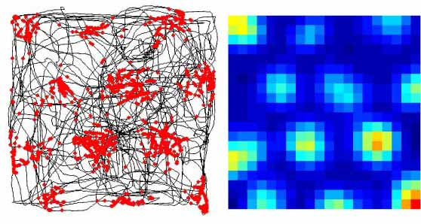
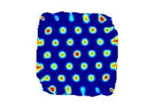
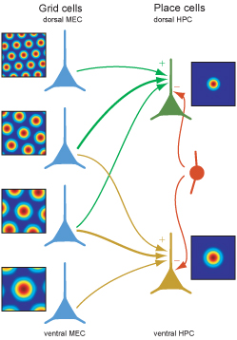
Grid Cells:

Slide 27
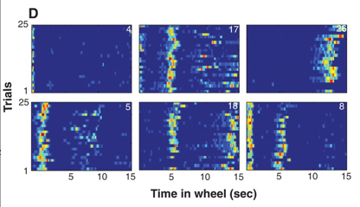
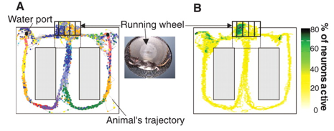
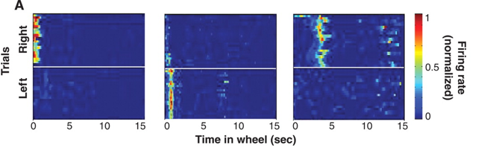
Time cells:
Notes:
Vídeo Buzsaki

Slide 28
Meanwhile, in humans…

Slide 29
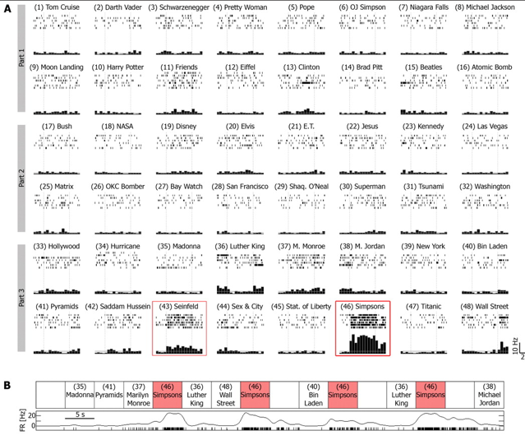
Continuous PSTH spike train
Notes:
Video Simpson cell

Slide 30
The Neural Code

Slide 31
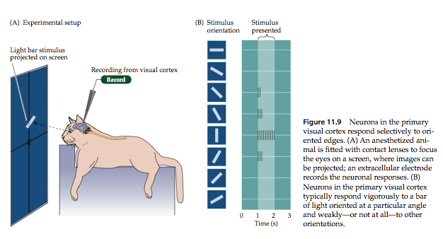

Slide 32
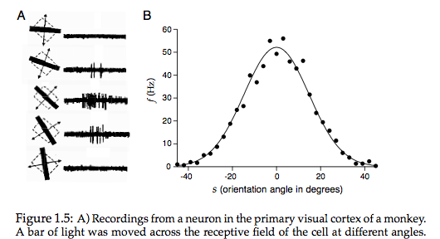
A population code (population vectors) is likely used by the brain

Slide 33
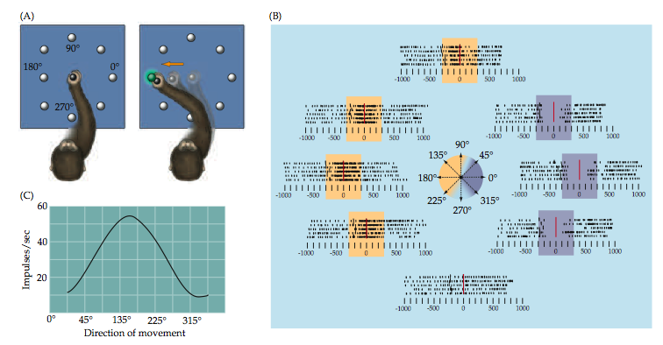
A classical result: Georgopoulos 1986

Slide 34
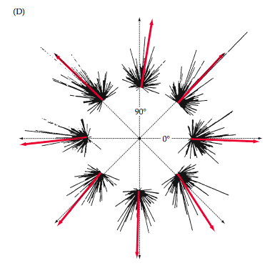
Population Vector

Slide 35
Population Vector VS Grandmother Cells
Is the neural code centralized or distributed?

Slide 36
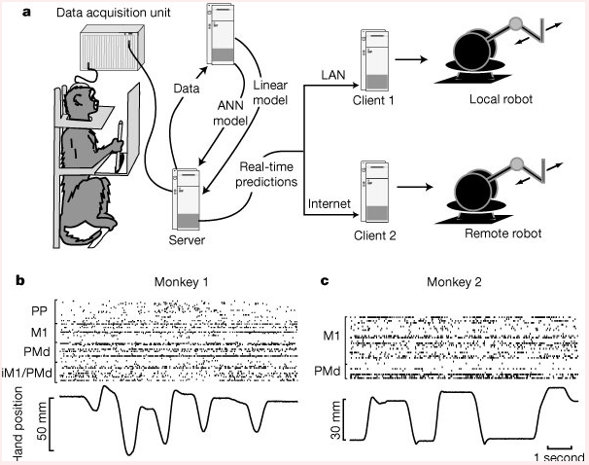
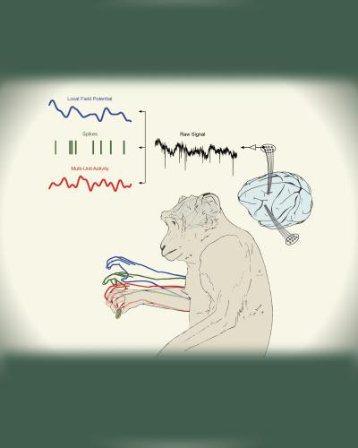
Monkeys Consciously Control a Robot Arm Using Only Brain Signals; Appear to "Assimilate" Arm As If it Were Their Own
Notes:
Vídeo Nicolelis

Slide 37
Cell Assemblies

Slide 38
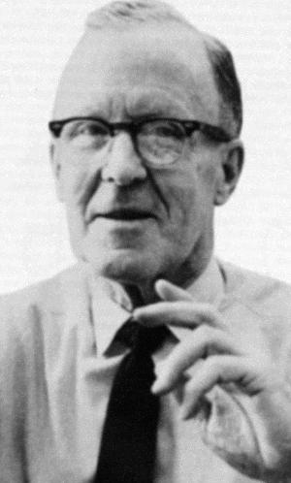
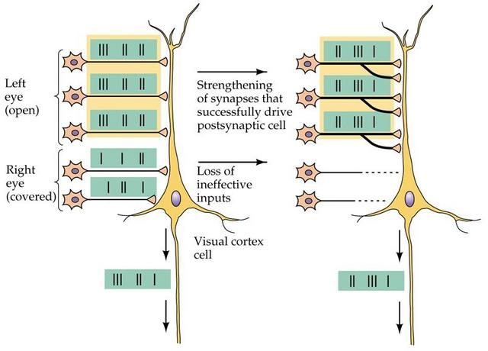
Hebb, 1949

Slide 39
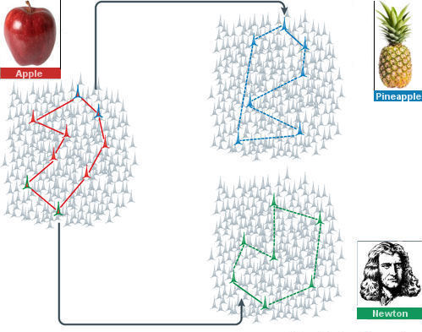
Quiroga, Adapted

Slide 40
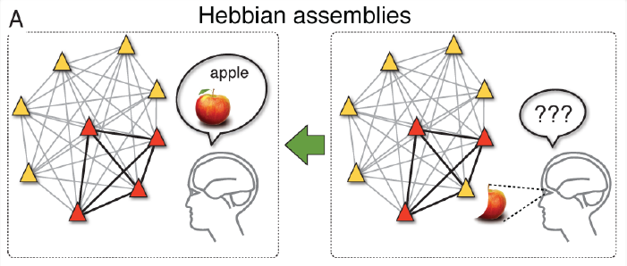
Pattern Completion
Phase Sequences
Gerstner et al, 2012
Harris, 2005

Slide 41
From SlideShare

Slide 42
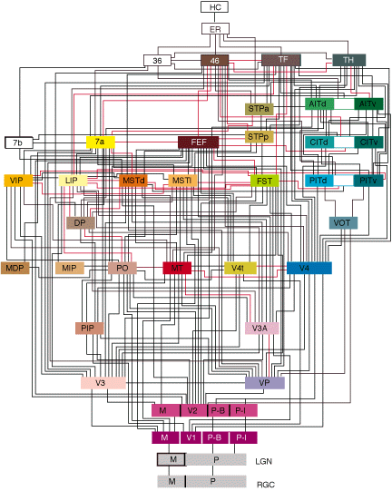
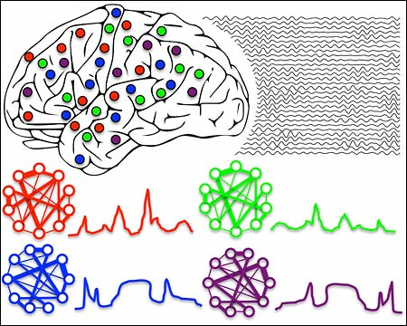
Canolty et al (2010)
Felleman & Van Essen (1991)

Slide 43
Brogliato et al (2014)

Slide 44
How to identify cell assemblies?

Slide 45
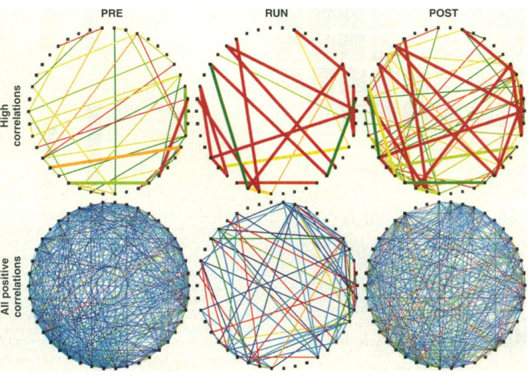
Pairwise correlations:
Wilson & McNaughton (1994)

Slide 46
Population analyses
Harris et al (2003)

Slide 47
Detecting Cell Assemblies by Principal Component Analysis

Slide 48
A Remark: This framework is an extension of the following work:

Slide 49
Intro to PCA (principal component analysis)
What we need to know:
PCA finds orthogonal directions of maximal variance in multidimenstional data
PCA is used for dimensionality reduction
In the end, PCA helps interpreting multidimensional data (such as the activity of multiple neurons in time)

Slide 50
Finding the direction of maximal variance

Slide 51
Compute Variance of Projected Data
Vector projection

Slide 57
How to compute the principal components?

Slide 58
From SlideShare

Slide 59
Standardize your data:
Calculate Covariance Matrix
Compute Eigenvector and Eigenvalues
of the Covariance Matrix

Slide 60
Principal components = eigenvectors of the covariance matrix The eigenvalues give the variance at the respective direction

Slide 61
Dimensionality Reduction: Discard PCs with low variance
Matlab?

Slide 62
Back to neurons...

Slide 63
Where are the cell assemblies?

Slide 66
General Framework

Slide 67
General Framework

Slide 70
Cool results coming out of the PCA-based framework...

Slide 71
Assembly Patterns
(or Projectors)
PC →
PCxPC →
(outer product)

Slide 72
Often squared projection is used:
The outer product:
← One can then delete the diagonal

Slide 73
How do we now which assemblies are meaningfull? That is, how many principal components should we take into account?

Slide 74
Random Matrix Theory:
The Marcenko-Pastur Distribution
Number of Neurons
Number of Time Bins
Chance Distribution Width α
Lopes-dos-Santos et al 2011

Slide 75
Lopes-dos-Santos et al 2011

Slide 77
Number of eigenvalues above chance distribution mark the number of cell assemblies

Slide 78
Using a statistical threshold for the number of assemblies:

Slide 79
Matlab?
Projecting the activity of detected cell assemblies:

Slide 80
So far so good, we can now detect (by Marcenko-Pastur) and track (via Projectors) cell assembly activity...
... except that the PCA-based framework has important limitations.

Slide 81
Original PCA approach fails to track individual assembly activity if there are common neurons among assemblies

Slide 82
←Assemblies having the same weight are not well separated by PCs

Slide 83
In Lopes-dos-Santos et al (2011) we solved some of these issues by means of “Assembly Vectors”...

Slide 84
The mean idea came from also counting the number of directions with lower variance than chance
In addition to one dimension with increased variance, another dimension has reduced variance

Slide 85
Number of eigenvalues above and below chance distribution mark the total number of cell assembly neurons

Slide 86
Assembly Vectors to project assembly activity instead of PCs:
Lopes-dos-Santos et al 2011

Slide 89
Assembly Vectors method overview:

Slide 90
In Lopes-dos-Santos et al (2011) we solved some of the PCA issues by means of “Assembly Vectors”...
... but later on we foud a much simpler way of achieving similar and even better results (Lopes-dos-Santos et al 2013),
by means of Independent Component Analysis

Slide 91
Detecting Cell Assemblies by Independent Component Analysis
(actually PCA is still used)

Slide 92
Intro to ICA (independent component analysis)
What we need to know:
A type of blind source separation
ICA finds directions in multidimenstional data that are most statistically independent

Slide 93
Correlation vs Independence
Statistical Independence:

Slide 96
From Slide Share

Slide 99
Principle behind ICA:
In essence what you do is to search for an umixing matrix W
such that y=Wx produces the most independent y (i.e., source estimates)

Slide 100
Some bla bla bla (actually very important info):
I love Wikipedia...

Slide 101
More bla bla bla:
Wikipedia again...

Slide 102
ICA algorithm in action:
http://research.ics.aalto.fi/ica/icademo/

Slide 103
Impressive results (actually, very typical):
Tons of applications... (denoising for example)

Slide 104
PCA vs ICA:

Slide 105
Back to neurons...

Slide 106
To detect cell assemblies:
ICA is applied after dimensionality reduction by PCA.
Only the significant PCs (that is, PCs with variance statistically above chance) are used to project the Spike Matrix into a new basis.
The number of ICs correspond to the number of cell assemblies (number of significant PCs).
So the method is not purely ICA-based, but PCA → ICA.
See also Laubach et al 1999.

Slide 107
PCA vs ICA:

Slide 109
Comparing PCA- vs AV- vs ICA-based methods:

Slide 110
Comparing PCA- vs AV- vs ICA-based methods (a more complicated case):

Slide 111
Increasing time-course resolution and playing around with LFPs:

Slide 112
Cool results coming out...

Slide 117
Vítor Lopes-dos-Santos

Slide 118
Possible next steps: phase sequences
The end

