Slide 1
Measurements, Model Independence & Monte Carlo
Jon Butterworth
University College London
ICTP/MCnet school
São Paulo
27/4/2015

Slide 2
Measurements, Model Independence & Monte Carlo
What are event generators for?
Event generators and theory
Event generators and simulation
What do we actually measure?
The final state
“Truth” particle definitions
Fiducial or not?

Slide 3
Event Generators and Theory
Mainly, see Leif’s lectures. But briefly:
In a collider or fixed-target experiment, the underlying theory (typically short distance physics), usually embedding in a more complex event, including known and lower energy physics

Slide 4
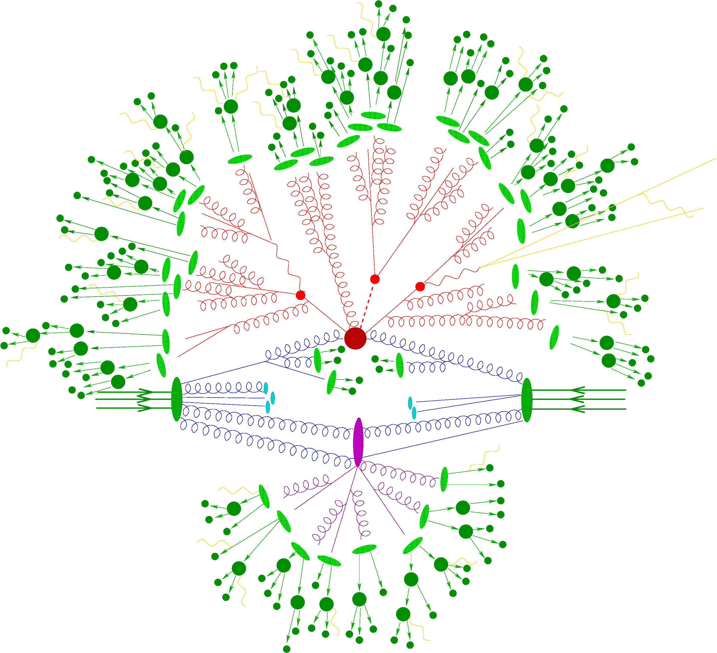

Slide 5
Event Generators and Theory
Mainly, see Leif’s lectures. But briefly:
In a collider or fixed-target experiment, the underlying theory (typically short distance physics), usually embedding in a more complex event, including known and lower energy physics
Event generators can embed state-of-the-art calculation in a realistic and complete collision, and predict the final state
Different levels of precision and modelling can be combined and tested

Slide 6
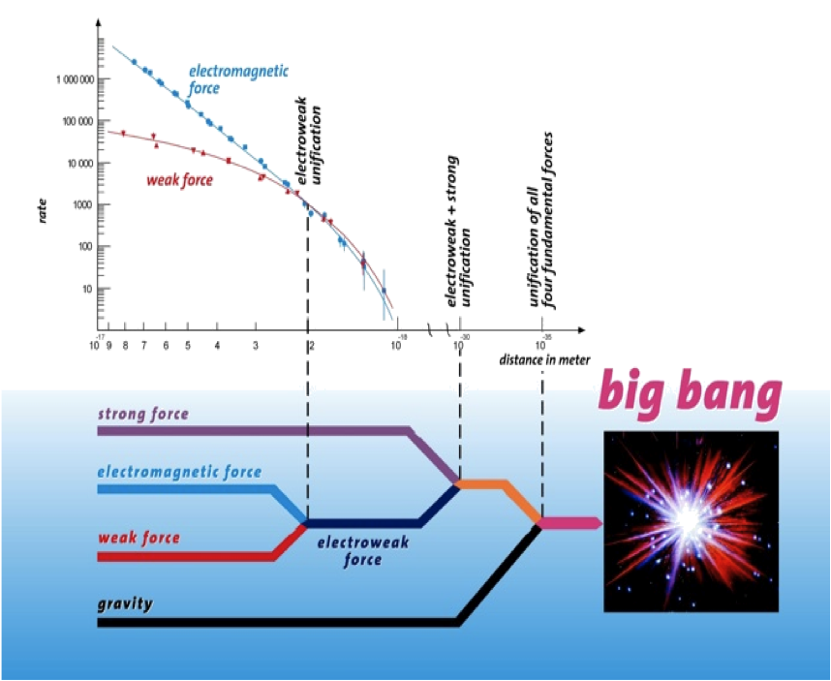
Notes:
The weak force (isnt)

Slide 7
Event Generators and Simulation
“Simulation” in context usually means “detector simulation”
Detailed model of detector(s) in GEANT
Particles (from the generator) propagate step by step through
Magnetic fields
Material
Quasi-stable particles can be decayed

Slide 8
Event Generators and Simulation
Simulation of readout
Digitisation, truncation, saturation etc
Trigger readout
Provide “as data” input to reconstruction algorithms
Retain knowledge of what “really” happened

Slide 9
Simulation and Experiment
Particle Four-Vectors
MC Event Generator
Digitized Readout
Detector & Trigger Simulation
Data for Analysis
Event Reconstruction

Slide 10
Simulation and Experiment
Particles
Collider!
Digitized Readout
Detector & Trigger
Data for Analysis
Event Reconstruction

Slide 11
Simulation and Experiment
Particle Four-Vectors
MC Event Generator
Digitized Readout
Detector & Trigger Simulation
Data for Analysis
Event Reconstruction
Unfolding & Data Correction: Test and evaluate

Slide 12
Simulation and Experiment
Particles
Collider!
Digitized Readout
Detector & Trigger
Data for Analysis
Event Reconstruction
Unfolding & Data Correction: Make the measurement!

Slide 13
What do we actually measure?
The final state!
Quantum mechanics says so!
Clearly we can’t, even in principle, tell the difference between amplitudes with different final states
If your measurement can’t be defined in such terms, worry!
Model dependence
Physical meaning!

Slide 14
What do we actually measure?
At least the first stage of a measurement, or search, should be stateable, and stated, in terms of “truth” final-state particle definitions where possible (and if not possible… why?)

Slide 15
What is your final state?
quarks, gluons? (top?)
W, Z, H?
Taus?
Hadrons? (lifetime cut? Do they propagate in B-field? In material?)
Jets (what are the input objects?)
Neutrinos? All of them? Missing E_{T}
Photons? Isolated photons?
Electrons, muons? (what about FSR?)

Slide 16
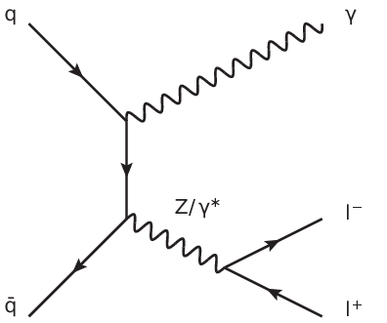
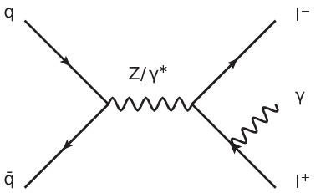
When is a lepton a lepton plus some photons?

Slide 17
Important considerations (for searches too)
What is your final state?
A common choice is place a lifetime cut at 10ps, and where necessary to draw further distinction, draw the line at hadronisation.

Slide 18
Fiducial or not?
Difference between “efficiency corrections” or “unfolding”, and “acceptance corrections”.
The first two generally mean correction for detector effects, which no one but the experimentalists can do.
The third means extrapolating into kinematic regions which have not been measured at all
Beware of the third, especially as we go to higher energies…

Slide 19
Unfold

Slide 21
Increase acceptance

Slide 22
Increase acceptance

Slide 23
Extrapolate

Slide 24
Extrapolate

Slide 25
But how reliably?

Slide 27
Concept of a “fiducial” cross section
Defines a region in which acceptance is ~100%
Implies that some kinematic cuts must be implemented in whatever theory is compared to (easy for MC, less so for some high-order calculations)

Slide 28
Inaccessible. Removed by kinematics cuts, and not part of the fiducial cross section

Slide 29
Concept of a “fiducial” cross section
Defines a region in which acceptance is ~100%
Implies that some kinematic cuts must be implemented in whatever theory is compared to (easy for MC, less so for some high-order calculations)
Ideally of course, build an experiment which covers all the phase space of interest…

Slide 32
Concept of a “fiducial” cross section
Defines a region in which acceptance is ~100%
Implies that some kinematic cuts must be implemented in whatever theory is compared to (easy for MC, less so for some high-order calculations)
Ideally of course, build an experiment which covers all the phase space of interest…
Fiducial cross defined in terms of the “ideal” or “true” final state

Slide 33
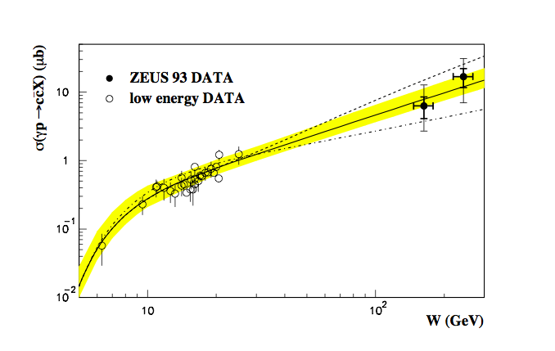
Real example: ZEUS charm photoproduction
Large energy extrapolation
Tiny acceptance → ~1.4% (and zero at low p_{T})

Slide 34
Real example: ATLAS WW cross section (to e, μ), 7 TeV
Efficiency/detector corrections to obtain fiducial cross section: 0.4-0.7 (defined in terms of lepton kinematics)
Acceptance (accessible phase space compared to include WW): 0.07-0.16
That missing 90% is stuff we don’t measure
The efficiency/detector efficiency won’t change much at 13 TeV, but the acceptance may well drop further

Slide 35
For example… Top cross section
Total cross section measurements extrapolate to 4π, 4 TeV>p_{T}>0
Often not even possible to extract the acceptance from the papers (convoluted with efficiencies and migrations)
Means for some, non-trivially-different, regions of phase space, we are just buying the theory
Will be even more of a problem at higher beam energies.

Slide 36
Garbage in, garbage out

Slide 37
THEORY in, THEORY out
… so the experiment is a waste of time

Slide 38
Important considerations (for searches too)
Will be residual model dependence in any measurement, but experimentalists should minimise it, make assumptions clear, and control it as far possible within some given systematic uncertainty
Theorists should look for measurements of physical final states and where possible calculate them
Of course we all want to learn about the underlying theory by interpreting what we see, but try to keep interpretation separate from measurement: interpretations can, and do, change, but we won’t build an LHC (Tevatron, LEP, HERA…) again.

Slide 39
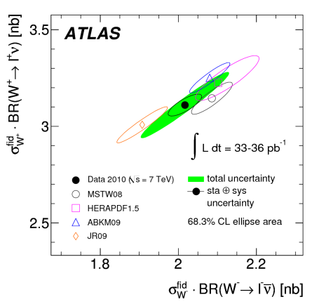
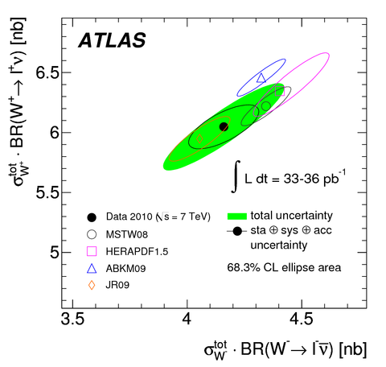

Slide 40
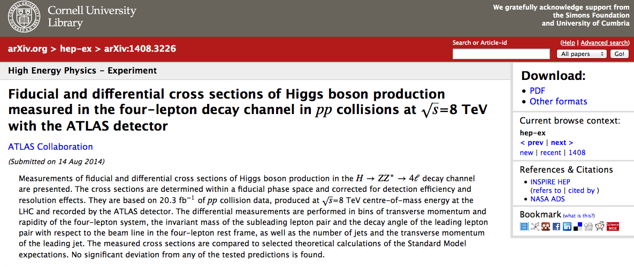

Slide 41
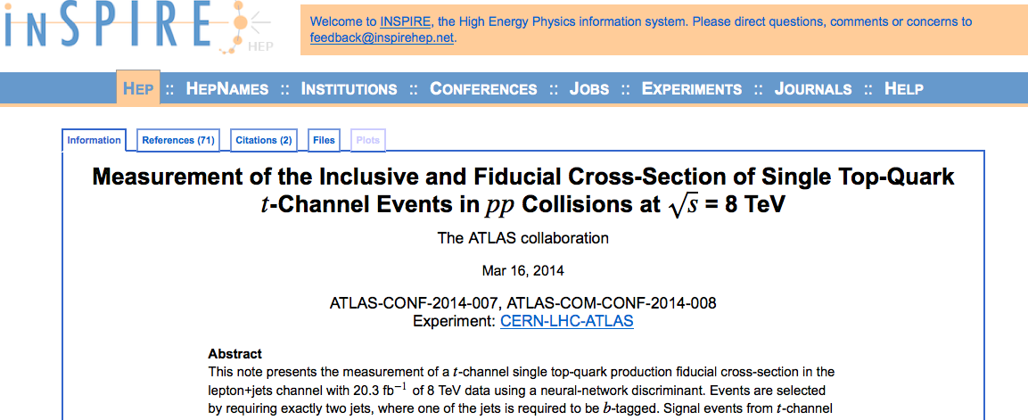

Slide 42
What do we actually measure?
The final state!
Quantum mechanics says so!
Clearly we can’t, even in principle, tell the difference between amplitudes with different final states
If your measurement can’t be defined in such terms, worry!
Model dependence
Physical meaning!
See also… RIVET

