Slide 1







Statistical Aspects of Topological Phase Transitions
Wei Chen (PUC-Rio), Manfred Sigrist, Markus Legner, Andreas Ruegg,
Paolo Molignini, Rama Chitra (ETH), Stefanos Kourtis (BU),
Titus Neupert (UZH), Christopher Mudry (PSI), Andreas Schnyder (MPI)
W. Chen, JPCM 28, 055601 (2016)
W. Chen, M. Sigrist, A. P. Schnyder, JPCM 28, 365501 (2016)
W. Chen, M. Legner, A. Ruegg, and M. Sigrist, PRB 95, 075116 (2017)
S. Kourtis, et al, PRB 95, 075116 (2017)
W. Chen, PRB 97, 115130 (2018)
P. Molignini, W. Chen, and R. Chitra, arXiv:1805.09698

Slide 2
Outline
Topology in our daily life
Topology in solids
Topological phase transitions in solids
Statistical aspects of topological phase transitions

Slide 3

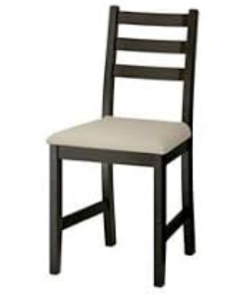

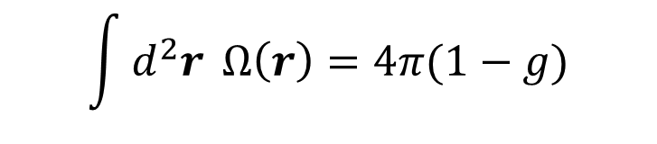
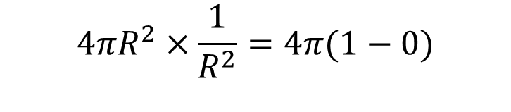

Topology in our daily life
Gauss-Bonnet theorem
$$\int{d^{2}r} Ω\left(r\right)=4π(1−g)$$
$$R$$
Gaussian
curvature
Number
of holes
Example: a perfect sphere
$$4πR^{2}×\frac{1}{R^{2}}=4π(1−0)$$

Slide 4
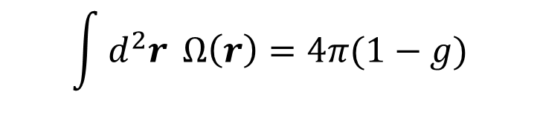
Different objects with the same topology
Gauss-Bonnet theorem
$$\int{d^{2}r} Ω\left(r\right)=4π(1−g)$$
Local curvature
changes
Number of holes
unchanged

Slide 5
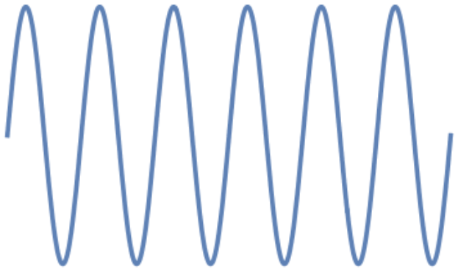

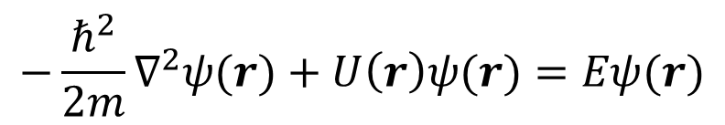




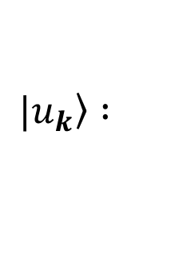
Quantum mechanical wave functions in solids
Schrodinger equation in a periodic potential
$$−\frac{ℏ^{2}}{2m}∇^{2}ψ(r)+U\left(r\right)ψ(r)=Eψ(r)$$
$$U\left(r\right)=U(r+R)$$
$$R$$
Bloch theorem
$$ψ(r+R)=e^{ik∙R}ψ(r)$$
$$ψ_{k}(r)=e^{ik∙r}u_{k}(r)$$
$$u_{k}\left(r+R\right)=u_{k}\left(r\right)=\left\langle r | u_{k}\right\rangle$$
$$\left.|u_{k}\right\rangle :$$
Periodic part of
Bloch state

Slide 6
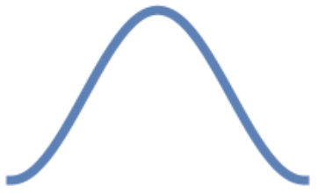
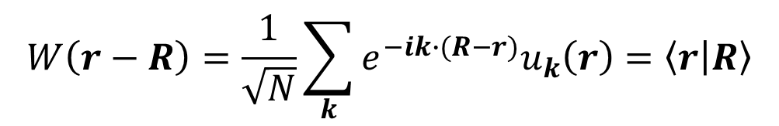
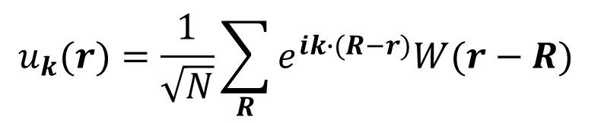




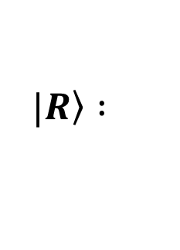
Quantum mechanical wave functions in solids
Tight-binding approximation
$$W(r−R_{1})$$
$$W(r−R_{2})$$
$$W(r−R_{3})$$
$$u_{k}(r)=\frac{1}{\sqrt{N}}\sum_{R}{e^{ik∙(R−r)}W(r−R) }$$
The overlap of atomic orbitals gives
lattice parameters such as kinetic energy,
chemical potential, atomic bonding, etc
Atomic orbitals as Wannier states
$$W\left(r−R\right)=\frac{1}{\sqrt{N}}\sum_{k}{e^{−ik∙(R−r)}u_{k}\left(r\right)}=\left\langle r | R\right\rangle$$
$$\left.|R\right\rangle :$$
Wannier state
localized at $R$

Slide 7









Metals and insulators
Metals
Insulators
$$E(k)$$
$$E(k)$$
Conduction band
Conduction band
$$k$$
$$k$$
$$0$$
$$2π$$
$$0$$
$$2π$$
Valance band
Valance band

Slide 8

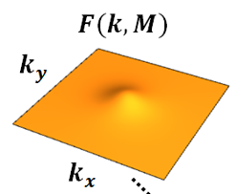
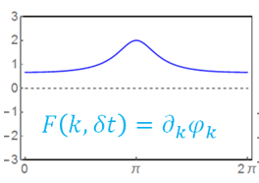






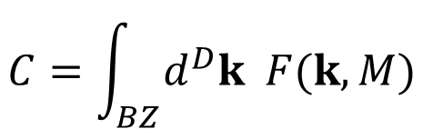


Topological insulators
$$E(k)$$
Integration of certain curvature function
over the Brillouin zone yields an integer
Conduction band
$$C=\int_{BZ}{d^{D}k F(k,M)}$$
$$k$$
$$0$$
$$2π$$
“Curvature function”
1D: Berry connection
Valance band
$$F\left(k,M\right)=\left\langle u_{k} | i∂_{k} | u_{k}\right\rangle$$
2D: Berry curvature
$$F\left(k,M\right)=∇_{k}×\left\langle u_{k} | i∇_{k} | u_{k}\right\rangle$$
$$M :$$
Tuning parameter such as magnetic field, chemical potential, etc

Slide 9
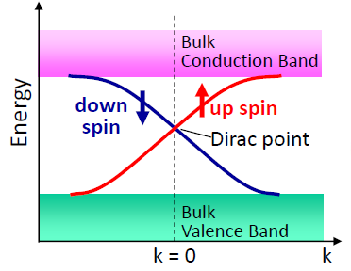
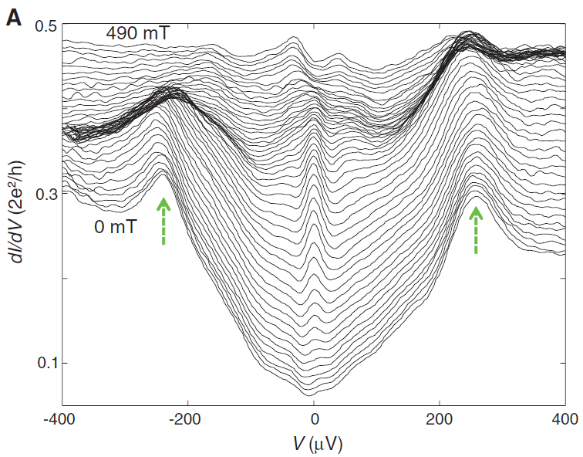
Possible applications: the edge states
Bulk-edge correspondence: topologically nontrivial phase $C≠0$ has edge states
1D
2D
3D
Majorana
edge states
B field
Semiconductor wire
Superconductor
Mourik et al, Science 336, 1003 (2012)
Konig et al, Science 318, 766 (2007)
Ando, JPSJ 82, 102001 (2013)

Slide 10
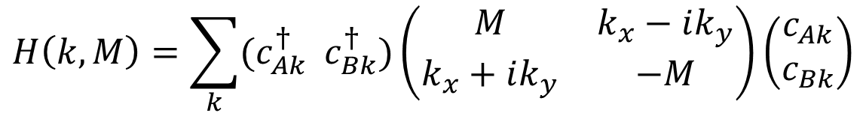




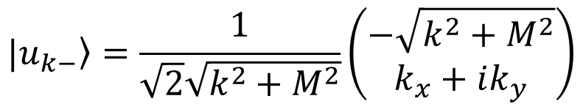

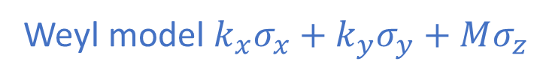
Dirac Hamiltonian in solids
Dirac or Weyl model as a low energy effective theory of topological insulators
$$H\left(k,M\right)=\sum_{k}{(c_{Ak}^{†} c_{Bk}^{†})}\left(\begin{matrix}M & k_{x}−ik_{y} \\ k_{x}+ik_{y} & −M\end{matrix}\right)\left(\begin{matrix}c_{Ak} \\ c_{Bk}\end{matrix}\right)$$
Two sublattices,
two orbitals, etc
Weyl model $k_{x}σ_{x}+k_{y}σ_{y}+Mσ_{z}$
Conduction band $E\left(k\right)=\sqrt{k^{2}+M^{2}}$
Periodic part of Bloch state
$$k$$
$$\left.|u_{k−}\right\rangle =\frac{1}{\sqrt{2}\sqrt{k^{2}+M^{2}}}\left(\begin{matrix}−\sqrt{k^{2}+M^{2}} \\ k_{x}+ik_{y}\end{matrix}\right)$$
$$0$$
$$2π$$
Valance band $E\left(k\right)=−\sqrt{k^{2}+M^{2}}$

Slide 11
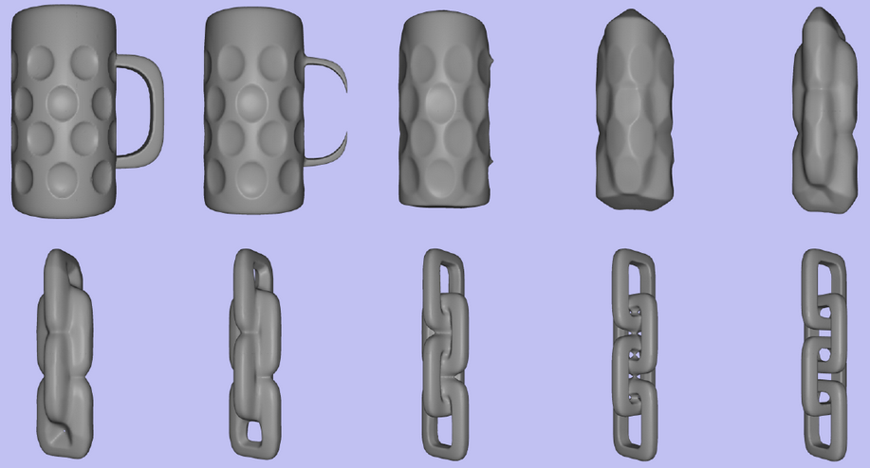
Topological phase transitions in daily life
TPT
TPT
TPT

Slide 12
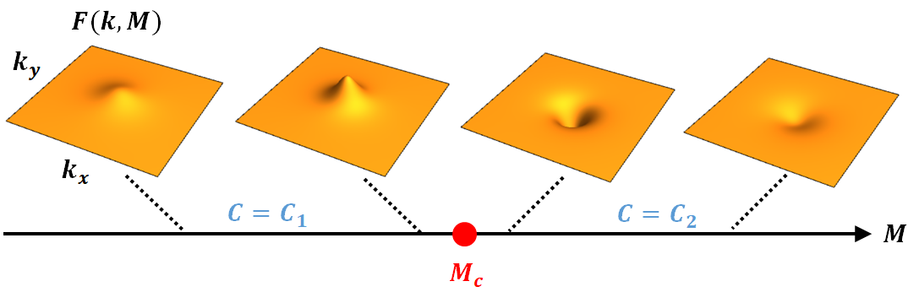
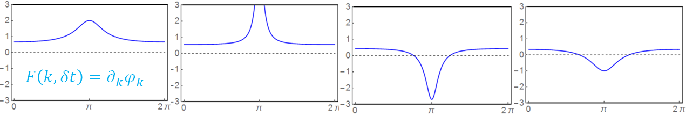


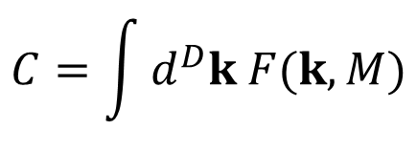


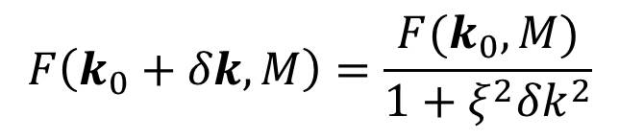
Topological phase transitions in solids
The discrete jump of topological order caused by tuning some parameter $M$ defines a TPT
$$C=\int{d^{D}k F(k,M)}$$
$$C=1$$
$$C=0$$
$$M$$
“Curvature function”
$$M_{c}$$
Generally, the curvature function develops a singularity at HSP as approaching TPT
Ornstein-Zernike form
$$F\left(k_{0}+δk,M\right)=\frac{F(k_{0},M)}{1+ξ^{2}{δk}^{2}}$$

Slide 13
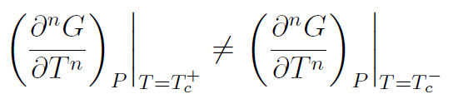
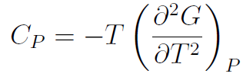
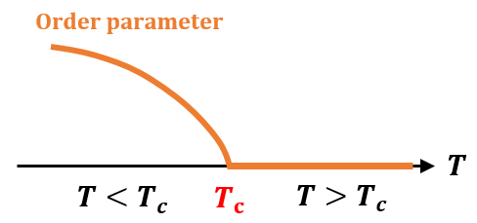


Statistical mechanics of phase transitions
Ehrenfest classification
Second-order phase transition
Local Order parameter
Correlation function

Slide 14
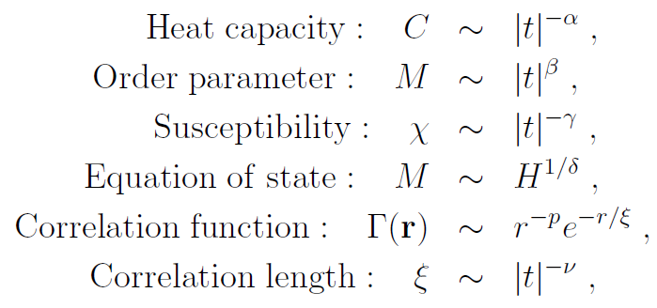

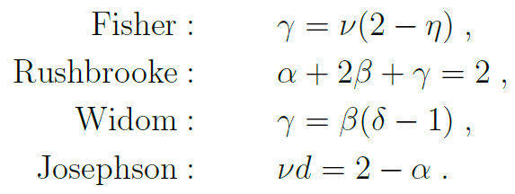
Statistical mechanics of phase transitions
Critical exponents
Scaling laws

Slide 15

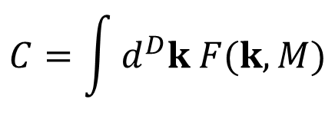



Do we have the same things for topological phase transitions?
$$C=\int{d^{D}k F(k,M)}$$
$$C=1$$
$$C=0$$
$$M$$
“Curvature function”
$$M_{c}$$
Given that topological phase transition is a quantum phase transition at $T=0$
Ehrenfest classification: Not sure
Second-order phase transition: By wave function or entanglement entropy
Local Order parameter: Nope
Correlation function: Yes!

Slide 16
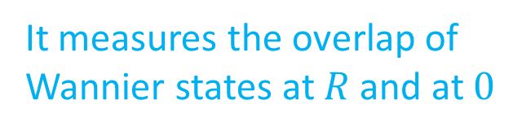




Wannier state correlation function
Statement: Fourier transform of curvature function gives a correlation function
$$λ_{R}=\int{dk}F\left(k,M\right)e^{ikR}=\int{dk}\left\langle u_{k} | i∂_{k} | u_{k}\right\rangle e^{ikR}=\left\langle R | r | 0\right\rangle =\int{dr}W^{∗}\left(r−R\right) r W(r)$$
$$W(r)$$
$$W(r−R)$$
It measures the overlap of
Wannier states at $R$ and at $0$
$$0$$
$$R$$

Slide 17
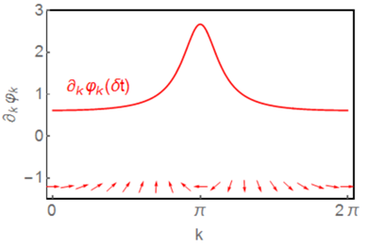
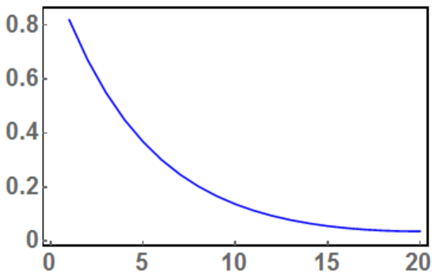




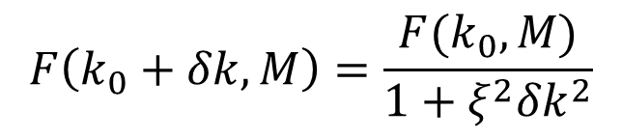



Correlation length
The Ornstein-Zernike form in k-space
$$F\left(k_{0}+δk,M\right)=\frac{F(k_{0},M)}{1+ξ^{2}{δk}^{2}}$$
$$1/ξ$$
$$F\left(k,M\right)$$
Exponentially decayed
Correlation function
in real space
$${ λ}_{R}=\left\langle R | r | 0\right\rangle ∝e^{−R/ξ}$$
$$k$$
Close to $M_{c}⇒$ large $ξ$ $⇒$ Extended Wannier state
$${ λ}_{R}$$
Far from $M_{c}⇒$ small $ξ$ $⇒$ Localized Wannier state
$$ξ$$
$$R$$

Slide 18
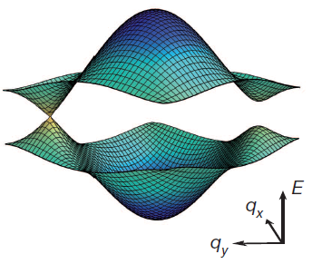

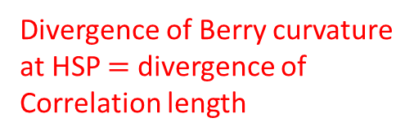
Measuring Berry curvature in cold atoms
Engineering topological models
by cold atoms (Haldane, SSH, etc)
Measure Berry curvature by
momentum space interferometry
or anomalous velocity
Divergence of Berry curvature
at HSP $=$ divergence of
Correlation length
2D: Berry curvature
$$F\left(k,M\right)=∇_{k}×\left\langle u_{k} | i∇_{k} | u_{k}\right\rangle$$
Bloch (Munich), Esslinger (ETH), etc

Slide 19
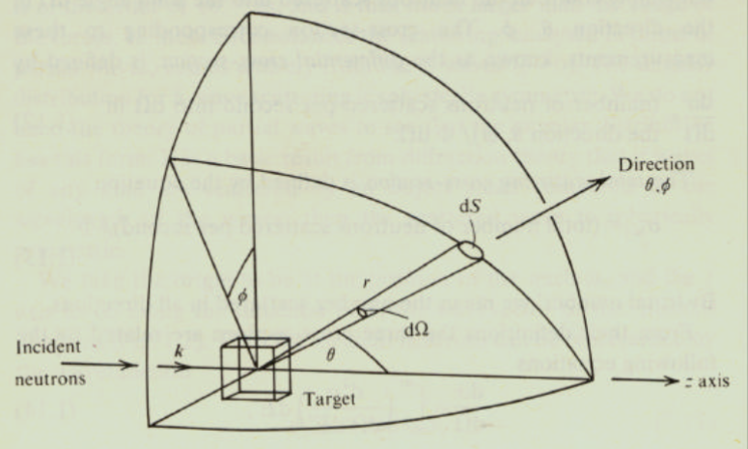



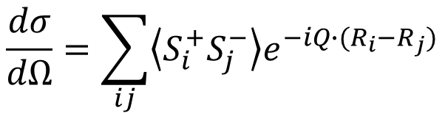
A new type of “topological” spectrascopy
Landau order parameter
Spin-spin correl. fn.
Elastic neutron scattering
Fourier Trans.
$$\left\langle S_{i}^{+}S_{j}^{−}\right\rangle$$
$$\frac{dσ}{dΩ}=\sum_{ij}{\left\langle S_{i}^{+}S_{j}^{−}\right\rangle e^{−iQ∙(R_{i}−R_{j})}}$$
Topological order
Wannier state correl. fn.
Cold atom interferometry
Fourier Trans.
$$λ_{R}=−i\left\langle R\left|(R×r)\right|0\right\rangle$$
$$F\left(k,M\right)=∇_{k}×\left\langle u_{k}|i∇_{k}|u_{k}\right\rangle$$

Slide 20

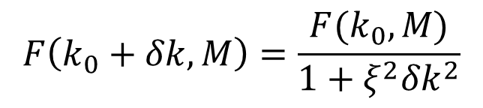



Critical exponents
Defining a length scale from curvature function
near the gap-closing momentum
$$1/ξ$$
Ornstein-Zernike form
$$F\left(k_{0}+δk,M\right)=\frac{F(k_{0},M)}{1+ξ^{2}{δk}^{2}}$$
$$F(k_{0},M)$$
$$ξ∝{|{M−M}_{c}|}^{−1}$$
$$F(k_{0},M)∝{|{M−M}_{c}|}^{−1}$$

Slide 21
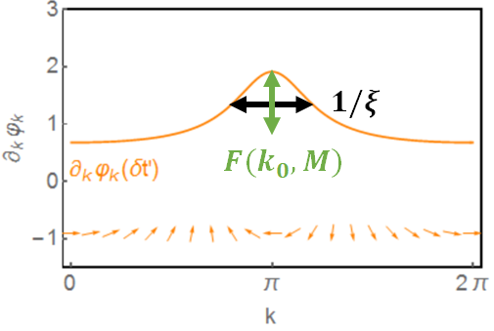
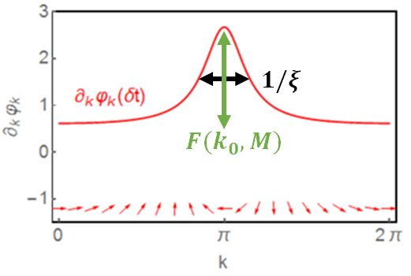
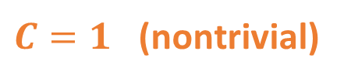


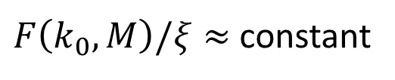

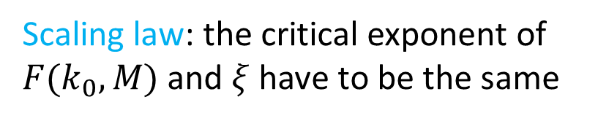
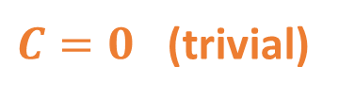
Scaling laws
$C=1$ (nontrivial)
$C=0$ (trivial)
$$δt$$
$${δt}_{c}$$
The area under the divergence
remains a constant
Scaling law: the critical exponent of
$F(k_{0},M)$ and $ξ$ have to be the same
$F\left(k_{0},M\right)/ξ≈$ constant
$$F(k_{0},M)∝ξ∝{|{M−M}_{c}|}^{−α}$$

Slide 22
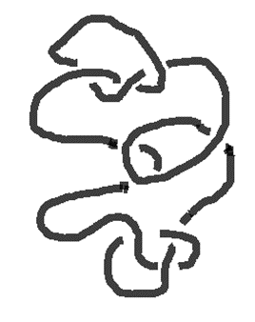
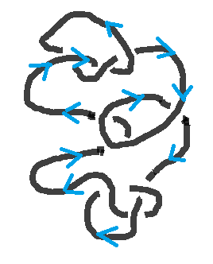

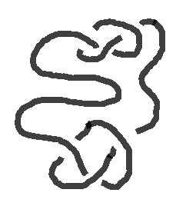
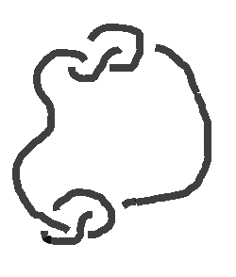



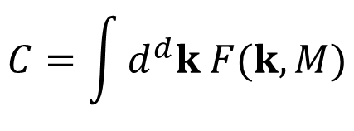




Introducing “curvature renormalization group” approach
First way: Integrating out the curvature to get the topological invariant
$$C=1$$
$$C=\int{d^{d}k F(k,M)}$$
$$C=0$$
$$M$$
$$M_{c}$$
“Curvature function”
Second way: stretch the string until the knots become obvious
Curvature function at high symmetry point $k_{0}$ at the new $M^{′}$
stretch
stretch
$$F\left(k_{0},M^{′}\right)=F(k_{0}+δk,M)$$
Curvature function slightly away from $k_{0}$ at the old $M$
$$M$$
$$M_{c}$$
$$M_{f}$$

Slide 23









The simplest model: 1D spinless Su-Schrieffer-Heeger model
$$H=\sum_{i}{\left(t+δt\right)c_{Ai}^{†}c_{Bi}+(t−δt)c_{Ai+1}^{†}c_{Bi}}+h.c.$$
$$t+δt$$
$$t−δt$$
A
B
The Hamiltonian is off-diagonal
$$H_{k}=\left(\begin{matrix}0 & h_{k} \\ h_{k}^{†} & 0\end{matrix}\right)$$
$$H_{k}|\left.u_{k}\right\rangle =E_{k}|\left.u_{k}\right\rangle$$
Polyacetylene
$$h_{k}=\left(t+δt\right)+\left(t−δt\right)e^{−ik}=|h_{k}|e^{−iφ_{k}}$$
The topological invariant is calculated from the “curvature function” (Berry connection in 1D)
$$C=\int_{0}^{2π}{\frac{dk}{2π}\left\langle u_{k} | i∂_{k} | u_{k}\right\rangle }=\int_{0}^{2π}{\frac{dk}{2π}∂_{k}φ_{k}}$$
$=\left\{\begin{aligned}0 Topologcally trivial \\ 1 Topologically nontrivial\end{aligned}\right.$
$$0$$
$$φ_{k}$$
$$2π$$

Slide 24











Using scaling to identify topological phase transitions in SSH model
$$F\left(k_{0},M^{′}\right)=F(k_{0}+δk,M)$$
$$∂_{k}φ_{k}\left(δt^{′}\right)|_{k=k_{0}}=∂_{k}φ_{k}\left(δt\right)|_{k=k_{0}+δk}$$
Defining $δt^{′}−δt=dδt$, and ${(δk)}^{2}=dl$, direct expansion gives the RG equation
$$\frac{dδt}{dl}=\frac{t^{2}}{4δt}\left(1−\frac{{δt}^{2}}{t^{2}}\right) if k_{0}=π$$
Fixed point
Critical point
Fixed point
$$δt$$
$$−t$$
$$0$$
$$t$$
$C=1$ (nontrivial)
$C=0$ (trivial)
$$δt$$
$${δt}_{c}=0$$

Slide 25









Why does scaling work: It’s like stretching a string
Topologically nontrivial phase

Slide 26


Summary
W. Chen, JPCM 28, 055601 (2016)
W. Chen, M. Sigrist, A. P. Schnyder, JPCM 28, 365501 (2016)
Topological invariant $=\int{d^{D}k F(k,M)}$
W. Chen, et al, PRB 95, 075116 (2017)
S. Kourtis, et al, PRB 95, 075116 (2017)
Generic critical behavior: $F\left(k_{0}+δk,M\right)=\frac{F(k_{0},M)}{1+ξ^{2}{δk}^{2}}$
W. Chen, PRB 97, 115130 (2018)
P. Molignini, W. Chen, and R. Chitra, arXiv:1805.09698
Correlation function $=\int{d^{D}k F(k,M)}e^{ik∙R}∝e^{−R/ξ}$
A scaling law constraints the critical exponents of $ξ$ and $F\left(k_{0},M\right)$
Curvature renormalization group approach: $F\left(k_{0},M^{′}\right)=F(k_{0}+δk,M)$
The universality class is determined by orbital symmetry of the system
These statements are true for:
Noninteracting models in any dimension and any symmetry class
(Kitaev, Kane-Mele, SSH, Haldane, Bernevig-Hughes-Zhang, chiral SC…)
Interacting models solved by Green’s functions
Interacting models solved by twisted boundary condition
Floquet systems

Slide 27
Summary
Correlation function

Slide 28
Renormalization group approach: Landau order parameter

Slide 29
Renormalization group approach: topological order

