Slide 1

Welcome to all on behalf of the organizing committee
Domenico Sapone, Jorge Noreña, Jeff Newman, Michael Strauss, Luiz da Costa and Rogerio Rosenfeld

Slide 2
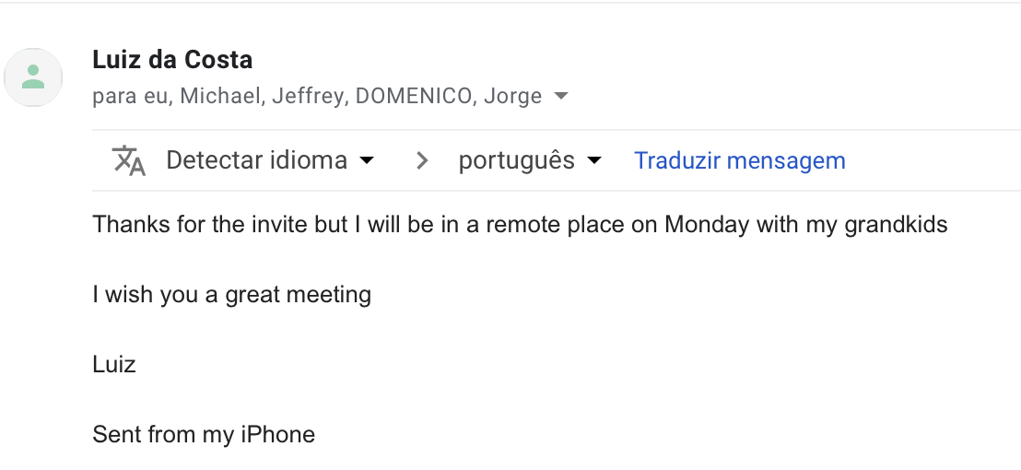
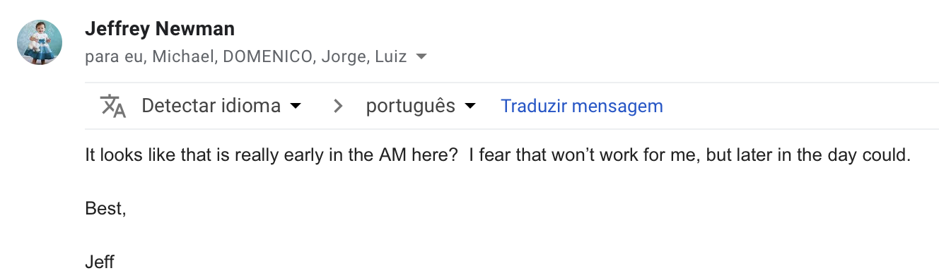
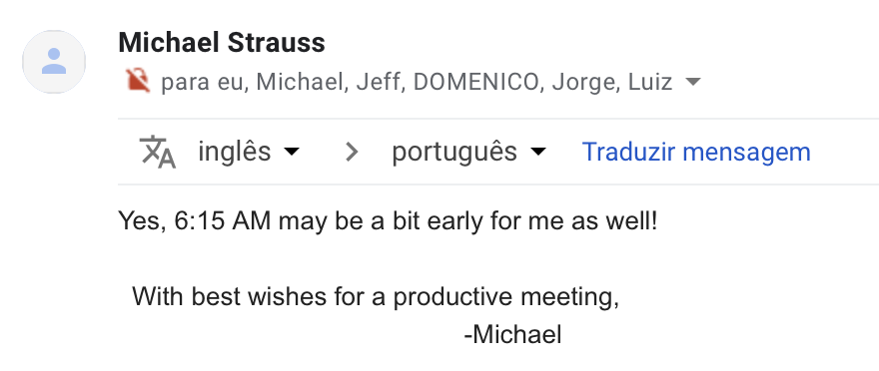

Slide 3
What is ICTP-SAIFR and IFT-UNESP?
Motivation of the workshop:
participation of South American based scientists in international collaborations for cosmology such as eBOSS, DES, DESI, J-PAS, LSST, Euclid (also Auger, CTA, Alma, Llama, Bingo, …)
discuss the challenges for precision cosmology
Format of the workshop: talks + posters + wrap-up sessions
Hope to foment discussions and collaborations
Ends at ~5pm but there are spaces available for discussions that can be used during and after the talks – encouraged to stay and work!
There can also be tutorials after the sessions: Core Cosmology Library (Krause), NaMaster (Alonso), …

Slide 4
Infrastructure
Jandira (executive secretary) and Humberto (secretary)
Internet: Eduroam, Auditorio (JornadasIFT2015)
Lockers available
Desks in the first floor and office #108
T-shirts
Official photograph will be taken in the 1st coffee break on Tuesday
Send your talks to isabela.pereira@ictp-saifr.org to be posted in the webpage
Dinner on Wednesday
Pre-reservation at Consulado da Bahia. Cost estimated at ~R$150. Please sign up by the end of today!

Slide 5

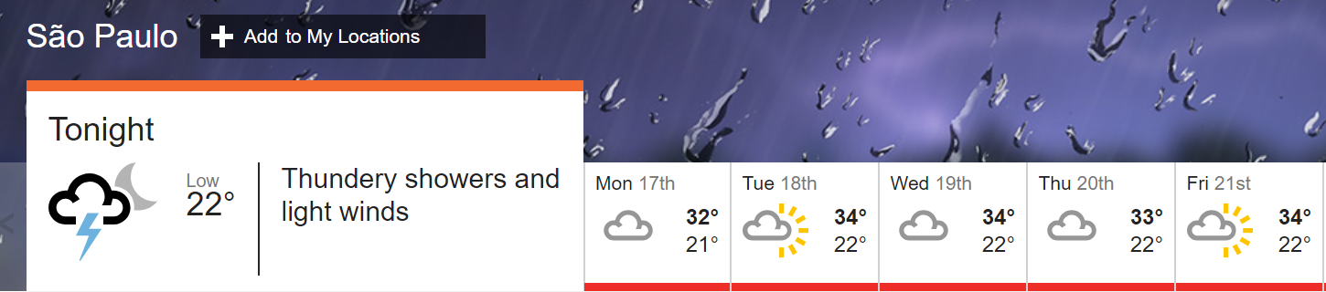
Weather: Summer is here!
Hot, with thunderstorms towards the end of the day
Drink lots of water! Fountains near the elevator.

Slide 6
Enjoy the workshop!

