Slide 1





Nucleon structure studies with the PANDA experiment at FAIR
Frank Maas
ICTP-SAIFR/FAIR Workshop on Mass Generation in QCD
Sao Paolo, 26 February 2019
Helmholtz Institute Mainz
Johannes-Gutenberg University Mainz

Slide 2
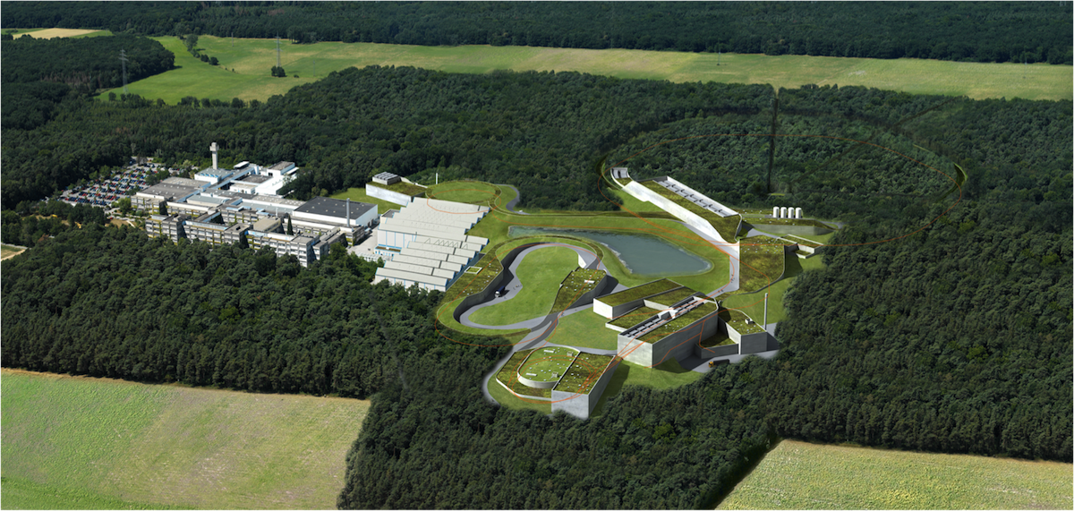


Facility for Antiproton and Ion Research - FAIR
(Darmstadt/Germany)
APPA
ions, antiprotons
  CBM
  relativistic nuclear collisions
PANDA
antiproton beams
NUSTAR
radioactive ion beams
Darmstadt, Germany

Slide 3
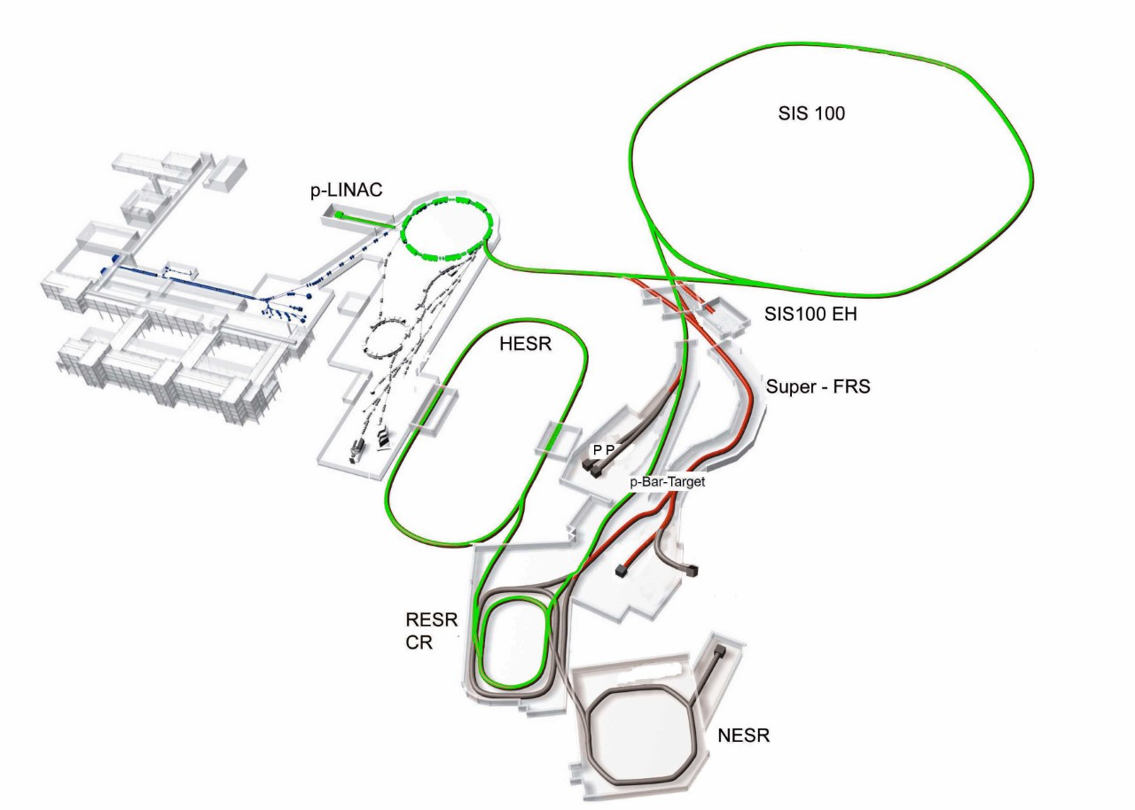

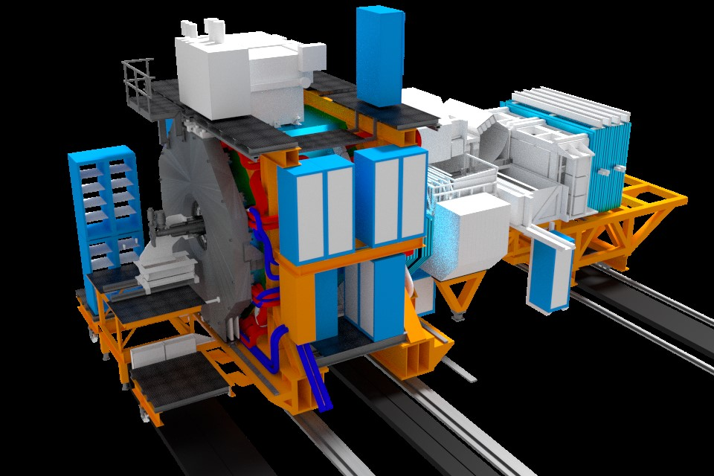
Facility for Antiproton and Ion Research - FAIR
29 GeV protons
High Energy Storage Ring
Antiproton beam momenta in the range of 1.5 GeV/c – 15 GeV/c
High momentum resolution
Luminosity up to 2.10³² cm⁻² s⁻¹
FAIR Start Version: Luminosity 10³¹cm⁻² s⁻¹
Internal target (pbar-p, pbar-A): cluster jet / pellet target; high density 4x10¹⁵ cm⁻²

Slide 4
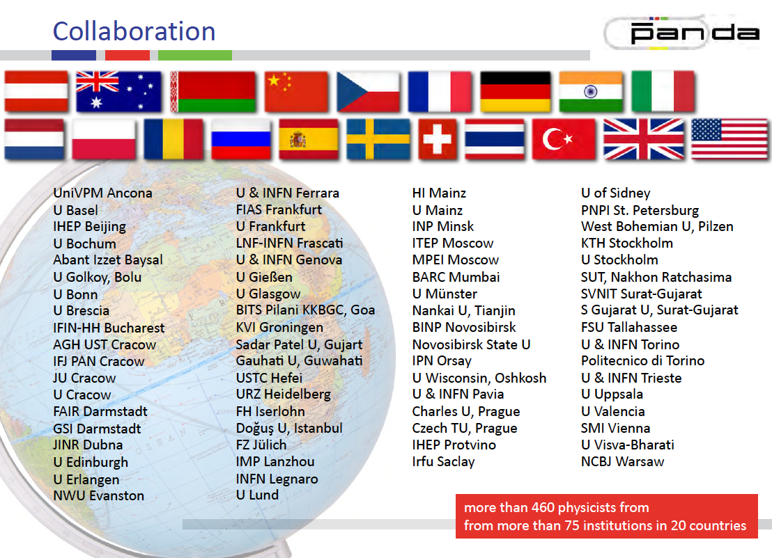
The PANDA experiment at FAIR

Slide 5
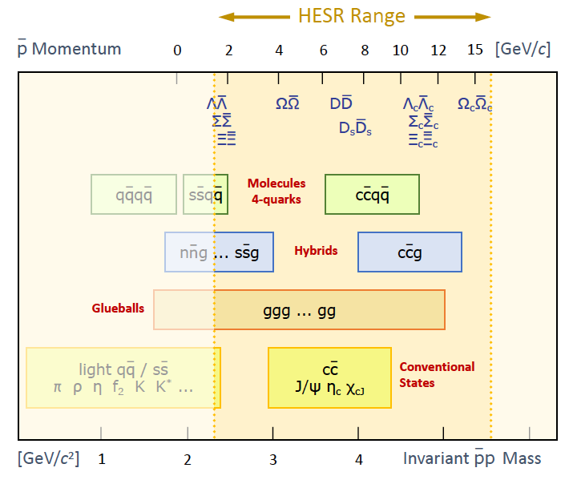
The PANDA experiment at FAIR
GeV
Hadron Spectroscopy
– Charmonium
– Light mesons, baryons
– Open charm
– QCD exotics: glueballs,
hybrid states, X,Y,Z-states,…
Hypernuclear physics
Hadrons in the nuclear medium
Nucleon structure

Slide 6

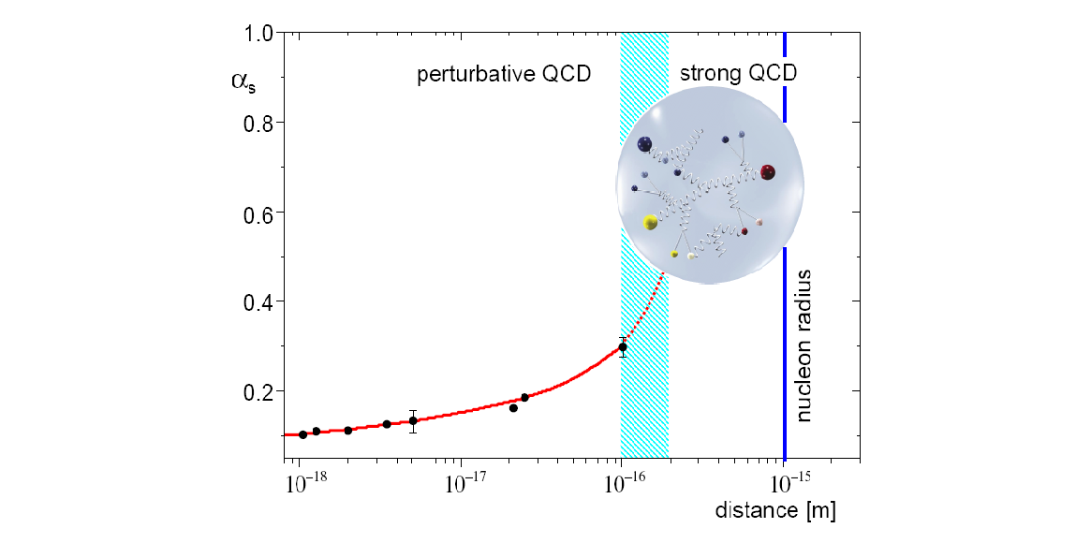
Study of the Hadron Structure
Hadrons: non-perturbative systems
Their electromagnetic interactions can be
described by long distance functions:
  Electromagnetic form factors,
  Parton Distribution Amplitudes,
  Fragmentation Functions,
  Generalized Parton Distributions,
  …..
By a global analysis of scattering and annihilation experiments one can determine these functions and understand the hadron structure
Crossing channels: - different kinematical regions
- observables are counterparts

Slide 7
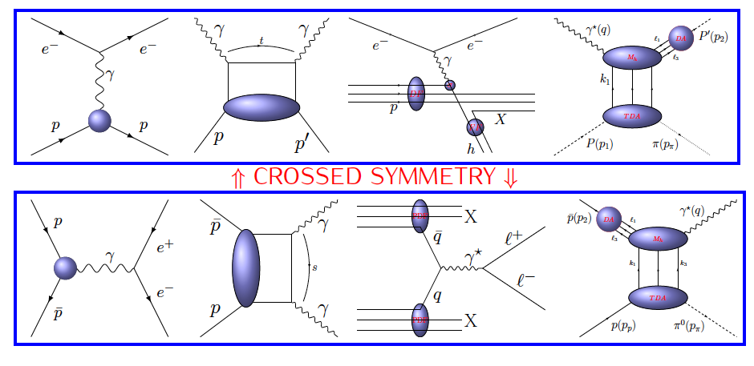
Study of the Nucleon Structure at PANDA
Proton Electromagnetic Form Factors (FFs)
Generalized Distribution Amplitudes (GDAs)
Transverse Momentum Dependent Parton Distribution Functions (TMD-PDFs)
Transition Distribution Amplitudes (TDAs)

Slide 8
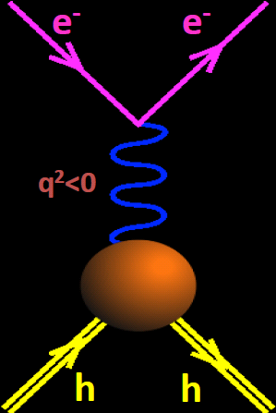
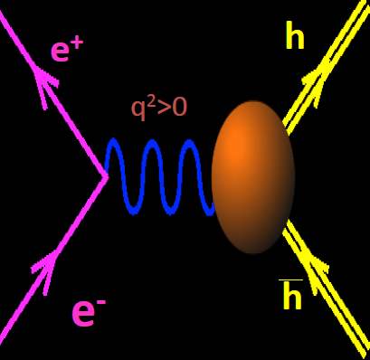
Electromagnetic Form Factors of the Proton
Annihilation:Time-Like region
Unphysical region
e⁺
Scattering
p
p
e⁻
_
FFs are real
FFs are complex
Space-Like region
0
q²
Electric G_{E} and magnetic G_{M} proton FFs are analytical functions
of the momentum transfer squared q²
Playground for theory and experiment:
- at low q², probe the size of the nucleus,
- at high q², test QCD scaling

Slide 9

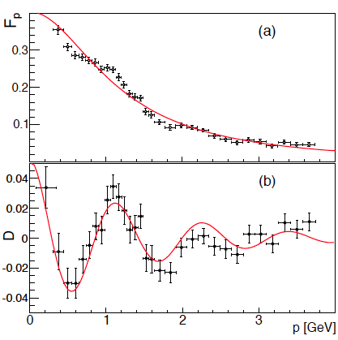
World data on the time-like (effective) proton form factor
Phys. Rev. Lett. 114,232301 (2015)
|G_{E}|=|G_{M}|
BaBar 2013 Data
  PRL 114 (2015) 232301
    Structures seen in BaBar data
    Interference effect from rescattering processes in the final states.
    Phys. Rev. Lett. 114,232301 (2015)
    Independent resonant structures
Phys. Rev. D 92, 034018 (2015)

Slide 10
World data on the time-like (effective) proton form factor
Vector Meson Dominance (VMD)
F. Iachello, PRC 69, 055204 (2004)
  QCD inspired parametrization
Phys. Rev. C 93, 035201 (2016)
Unphysical
region
|G_{E}|=|G_{M}|
Phys. Rev. C 75, 045205 (2007)
Notes:
VMD definition

Slide 11
World data on the time-like proton form factor ratio
R=|G_{E}|/|G_{M}|
@ BaBar (SLAC):
data collection over wide energy range
@ PS 170 (LEAR):
data collection at low energies
Data from BaBar & LEAR show different trends
@ BESIII:
Measurement at different energies
Uncertainties comparable to previous experiments
@ CMD-3 (VEPP2000 collider, BINP):
Energy scan
Uncertainty comparable to the existing data
BaBar: Phys. Rev. D88 072009
LEAR: Nucl.Phys.J., B411:3-32. 1994
BESIII: arXiv:1504.02680. 2015
CMD-3: arXiv:1507.08013v2 (2015)

Slide 12
World data on the time-like proton form factor ratio
R=|G_{E}|/|G_{M}|
@ BaBar (SLAC):
data collection over wide energy range
@ PS 170 (LEAR):
data collection at low energies
Data from BaBar & LEAR show different trends
@ BESIII:
Measurement at different energies
Uncertainties comparable to previous experiments
@ CMD-3 (VEPP2000 collider, BINP):
Energy scan
Uncertaincy comparable to the measurement by BaBar
More data needed with high precision!
Test of the theory, also at high q²
Data with high statistics increase the precision of Form Factors
Existing data were obtained with electron channels
PANDA: Measurement over wide range of q² with high precision
BaBar: Phys. Rev. D88 072009
LEAR: Nucl.Phys.J., B411:3-32. 1994
BESIII: arXiv:1504.02680. 2015
CMD-3: arXiv:1507.08013v2 (2015)

Slide 13
Time-like electromagnetic proton form factors
@ PANDA: The goals
Form factor measurements different final states:
  First time measurement with muons in final state
  Study of radiative corrections
  Consistency check of proton form factor data
Possibility to access the relative phase of proton time-like form factors:
  in the Born approximation:
    Unpolarized cross section -> access to |G_{E}| & |G_{M}|
    Polarization observables -> access to relative phase G_{E}G_{M}*:
Single spin polarization observable
    Development of a transverse polarized target for PANDA in Mainz
A. Z. Dubnickova, S. Dubnicka & M.P. Rekalo Nuovo Cim. A109 (1996) 241-256
with

Slide 14
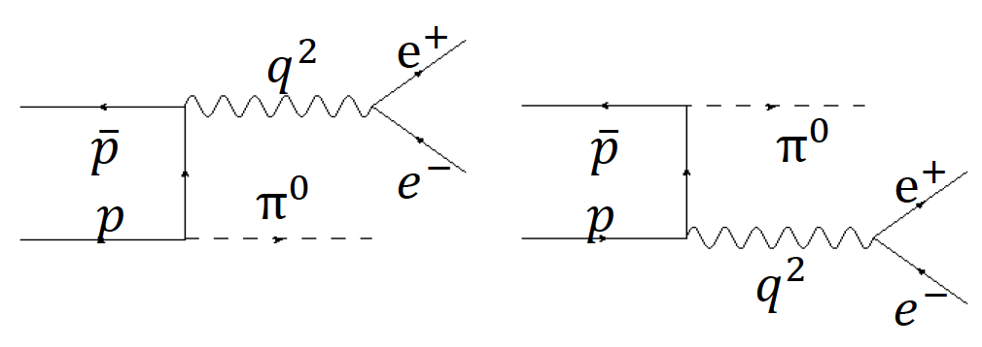
Time-like electromagnetic proton form factors
@ PANDA: The goals
Access the unphysical region (R=|G_{E}|/|G_{M}| and relative phase between G_{E} and G_{M}) :
Measurement of time-like proton form factors over wide range of q² @ PANDA
  Study the asymptotic behavior of the form factors
Strong hadronic background, mainly
M. P. Rekalo, Sov. J. Nucl. Phys. 1 (1965) 760
C. Adamuscin, E.A. Kuraev, E. Tomasi-Gustafsson and F.E. Maas, Phys. Rev. C 75, 045205 (2007)
Feasibility studies by
  J. Boucher, M. C. Mora-Espi; PhD thesis
Phys.Rev. C95 (2017) no.4, 045202
Phys.Rev. C96 (2017) no.2, 025204
E.W. Singh et al.: EPJA52, 325 (2016)
Good background rejection (~10⁻⁸ ) necessary
Feasibility studies needed
for both signal channels!

Slide 15
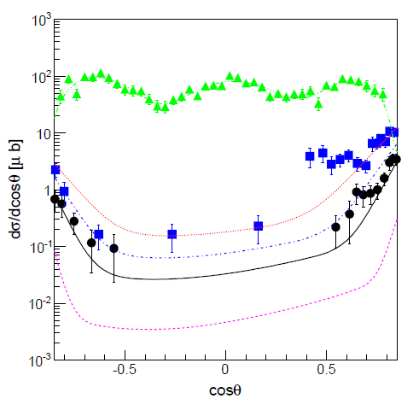
Feasibility studies: time-like proton form factors @ PANDA
Simulation & Analysis: Background studies
New event generator developed by Mainz group (M. Zambrana et al.)
Based on two different parametrizations
p_{beam}= 1.7 GeV/c
p_{beam}= 5.0 GeV/c
P_{beam}= 6.21 GeV/c
10⁸ events generated at each energy point
J. Van de Wiele and S. Ong: EPJA46, 291-298 (2010)
M. Sudol et al.: EPJA44, 373 (2010)
E.W. Singh et al.: EPJA52, 325 (2016)

Slide 16
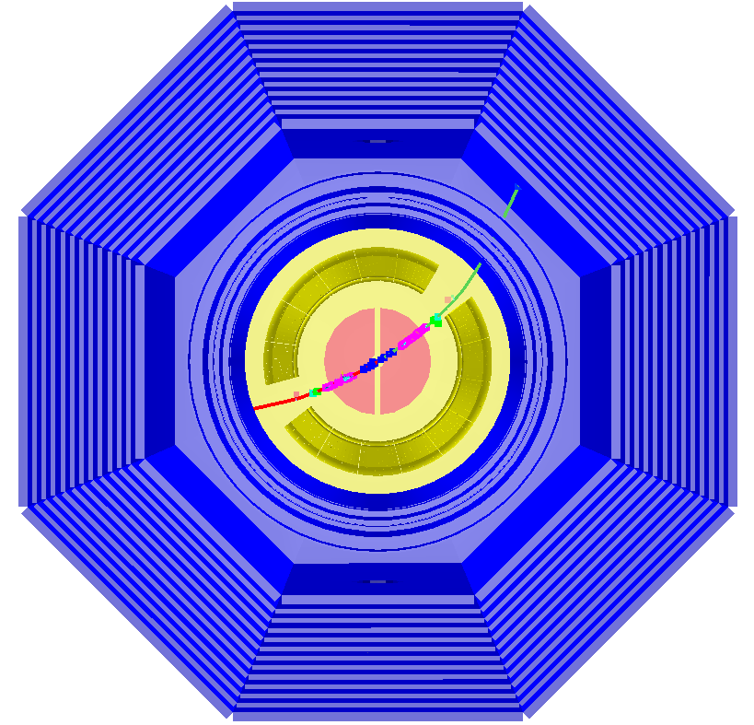
Feasibility studies: time-like proton form factors @ PANDA
Monte Carlo Simulation Studies
Standard chain
Simulation & Analysis
with PANDARoot:
Event selection:
Preselection: One positive and one negative particle per event
Cuts on kinematical variables:
Production angles (back-to-back in center-of-
mass system), & Invariant Mass.
Signal/Background separation based on:
  For e⁺e⁻ : Different subdetector information like Electromagnetic Calorimeter, Straw Tube Tracker etc. contribute to particle identification
  For µ⁺µ⁻ : Boosted Decision trees + cuts
  Detector information MAINLY from Muon Range System
Event generation
Digitization
Reconstruction
Particle Identification
Event Analysis

Slide 17
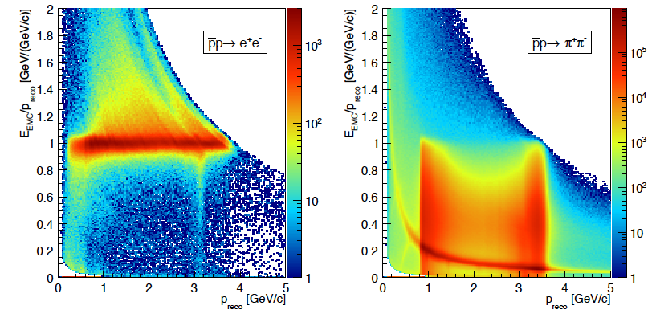
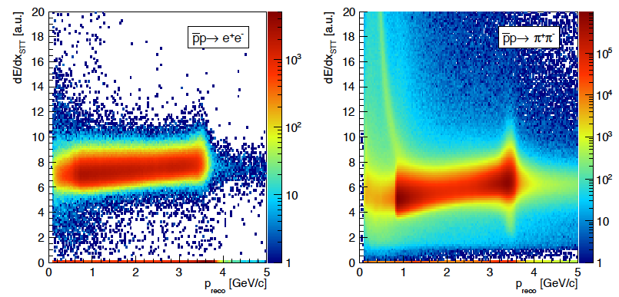
A) Feasibility studies: time-like proton form factors @ PANDA
Signal efficiency & Background rejection
Electromagnetic Calorimeter
PID variables from the EMC, STT, DIRC, MVD → PID probability PID_{e}>0.99
Signal efficiencies between 39% and 51%
Background rejection ~ 10⁻⁸
Signal pollution < 1%
Straw Tube Tracker

Slide 18
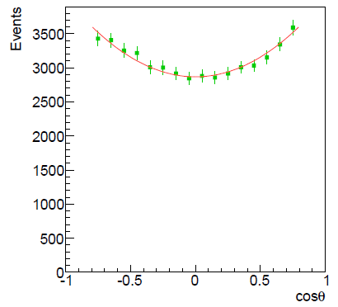
Feasibility studies: time-like proton form factors @ PANDA
The results
Efficiency corrected events
Precision on R=1, L= 2 fb⁻¹
q² [(GeV/c)²] | 5.4 – 14
∆R/R | 3.3 % - 57%
The eff. FF can be measured
up to q2 ~30 GeV²

Slide 19
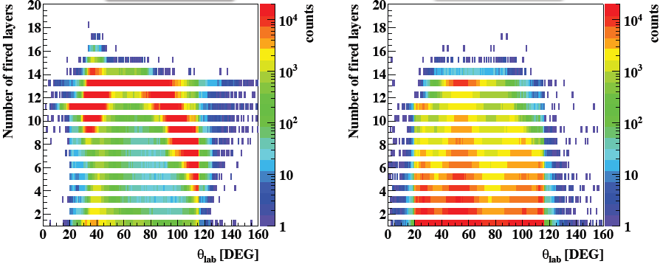
B) Feasibility studies: time-like proton form factors
@ PANDA for
Muon System
Only Muon System provides powerful variables
Signal/Background separation using simple cuts, typically expected S:B ratio too small: 1:50 – 1:70
Enhanced data classification needed
  Analysis based on Boosted Decision Trees & Cuts

Slide 20
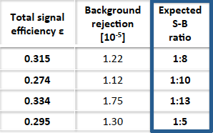

Feasibility studies: time-like proton form factors @ PANDA
The results
Precision on R=1, L= 2 fb⁻¹
q² [(GeV/c)²] | 5.1 – 8.2
∆R/R | 5.0 % - 37%
Systematic uncertainties
Luminosity measurement: ΔL/L~4%
Choice of cuts
Choice of histogram bin width
Δσ/σ: 4.1% - 4.9%
Δ|G_{eff}|/|G_{eff}|: 2.03% - 2.44%

Slide 21
Feasibility studies: time-like proton form factors @ PANDA
Phases 1,2,3
R=|G_{E}|/|G_{M}|
Phase-1,2 (L=10³¹ cm⁻² s⁻¹)
pbarp → e⁺e⁻ @1.5 GeV/c ~ 220 /day
pbarp → e⁺e⁻ @3.3 GeV/c ~ 10/day
∆R/R: 4-26%, Δ|G_{eff}|/|G_{eff}|: 2.5% (stat.+syst.)
pbarp → μ⁺μ⁻ @1.5 GeV/c ~ 170/day
∆R/R: 21%, Δ|G_{eff}|/|G_{eff}|: 2.5% (stat.+syst.)
pbarp → e⁺e⁻π⁰ @1.5 GeV/c ~ 3,5k/day
PANDA P1,2
PANDA P3
BESIII
NO competition for first muon pair study
Also first access to unphysical region

Slide 22
Hard exclusive processes at PANDA

Slide 23
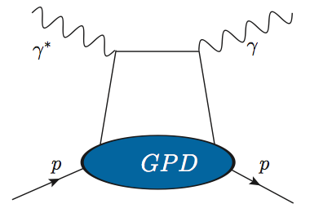
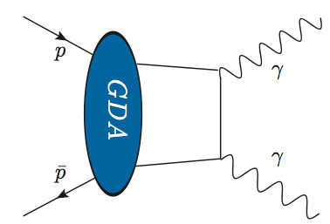
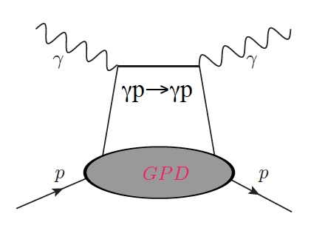
From GPDs to GDAs and TDAs
t <-> s channels
GPDs <-> GDAs
Data on GPDs from HERMES, COMPASS, JLAB, …
GDAs
Fermilab ppbar→γπ⁰ data [8.5 – 13.6] GeV²
Belle, CLEO,… γγ→ppbar data below 16 GeV²
Precise data at higher energies and with different processes are needed
PANDA: ppbar→γγ, γΜ (Μ=π^{0,},η,ρ⁰,φ)
Time-Like Wide Angle Compton Scattering Generalized Distribution Amplitudes GPDs
Wide Angle Compton Scattering
Generalized Parton Distributions GPDs

Slide 24
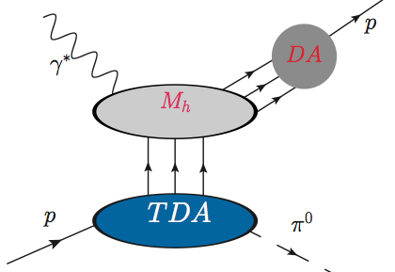
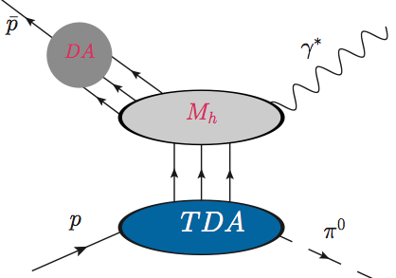
From GPDs to GDAs and TDAs
t <-> s channels
GPDs <-> GDAs
Data on GPDs from HERMES, COMPASS, JLAB, …
GDAs
Fermilab ppbar→γπ⁰ data [8.5 – 13.6] GeV²
Belle, CLEO,… γγ→ppbar data below 16 GeV²
Precise data at higher energies and with different processes are needed
PANDA: ppbar→γγ, γΜ (Μ=π^{0,},η,ρ⁰,φ)
TDAs
No data yet on TDAs !
Test of TDA universality with different process is needed
JLAB
COMPASS
EIC
TDAs for proton and antiproton !

Slide 25
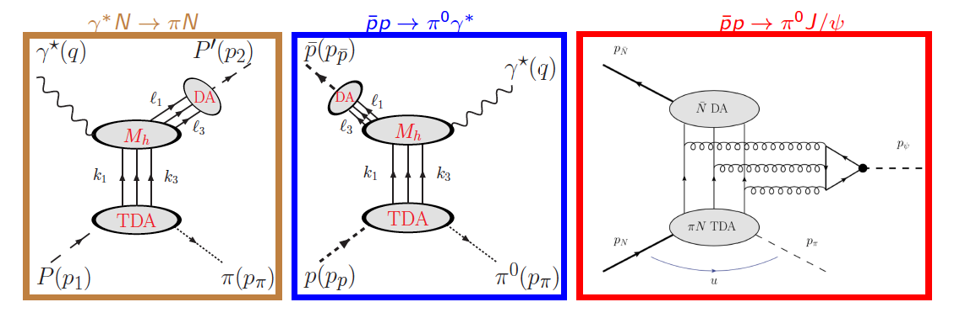

Nucleon to meson TDAs
New class of non-perturbative structure functions
Occur in collinear factorization description of various hard exclusive processes
Are independent of reaction type, s and q²
Give information on pionic components of the nucleon wave-function

Slide 26

Nucleon to meson TDAs at PANDA
( this process never been measured)
  Hard scale: large q²~s
t is small (forward kinematics)
u is small (backward kinematics)
J. P. Lansberg et al., Phys Rev D 76, 111502(R) (2007)
Feasibility studies of measuring at PANDA
Background suppression of the [σ(𝜋⁺𝜋⁻𝜋⁰ )/σ(e⁺e⁻𝜋⁰)~10⁶ ]:
Luminosity= 2 fb⁻¹
s = 5 GeV²: 5 . 10⁷ at low q² (1 . 10⁷ at high q² )
s = 10 GeV²: 1 . 10⁸ at low q² (6 . 10⁶ at high q² )
Eur.Phys.J. A51 (2015) 8, 107

Slide 27
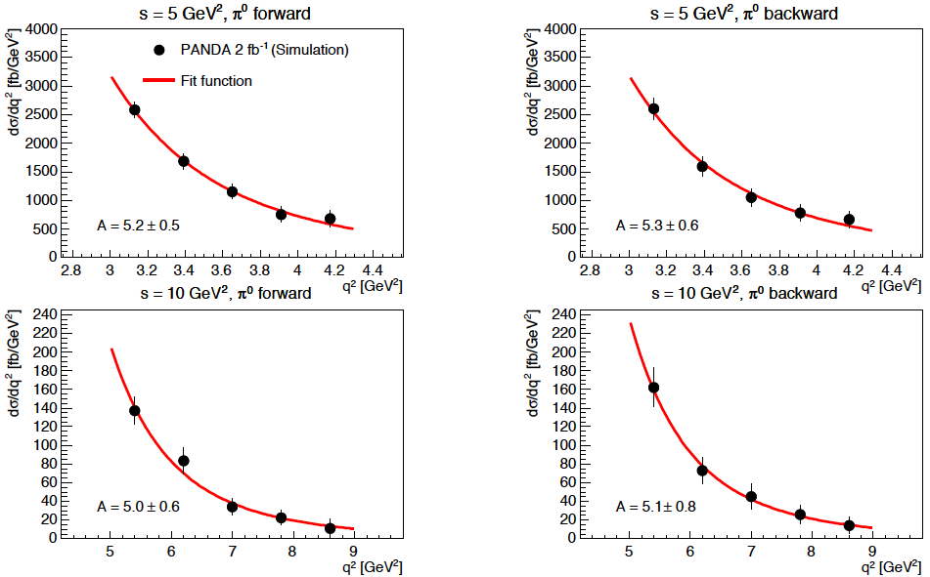
Nucleon to meson TDAs at PANDA
Fit measured cross section and measure scaling component A (A=5)
→Test QCD factorization
L=2 fb⁻¹
Eur.Phys.J. A51 (2015) 8, 107
L=2 fb⁻¹

Slide 28
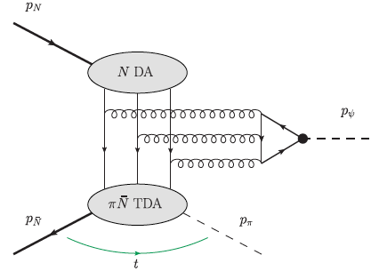
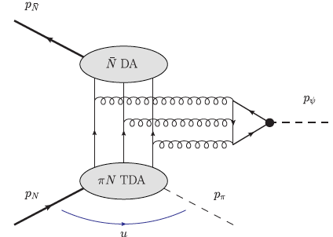
Nucleon to meson TDAs at PANDA
t is small (forward kinematics)
u is small (backward kinematics)
B. Pire et al., Phys. Lett. B. 724 99-107 (2013)
High signal cross section
Large q² fixed to (factorization theorem is likely reached)
Reduces uncertainty on DAs by using the data on the partial decay modes
Complementary measurements: test of universality of TDAs by comparing to
at different q²

Slide 29
Nucleon to meson TDAs at PANDA
Validity ranges of the TDA
model:
t is small (forward kin.)
u is small
(backward kin.)
Background final states:
  Three pion production: 𝜋⁺𝜋⁻𝜋⁰ (B/S~10⁵ - 10⁶)
  Multipion final states (N>3): 𝜋⁰𝜋⁰𝜋⁺𝜋⁻, 𝜋⁰𝜋⁺𝜋⁻𝜋⁺𝜋⁻ 𝜋⁰ (B/S~3-15)
  Dielectron continuum :𝛾∗𝜋⁰ ->e⁺e⁻𝜋⁰
  Annihilation into 𝜋⁰𝜋⁰𝐽/𝜓
  Hadronic decays of 𝐽/𝜓
Phys. Rev. D 95,
032003 (2017)

Slide 30
Nucleon to meson TDAs at PANDA
Fit funtion:
L=2 fb⁻¹
Phys. Rev. D 95,
032003 (2017)

Slide 31
Hard exclusive processes at PANDA-GDAs
γp→γp
ppbar→γγ
large photon transverse momentum
(hard scale)
QCD factorization
Wide Angle Compton Scattering
Generalized Parton Distributions GPDs
Time-Like Wide Angle Compton Scattering Generalized Distribution Amplitudes GPDs
GDAs can be measured at PANDA with the hard exclusive electromagnetic
processes: ppbar→γγ, γΜ (Μ=π^{0,},η,ρ⁰,φ)
PANDA measurements are complementary to the results from the deeply virtual Compton scattering (DVCS), the deeply virtual meson production (DVMP), the time-like Compton scattering using real photon beams, and lepton-pair production with meson beams.

Slide 32
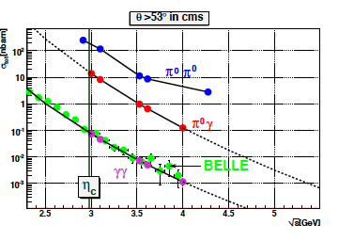
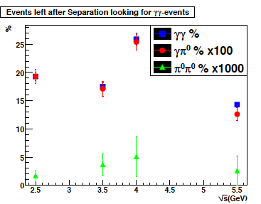
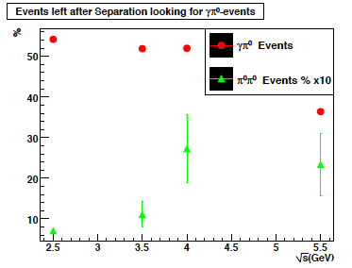
Feasibility studies for GDAs measurement at PANDA
  4 different CM energies
  Main background channels:
(for both signals)
(for signal1: )
PANDA Physics Performance Report
arXiv:0903.3905
Preliminary studies
S/B~2 (50% signal efficiency)
S/B~1 (25% signal efficiency)

Slide 33
  Drell-Yan at PANDA

Slide 34
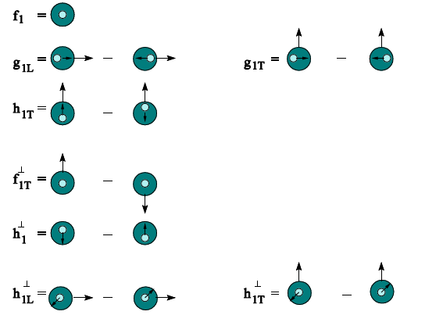
Drell-Yan at PANDA: TMD-PDFs
SIDIS
Data on TMDs are from: HERMES, COMPASS, JLab, RHIC, …: limited kinematical regions and/or precision
TMD measurements requires High luminosity, polarized beams and targets, and large acceptance detectors
PANDA: Boer-Mulders with unpolarized proton-antiproton experiment; Sivers and Transversity with a polarized target
    Systematic advantage with quark-antiquark and protons: sea and valence quark distributions of beam and target are the same
Transversity
Sivers
Boer-Mulders (BM)

Slide 35
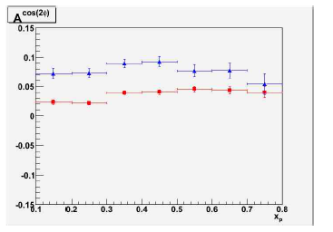
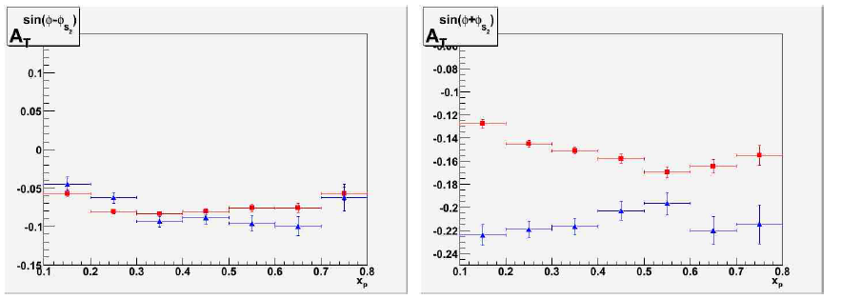
Feasibility measurement of Drell Yan processes at PANDA
Monte-Carlo simulations:
Signal:
Unpolarized DY
Single-polarized DY
Main background:
, required rejection factor ~10⁷
Simulations @ s=30 GeV² and
(large cross section)
Number of simulated events N~5 . 10⁵
PANDA Physics Performance Report
arXiv:0903.3905
Preliminary studies
1≤q_{T}≤2 GeV/c
2≤q_{T}≤3 GeV/c
x_{p}: the longitudinal momentum of the hadronic probe
q_{T}: transverse momentum of the muon pair
A. Bianconi event generator
Phys. Rev. D 71, 074014 (2005)

Slide 36
Feasibility measurement of Drell Yan processes at PANDA
Monte-Carlo simulations:
Signal:
Unpolarized DY
Single-polarized DY
Main background:
, required rejection factor ~10⁷
Simulations @ s=30 GeV² and
(non resonance region, large cross section)
Number of simulated events N~5 . 10⁵
PANDA Physics Performance Report
arXiv:0903.3905
Preliminary studies
Acceptance, efficiency corrections, background rejection are still under investigation: expectation: ~130. 10³ DY/month
Few months of data taking (L=2 . 10³² cm⁻² s⁻¹): precise measurements of the
azimuthal asymmetries are possible
Feasibility studies for measuring Drell Yan processes at PANDA are ongoing
1≤q_{T}≤2 GeV/c
2≤q_{T}≤3 GeV/c
x_{p}: the longitudinal momentum of the hadronic probe
q_{T}: transverse momentum of the muon pair

Slide 37
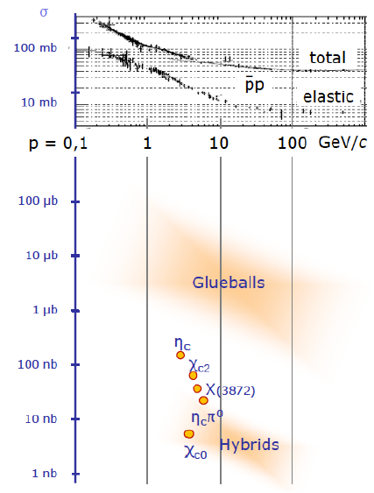
Detector requirements from physics case
~ 4π acceptance
Momentum resolution: 1%
central tracker in magnetic field
Photon detection: 1 MeV - 10 GeV
high dynamic range
good energy resolution
Particle identification: γ, e, μ, π, K, p
Cherenkov detector
time of flight, dE/dx, muon counter
Displaced vertex info
cτ = 317 μm for D±
γβ ≈ 2
Cross section for electromagnetic Processes

Slide 38
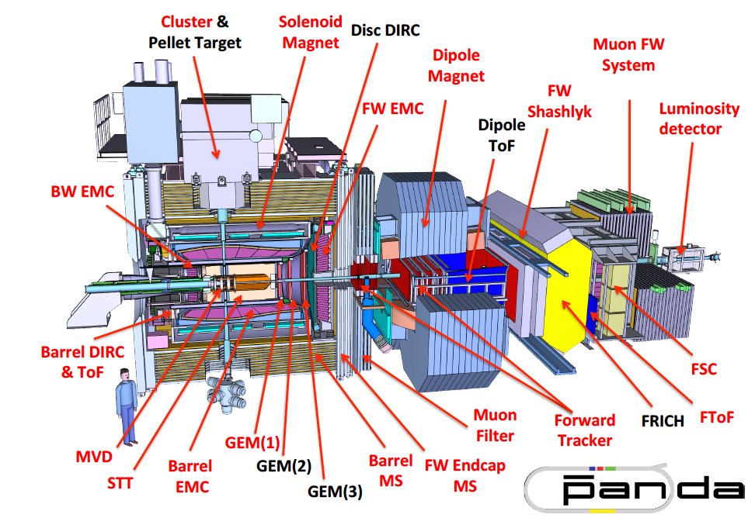
The PANDA detector (start/full setup)

Slide 39
The PANDA phases

Slide 40
Summary
Proton form factors can be measured at PANDA in the time-like region and over a large kinematical region through:
  Existing data with electron channels only
  PANDA: electron and muon channels
  No data below 4M² (unphysical region)
PANDA: ppbar→e+e-π⁰ below threshold
  No information on the relative phase between G_{E} and G_{M}
PANDA: relative phase from unphysical region or polarized target
Physics Performance Report for PANDA: Strong Interaction Studies with
Antiprotons, arXiv:0903.3905
[PANDA Collaboration], Phys. Rev. D 95, 032003 (2017)
[PANDA Collaboration], Eur. Phys. J. A 52, 325 (2016)
[PANDA Collaboration], Eur. Phys. J. A 51, 107 (2015)

Slide 41
Summary
Proton form factors can be measured at PANDA in the time-like region and over a large kinematical region through:
PANDA will provide valuable measurements for the test of universality of TDAs through:
PANDA experiment will provide a complementary study of the nucleon structure with the hard inclusive and exclusive processes: Generalized Distribution Amplitudes (GDAs), (TMD) Parton Distribution Functions, and Transition Distribution Amplitudes (TDAs)
Physics Performance Report for PANDA: Strong Interaction Studies with
Antiprotons, arXiv:0903.3905
[PANDA Collaboration], Phys. Rev. D 95, 032003 (2017)
[PANDA Collaboration], Eur. Phys. J. A 52, 325 (2016)
[PANDA Collaboration], Eur. Phys. J. A 51, 107 (2015)

Slide 42
  Backup slides

Slide 43
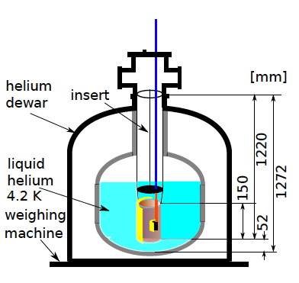
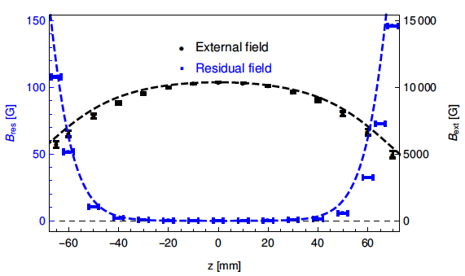
Investigation on intense magnetic flux shielding with a high temperature superconducting tube for a transverse polarized target at the PANDA experiment (Bertold Fröhlich)
A transversally polarized target at PANDA requires longitudinal shielding.
The experimental investigations have shown that with a shielding tube (BSCCO) with a wall thickness of 3.5 mm, a magnetic flux density of 1T can be shielded

Slide 44
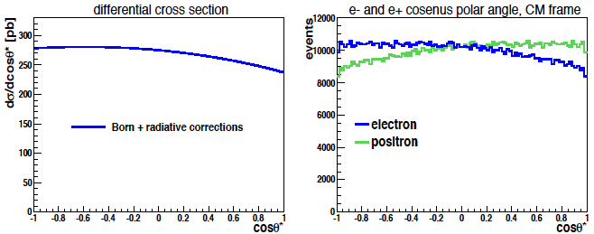
Radiative corrections on ppbar->e⁺e⁻ at PANDA
Monte Carlo event generator (M. Zambrana et al.)
First order radiative corrections to ppbar->e+e- have been calculated in the point-like approximation, including both virtual and real corrections, and interference effects.
Event generators have been developed on the basis of the calculated cross section.
s = 5.08 GeV²

Slide 45
B) Feasibility studies: time-like proton form factors @ PANDA
Statistical error on R = |G_{E}|/|G_{M}|
Analysis : Boosted Decision Trees & Cuts
Signal:
  Follows physical cross section
  Assuming
  s [GeV²]: 5.4 (5.1, 6.8, 8.2)
Additional samples for signal efficiency determination ~10⁷ events
Signal efficiency ~ 21%
Background:
  New event generator @ s [GeV²]: 5.4 (5.1, 6.8, 8.2)
Two samples each for studying background rejection and effects of background subtraction, 10⁸ events at each energy point
Generated events
Efficiency corrected events
Fit function ~ dσ/dcosθ
Background rejection factor ~ 10⁻⁶
Background subtraction removes pion background contamination
Extraction of FF´s & R±∆R from efficiency corrected signal distribution
Time-integrated cross section of 2 fb⁻¹

Slide 46
A) Feasibility studies: time-like proton form factors
@ PANDA for
Study of precision for |G_{E}|&|G_{M}|, the form factor ratio R & effective form factor
Study of the systematic effects : generator model, fluctuations and fit function
Method I: event generator based on physical cross section & expected events are simulated
Method II: 10⁶ events + flat Phase Space (PHSP) event generator + weighting

