Slide 1

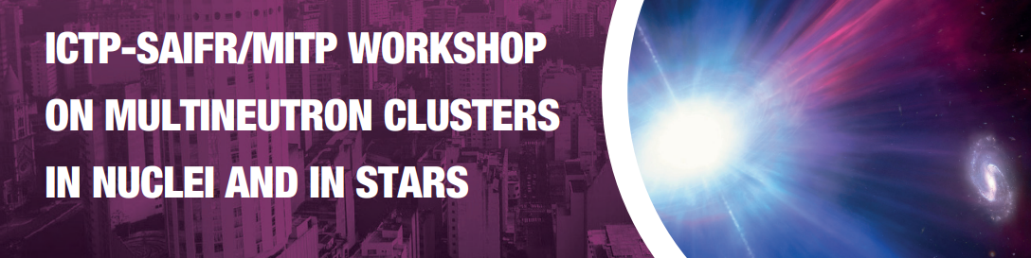
Light proton rich nuclei structure using the 3n-cluster (³He,⁶He) reaction
and quest for resonances in ⁶Be
Valdir Guimarães
University of São Paulo – São Paulo - Brazil

Slide 2
Typical cluster structures known in stable nuclei
Light nuclei can present cluster configuration where nucleons are grouped in clusters.
Uncorrelated behavior of independent particles organized in coherent structures.
Near corresponding decay threshold, it may behave like Open Quantum System (OQS).
⁷Li
α-cluster excitation
¹⁶O*
3α linear chain
α + t
¹²C
Molecular orbital
¹²C + α
¹²C*
3α bending arm (Hoyle)
3α
3α linear chain
3α linear chain
¹²C*
Nuclear linear-chain structure arises in carbon-14
Nature Communication Physics 6 (2023) 220
Jiaxing Han, Jianling Lou et al.,
¹⁴C*
¹⁶C*
High density (nucleon liquid) cluster gas, crystal low density (nucleon gas)
Independent particle in MF
Cluster formation
Cluster excitation
Many-body no correlation
g.s. correlation
few-body cluster
excited states

Slide 3
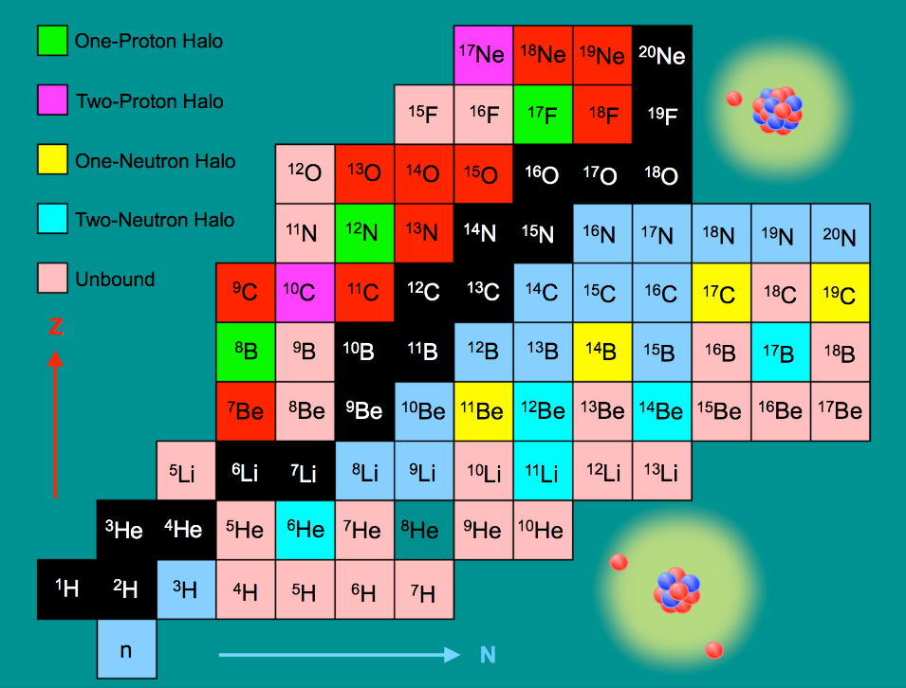

Slide 4
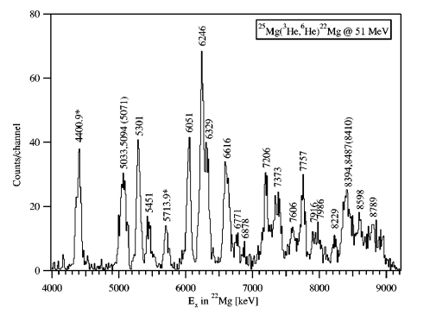
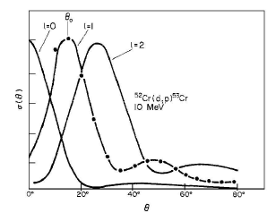
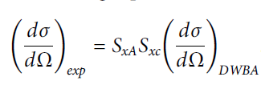
3n-cluster transfer reaction
A(³He,⁶He )B (-3n)
C+x
Kinetic energy spectra
of the detected particle
Excitation energy spectra of particle B
(states and resonances)
A(a,b)B with A=B+x and b=a+x
c=transferred cluster
Energy of the states or resonances
Angular momentum transferred (L)
Spectroscopic Factor (DWBA)

Slide 5
3n-cluster transfer reaction
A(³He,⁶He )B (-3n)
C+x
²⁴Mg(³He,⁶He)²¹Mg S. Kubono et al. PRC 43, 1821 (1991)
Elab = 73.7 MeV energy spectra and angular distributions
²⁰Ne(³He,⁶He)¹⁷Ne V. Guimaraes et al., PRC 58, 116 (1998)
Elab = 70.0 MeV energy spectra and angular distributions
²⁸Si(³He,⁶He)²⁶Si J. Caggiano et al. PRC 65, 055801 (2002)
Elab = 51 MeV only energy spectra at 7.5 degree
²⁵Mg(³He,⁶He)²²Mg J. Caggiano et al. PRC 66, 015804 (2002)
Elab = 51 MeV only energy spectra at 7.5 degree
¹⁴N(³He,⁶He)¹¹N V. Guimaraes et al. PRC 67, 064601 (2003)
Elab = 70.0 MeV energy spectra and angular distributions
⁹Be(³He,⁶He)⁶Be B.A.Urazbekov et al., Chin.Phys.C 48, 014001 (2024).
Elab = 30.0 MeV energy spectra and angular distributions

Slide 6
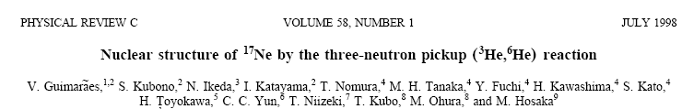
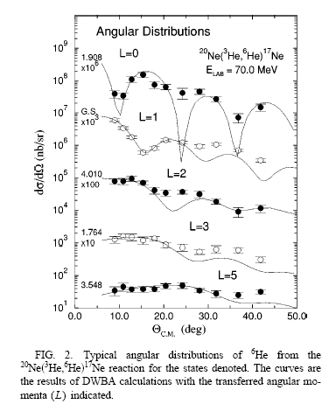
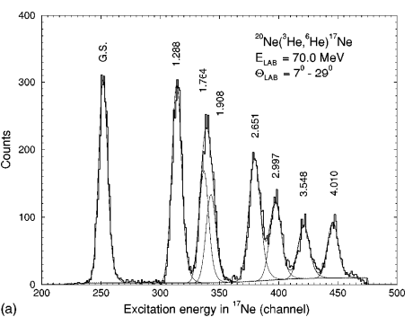
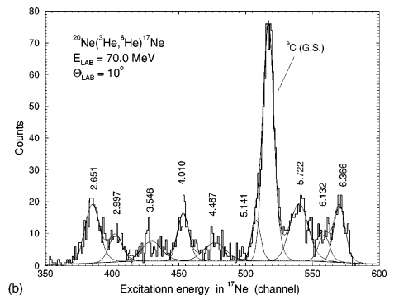
²⁰Ne(³He,⁶He)¹⁷Ne reaction
²⁰Ne ( ³He, ⁶He ) ¹⁷Ne
0+ ½+ 0+ J^{π}
Spin assignment of states in residual nuclei
J^{π} = L ± ½ and π = (-1)^{L}
Transferred angular momentum obtained from DWBA analysis of the angular distributions
Clear indication of the 3n-cluster transfer

Slide 7
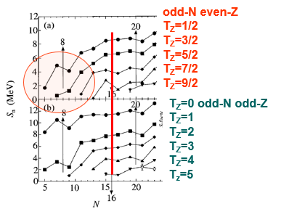
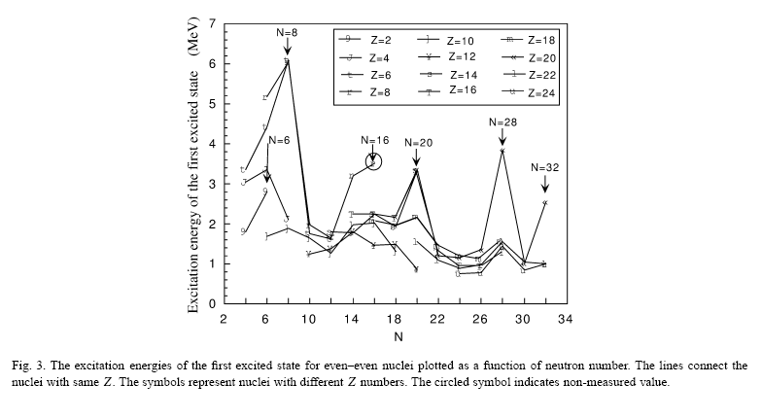
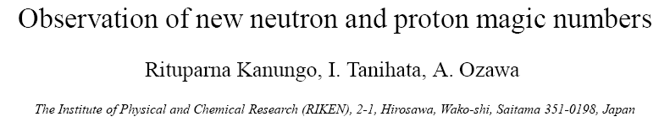
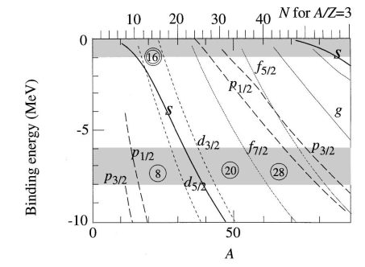


Tz= 3/2 and inversion of orbital
Sn (Neutron Separation energy)
¹⁶O
6, 16
new magic
numbers ! !
²⁴O
⁴⁸Ca
¹²Be
³⁶S
Exotic dripline nuclei
Inversion of orbitals)

Slide 8
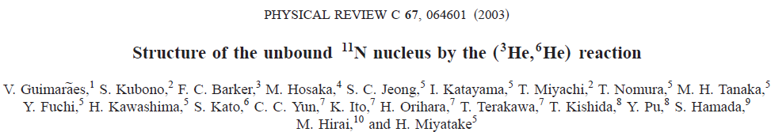
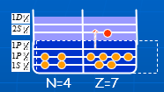
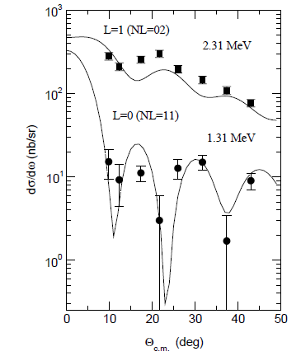
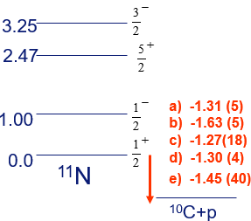
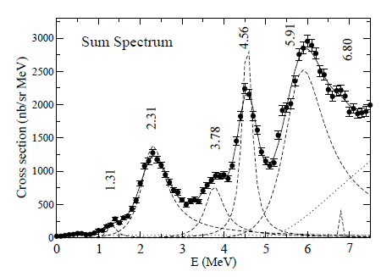
¹⁴N(³He,⁶He)¹¹N reaction
¹⁴N ( ³He, ⁶He ) ¹¹N
0+ ½+ 0+ J^{π}
¹¹N is the mirror of ¹¹Be
J^{π} = L ± ½ and π = (-1)^{L}
Transferred angular momentum obtained from DWBA analysis of the angular distributions
a) V. Guimarães et al. PRC 67(2003) 64601
b) Oliveira , Lepine-Szily et al. PRL 84 (2000) 4056
c) Markenroth et al. PRC 62 (2000) 34308
d) Axelson et al. PRC 54 (1996) R1511
e) Azhari et al. PRC 57 (1998) 628

Slide 9
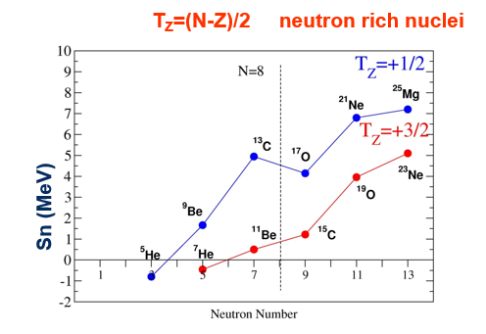
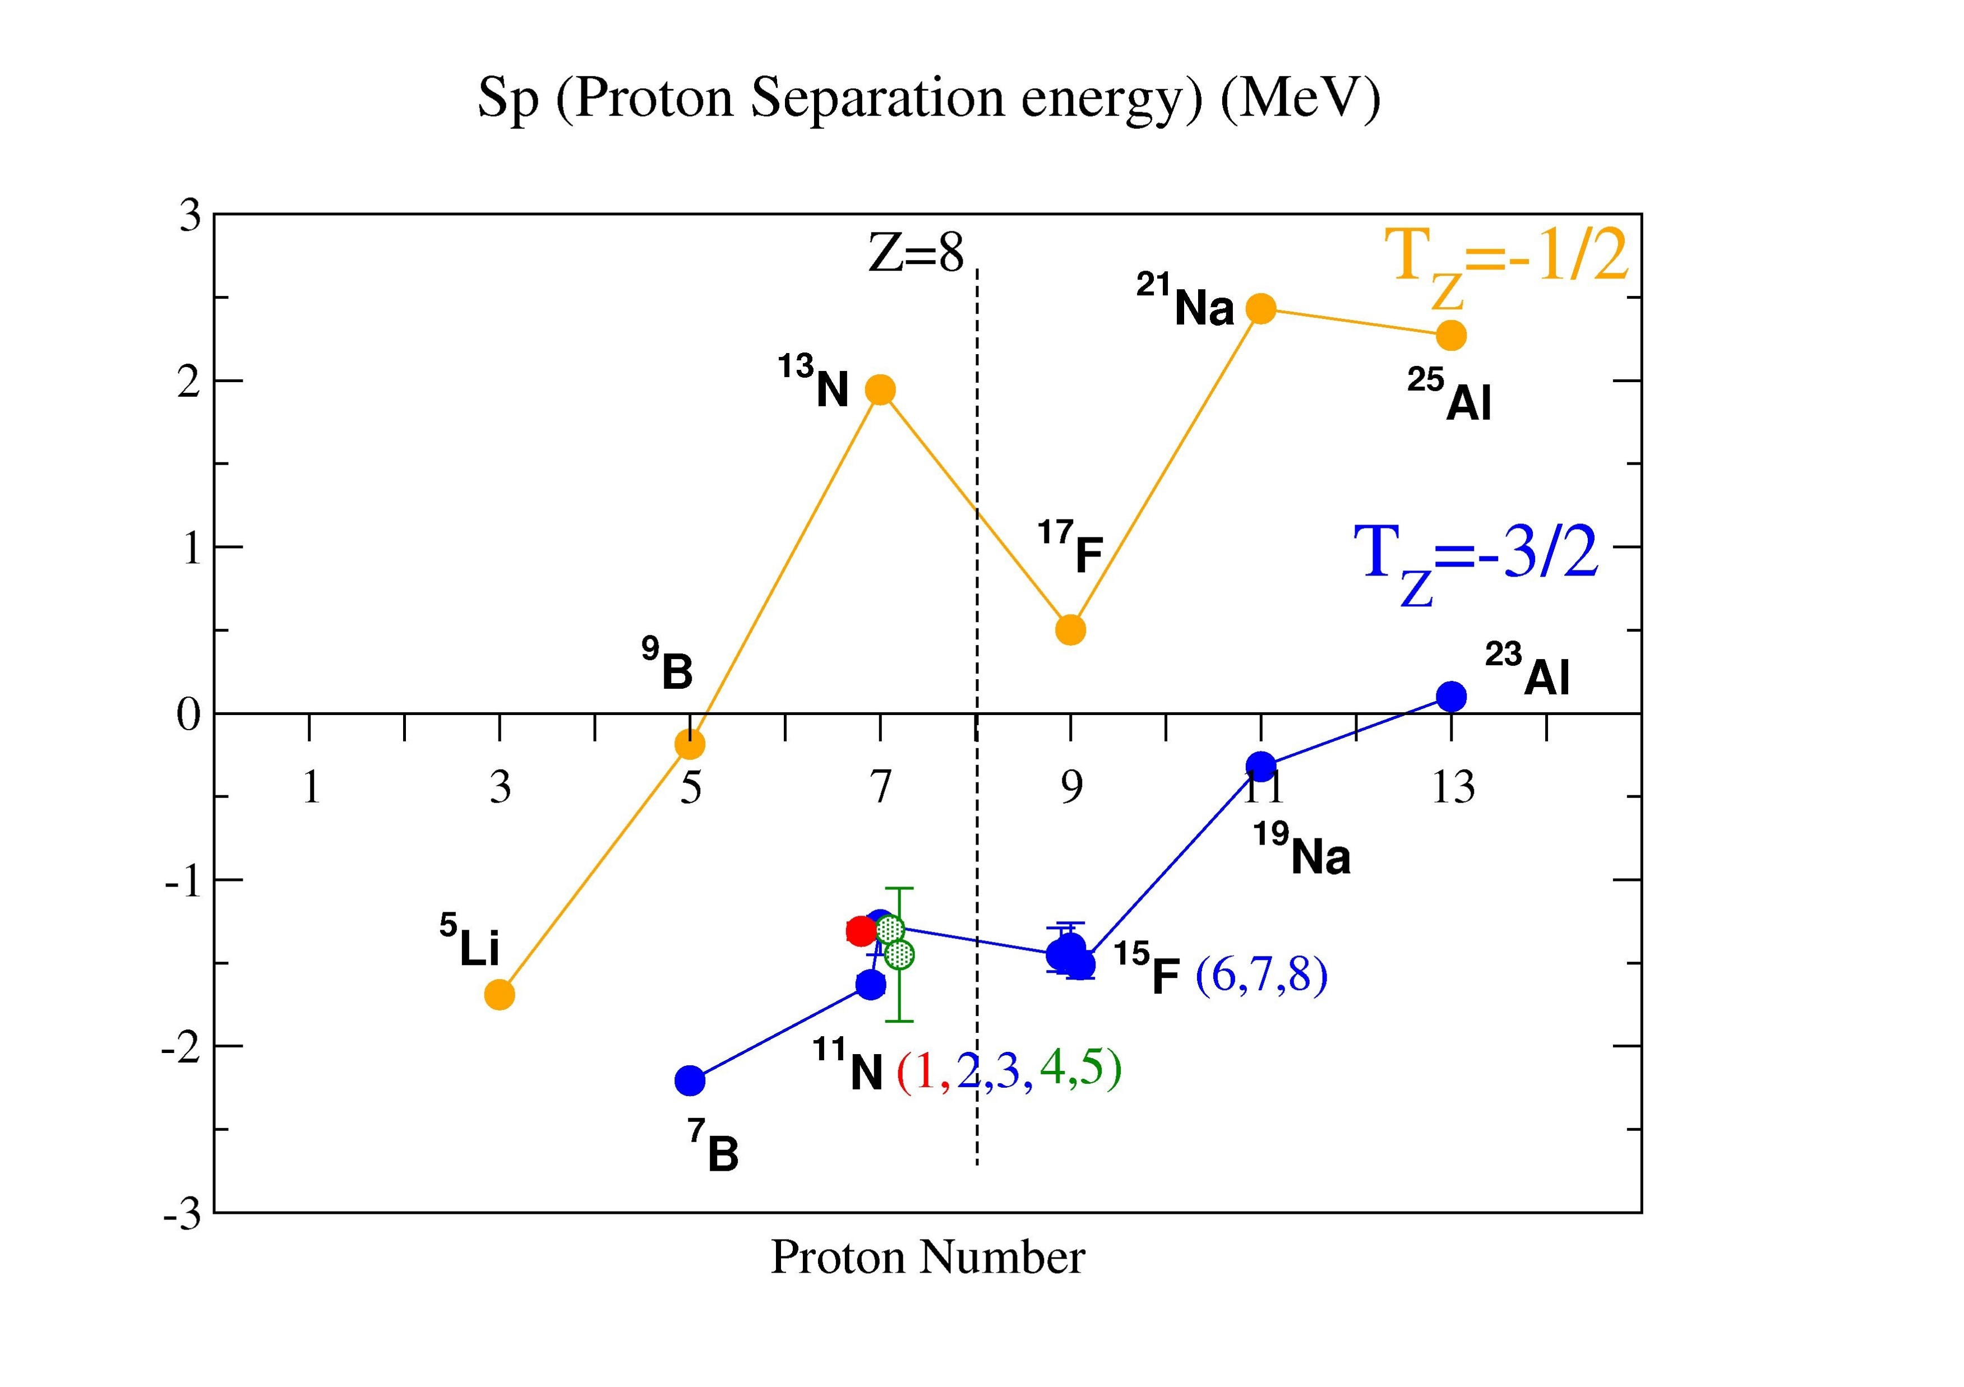
Tz= 3/2 and inversion of orbital
Neutron rich nuclei
Sn (neutron separation energy)
Proton rich nuclei
Sp (proton separation energy)
1) V. Guimarães et al. PRC 67(2003) 64601
2) Oliveira et al. PRL 84 (2000) 4056
3) Markenroth et al. PRC 62 (2000) 34308
4) Axelson et al. PRC 54 (1996) R1511
5) Azhari et al. PRC 57 (1998) 628
1) -1.31 (5)
2) -1.63 (5)
3) -1.27(18)
4) -1.30 (4)
5) -1.45 (40)
6) Golberg et al. PRC 69 (2004) R31302
7) Lepine et al. NPA 722 (2003) 512c
8) Peters et al. PRC 68 (2003) 3460

Slide 10

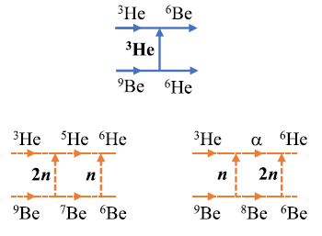
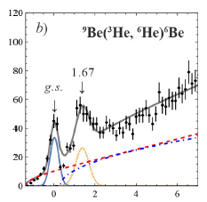
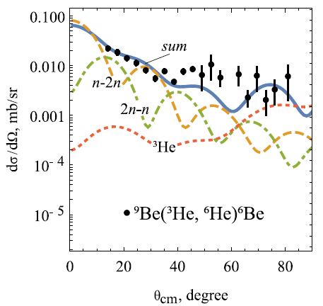
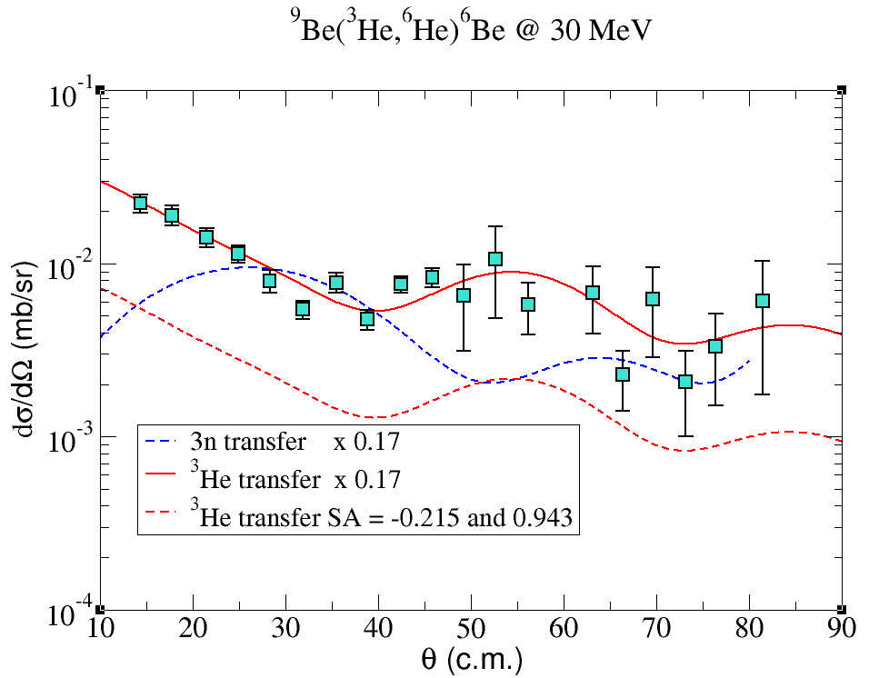
⁹Be(³He,⁶He)⁶Be reaction
⁹Be ( ³He, ⁶He ) ⁶Be
3/2+ ½+ 0+ J^{π}
J^{π} = L ± ½ and π = (-1)^{L}
They considered
direct ³He transfer
sequential 3n transfer
CRC (Coupled Reaction Channel)
Roberto Linares, Erica Nunes Cardozo

Slide 11
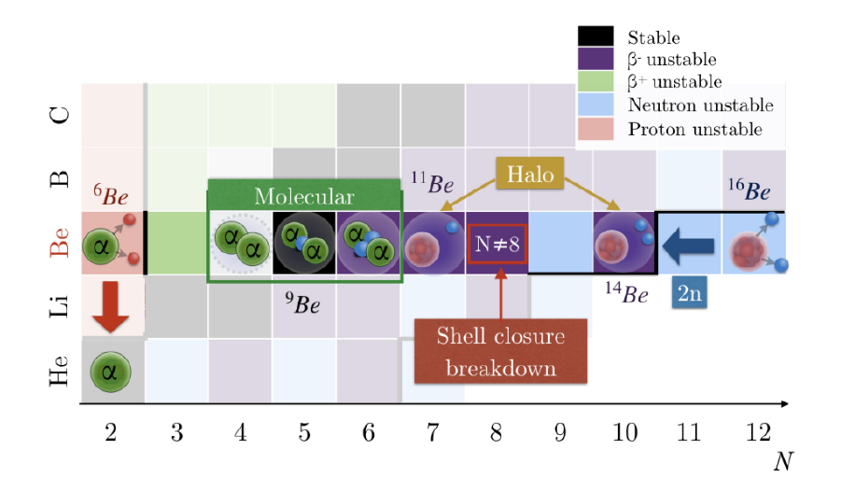

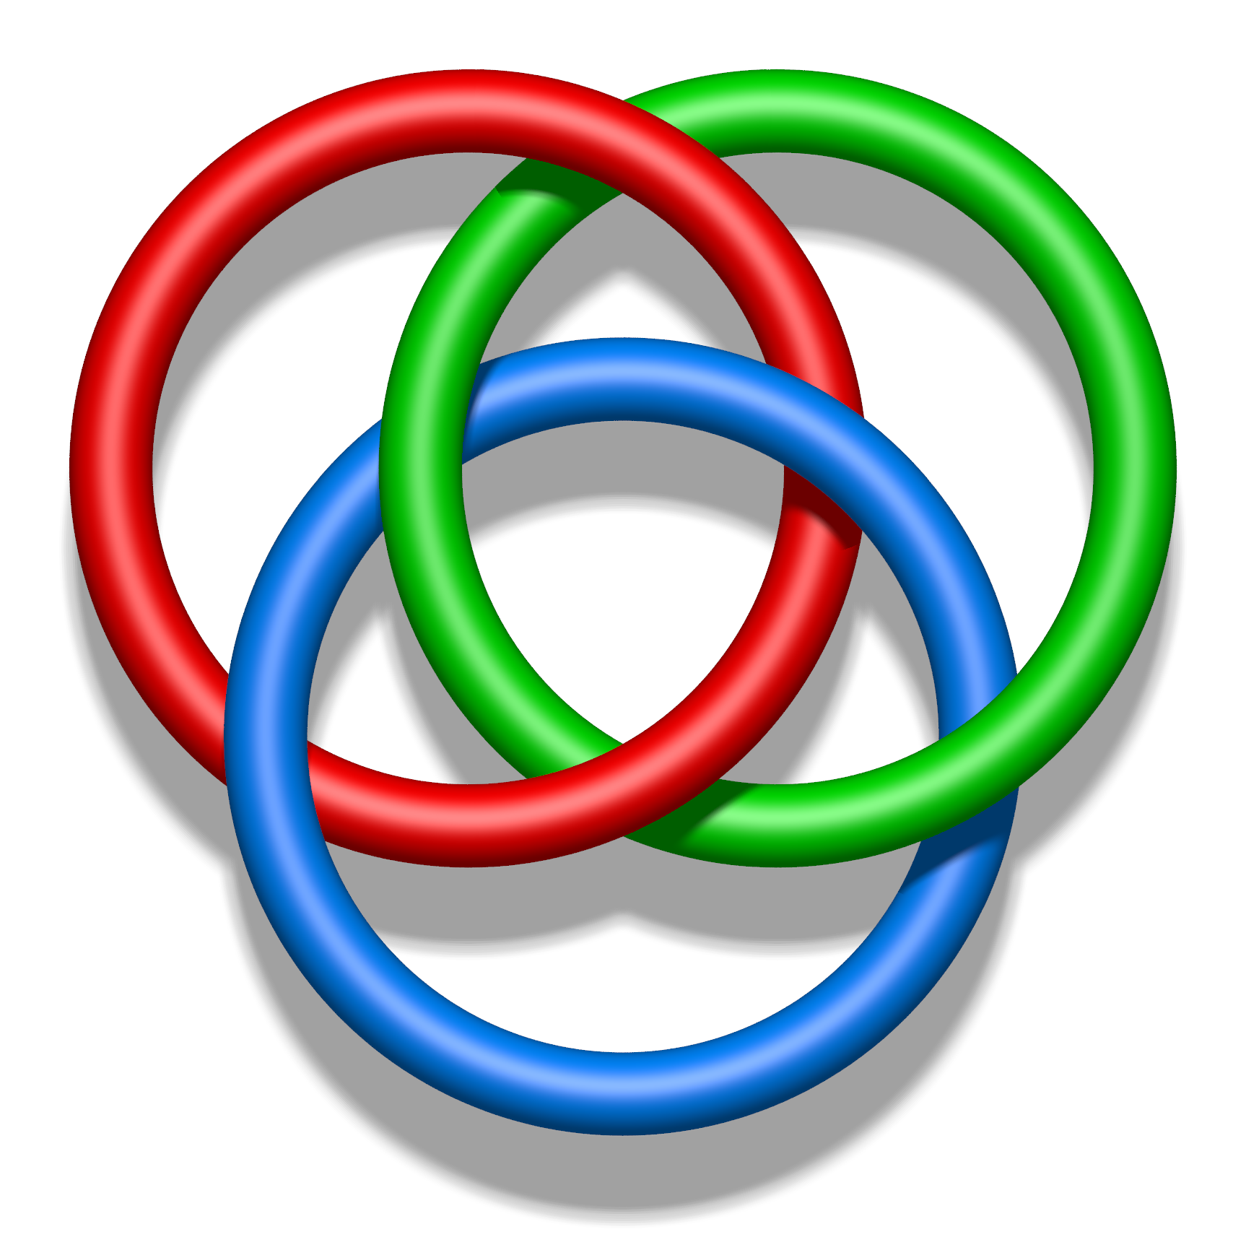
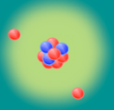
Be isotopes structures
Be isotopes (⁶⁻¹²Be) have shown to be good candidates for clustering studies.
Their cluster structures are built on a well-established α+α rotor of ⁸Be
¹²Be (Z=4 and N=8)
PhD thesis Armel Kamenyero
(Olivier Sorlin)
Université de Caen Normandie
⁶Be (α+p+p)
2p decay,
³He-³He molecular structure
¹²Be (α+α+4n)
(⁸He+α)
(⁶He+⁶He)
⁸Be (α+α) molecular
⁹Be (α+α+n) Borromean stable nucleus
¹⁰Be (α+α+n) molecular
¹¹Be 1n-halo
¹⁴Be 2n-halo
¹⁶Be 2n-halo

Slide 12
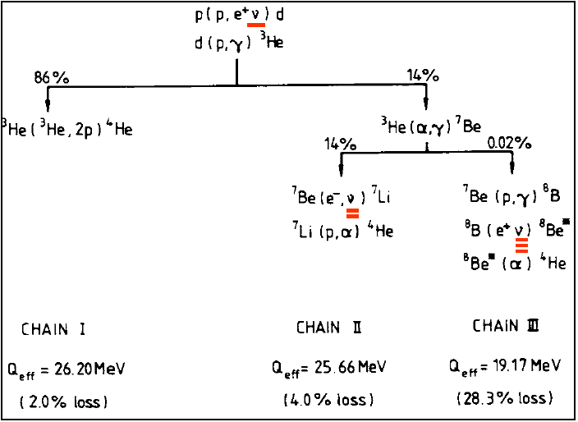
⁶Be and solar neutrinos
86% of ³He is destroyed by (1) ³He(³He,2p)⁴He reaction and 14% by (2) ³He(⁴He,)⁷Be.
competition of (1) and (2) may have implications in the solar neutrino problem.
Constraints to the baryon-to-photon ratio from BBN. (indicates inconsistency in the ³He abundances compared to the other abundances).
A resonance at 11.0 MeV in this reaction for the compound nucleus ⁶Be=³He+³He would increase the destruction of the ³He.

Slide 13
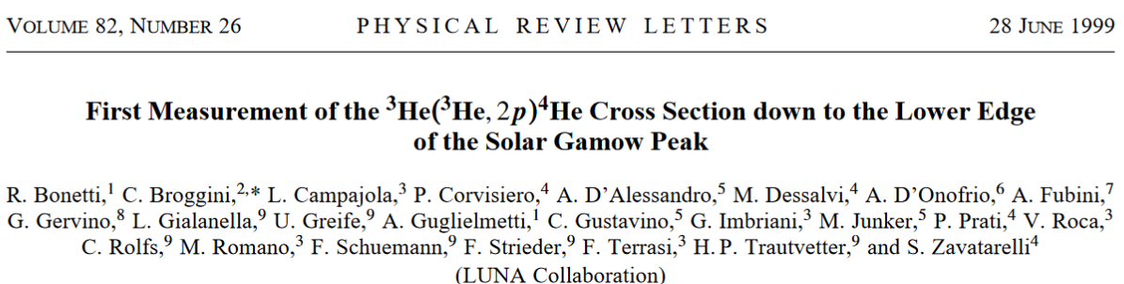
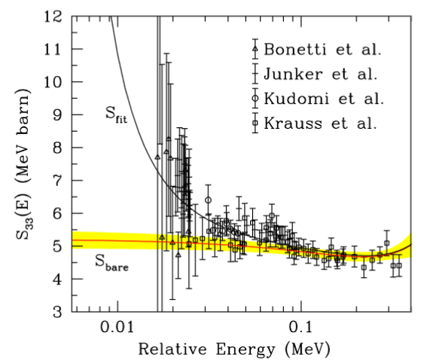

⁶Be and the ³He(³He,2p)⁴He reaction
Gran Sasso: direct measurements for the ³He+³He capture:
Electron screening effects or a broad resonance in ⁶Be
near the ³He+³He threshold?
Ue = 294 +- 47 eV from Bonetti et al. PRL 82 (1999) 5205
Ue = 305 +- 90 eV from compilation
Ue = 240 eV adiabatic model
C. Bertulani , Spitaleri,
Eur. Phys. J. 165, 02002 (2017)

Slide 14
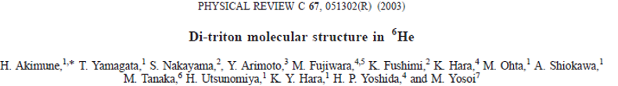
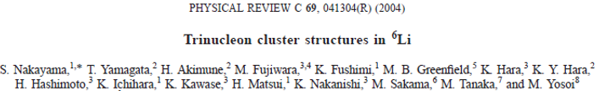
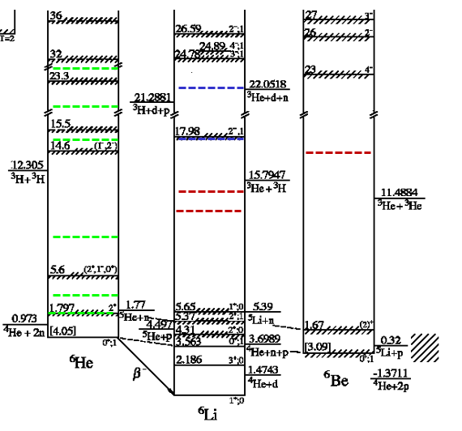
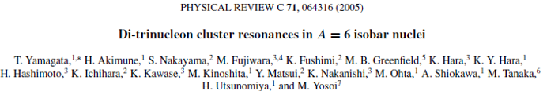
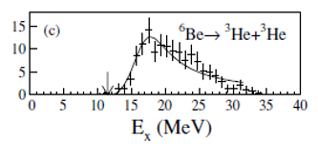
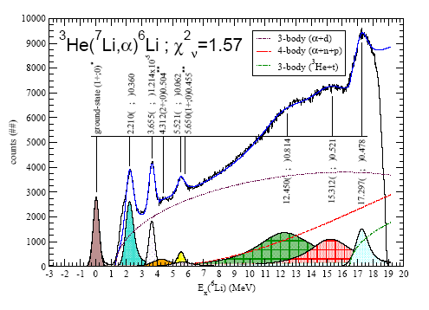
What is known for A=6
⁶Li(⁷Li,⁷Be)⁶He reaction at 455MeV
⁶Li(³He,t)⁶Be reaction at 450MeV
RCNP Osaka University.
V. Guimaraes et al.
NPA 722, 341c (2003).

Slide 15
Quest for resonances in ⁶Be

Slide 16


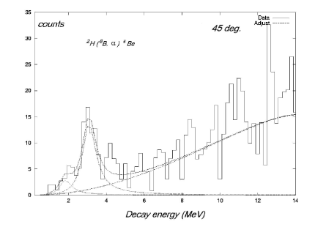
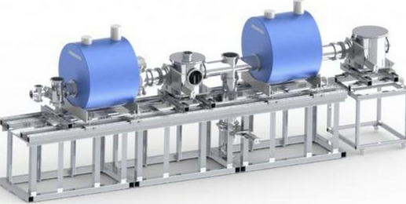
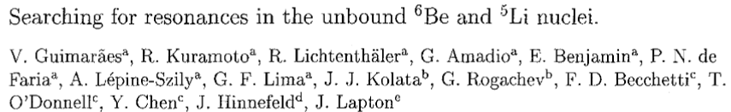

The d(⁸B,α)⁶Be reaction at Notre Dame - USA
Experiment 2002 at University of Notre Dame
Spokesperson: Valdir Guimaraes
⁸B (4-2-2 cluster configuration)
Timofeyuk et at.
NPA 652(1998) 383
Deuteron transfer reaction
d
4He
d(⁸B,⁴He)⁶Be Q = + 15.25 MeV
2p
⁴He+2p
³He+ ³He
⁸B = ⁶Be+d
= 4He+2p+d
⁸B radioactive ion beam @ 27 MeV with TWINSOL

Slide 17
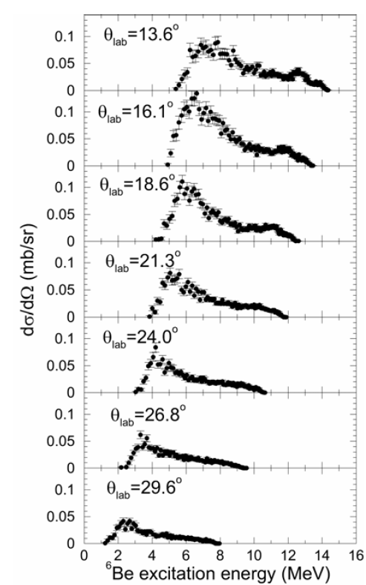
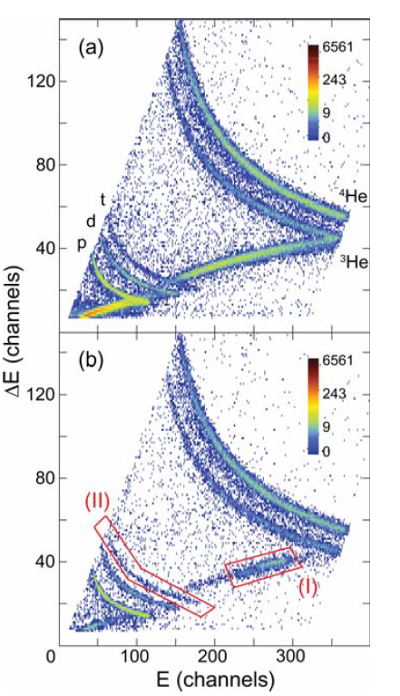
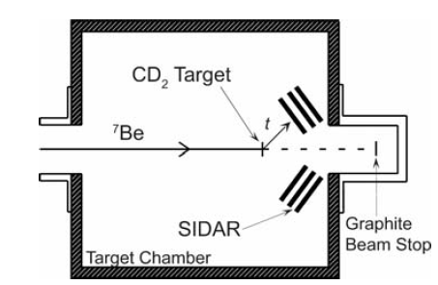
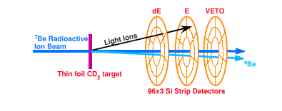
The d(⁷Be,t)⁶Be reaction at OakRidge - USA
Experiment 2004 at Oak Ridge USA
Spokespersons: Daniel Bardyan and Valdir Guimaraes
neutron transfer reaction ?
E_{Lab} = 100.0 MeV
d(⁷Be,t)⁶Be
⁴He+2p
³He+ ³He
Searching for Resonances in the Unbound 6Be Nucleus by Using a Radioactive 7Be Beam
K. Y. Chae, D. W. Bardayan, J. C. Blackmon, M. S. Smith, A. E. Champagne, J. J. Das, R. P. Fitzgerald, D. W. Visser,
V. Guimaraes, K. L. Jones, S. D. Pain and J. S. Thomas, M. S. Johnson.

Slide 18
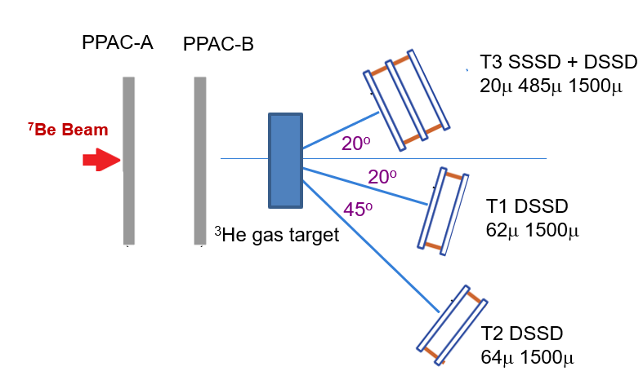
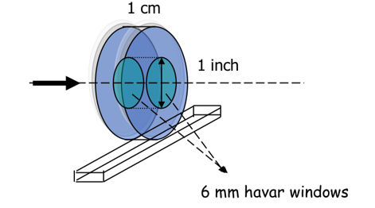
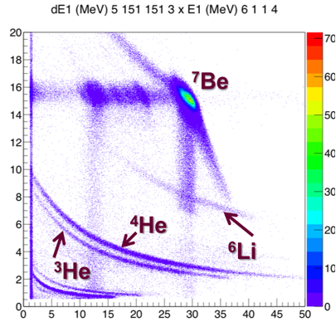
The ³He(⁷Be,α)⁶Be reaction at CRIB-RIKEN - Japan
Experiment 2007 CRIB=-RIKEN Japan
Spokespersons: V. Guimaraes, R. Lichthentaler, S. Kubono
Neutron and/or ³He transfer
ELab = 53.5 MeV
Intensity 1.4x10⁵ pps
³He(⁷Be,α)⁶Be
⁴He+2p
³He+ ³He
CRIB-RIKEN
Particle identification
(ΔExE) Sspectum Telescope 1

Slide 19
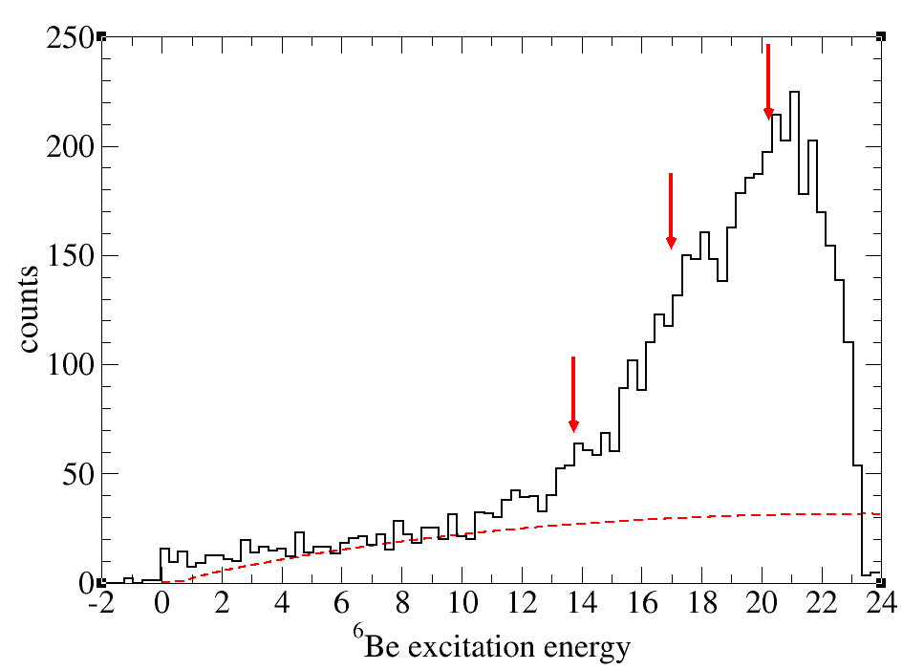
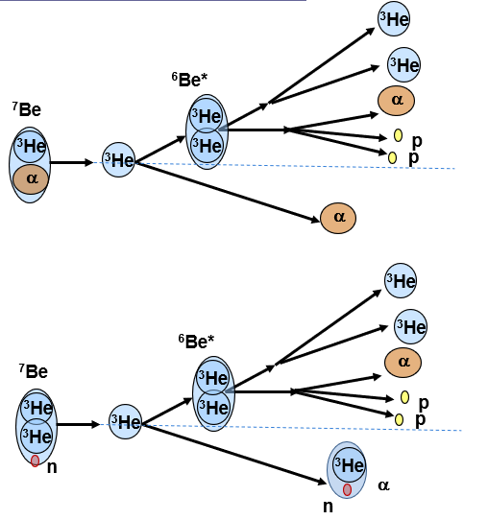
³He(⁷Be,α)⁶Be
21.0 MeV
17.0 MeV
³He transfer
13.0 MeV
Neutron transfer
4 body phase space background
(α+α+p+p)
3 body phase space background
(α+³He+³He)
Next R-matrix calculation

Slide 20
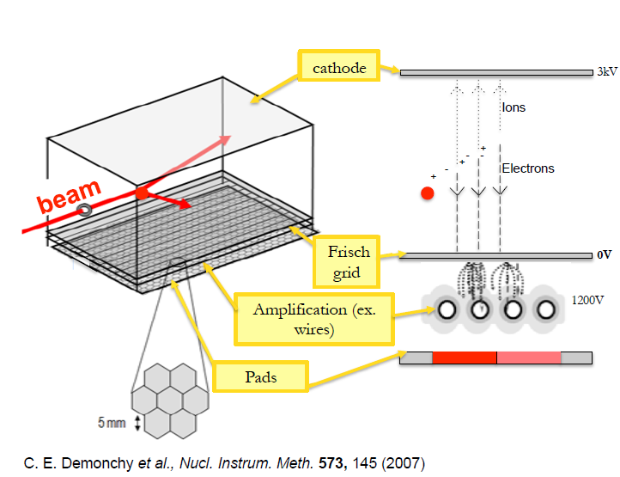
Active Target –Time projection Chamber

Slide 21


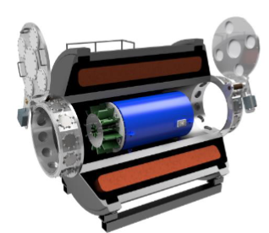



The d(⁷Be,t)⁶Be reaction at Argonne - USA
Experiment 2023 Argonne National Laboratory - USA
Spokespersons: Juan Zamora (MSU) and V. Guimaraes
d(⁷Be,t)⁶Be
Using the combination of Helios and AT-TPC
The versatility, luminosity, angular coverage, and particle identification will allow the observation of resonances in the ⁶Be up to 14 MeV.
⁴He+2p
³He+ ³He
ELab = 53.5 MeV
+ AT-TPC
The possibility to measure individual decay particles will allow the investigation of the decay mechanism of ⁶Be → p+p+α (sequential or democratic) and the 2p decay correlation

Slide 22



Preliminary results
Excitation energy
Kinematic plots
Energy versus angle
0.0 MeV
18.0 MeV
0.0 MeV
7.0 MeV
⁷Be(d,p)⁸Be ⁷Li(d,p)⁸Li
0.0 MeV
5.0 MeV
10.0 MeV
0.0 MeV
⁷Be(d,t)⁶Be ⁷Li(d,t)⁶Li
⁷Be(d,d)⁷Be ⁷Li(d,d)⁷Li
Also
⁷Be(d,³He)⁶Li ⁷Li(d,³He)⁶He

Slide 23


Resonant scattering ⁸He(⁴He, ⁴He) ⁸He using ACTAR
Experiment April 2024: ¹²Be structure in multi-threshold vicinity: search for narrow resonances
Spokesperson: Valdir Guimaraes and Thomas Roger.
ACTAR-TPC
~14.0 MeV
?
Plastic scintilator
~1.8 AMeV
beam
~11.5 MeV
3.191 MeV
⁸He + ⁴He
~ 14 MeV
8.956 MeV
¹²Be
The ⁸He beam ~1.8 AMeV (14.5 MeV)
Thick target (97% ⁴He gas + 3% C₄F₂ as a quencher, ~700 mbar pressure
resolution ~50 keV
Plastic scintilator – beam catcher
silicon wall (for scattered He particles)
Several decay channels to investigate ⁴He+⁸He, ⁶He+⁶He, ⁶He+⁶He*, ⁴He+⁸He*, ^{12-x}Be +xn, ⁷He+⁵He by detecting residual ⁴He and ⁶He
g.s.

Slide 24


Preliminary analysis
⁸He+⁴He resonant scattering channel (for center-of-mass angles between 165° and 170°)
Excitation energy spectrum for ¹²Be, in the energy range of 11.6 to13.6 MeV.
One prominent resonance is clearly observed at 12.1 MeV (other two are also observed).
Thresholds: ⁶He+⁶He (11.90 MeV), ⁵He+⁷He (12.23 MeV), ⁸Be+4n (12.15 MeV), α+α+4n (12.07 MeV),
The full analysis involves the analysis of angular distributions and energy spectra of the other particles: ⁴He and ⁶He.
⁸He (scattered) energy spectrum
Possible tetra neutron (4n) cluster observation:
⁸He+⁴He-> α+α+4n
11.0 11.5 12.0 12.5

Slide 25

Thank you
https://valdir0guimaraes.wixsite.com/nean

Slide 27








¹⁰C+²⁰⁸Pb Elastic Scattering at near barrier in Texas A&M
¹⁰C (J^{π}=0+)
Cluster configuration
¹⁰C+²⁰⁸Pb – Texas A&M University – April 2020
α
α
p
p
¹⁰C proton rich radioactive nuclei
brunian nucleus = super borromean nucleus (4 interactions)
¹⁰C = α + α + p + p
DSSSDs
¹⁰B
7.0 MeV/A
¹⁰C 6.7 MeV/A

Slide 28




¹⁰C+²⁰⁸Pb Elastic Scattering at near barrier in Texas A&M
CDCC Cluster Folding Model
Elastic Scattering measurements for ¹⁰C+²⁰⁸Pb at E_{lab} = 66 MeV.
Phys. Rev. C 103 (2021) 044613
R. Linares, M. Sinha, E. N. Cardozo, V. Guimaraes, G. V. Rogachev et al.,
3-body
¹⁰C = ⁹B + p (4.005 MeV)
= ⁶Be + α (5.101 MeV)
Optical Model: Strong suppression of the Fresnel peak
4-body
¹⁰C = ⁸Be + p + p ( 3.861 MeV)
¹²C
¹⁰C
²⁰⁸Pb
Cluster folding model is important to take into account the exotic structure.
The coupling to continuum might not be so important due to the high proton separation energy
4-body calculations Manuela Rodriguez-Gallhardo.
Cluster Folding Model 5-body (not possible) ?

Slide 29


¹²N + ²⁰⁸Pb Elastic Scattering at near barrier in Texas A&M
¹²N = ¹¹C + p (0.600 MeV)
proton-rich weakly bound
¹²N+¹⁹⁷Au – Texas A&M University – April 2022
Measurement April 2022
¹²N beam 73.3 MeV 1x10³ pps
contamination ⁷Be beam 42.0 MeV 1,4 x 10³ pps
¹⁹⁷Au target 4 mg/cm²
Details of the experiment and analysis will be present in the oral contribution by Pedro Luiz Domingues Magro
¹⁹⁷Au
¹¹C
Preliminary results:
Optical Model calculation with Woods-Saxon Potential.
Cluster folding (¹²N=¹¹C+p) and CDCC calculations

