Slide 1

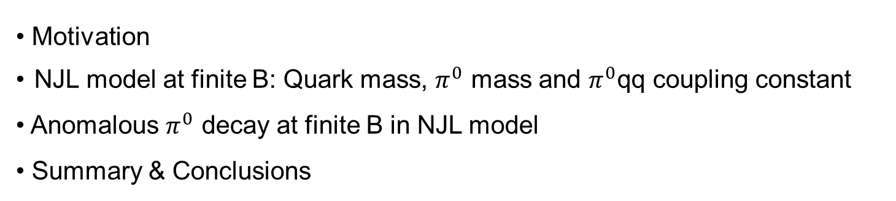
Anomalous $π^{0}$ decay in a strong magnetic field
N. N. Scoccola
Tandar Lab -CNEA– Buenos Aires
OUTLINE
• Motivation
NJL model at finite B: Quark mass, $π^{0}$ mass and $π^{0}$qq coupling constant
• Anomalous $π^{0}$ decay at finite B in NJL model
• Summary & Conclusions
In collaboration with M. Coppola and D. Gomez Dumm

Slide 2
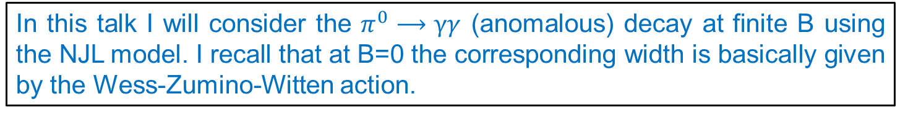
Introduction
Recently, there has been quite a lot of interest in investigating how the QCD matter is affected by the presence of strong magnetic fields.
Main motivation is possible existence in physically relevant situations:
High magnetic fields in non-central relativistic heavy ion collisions
Interior of Compact Stellar Objects (magnetars)
Early Universe
The effect of intense magnetic fields on some hadronic properties have been analyzed, e.g.
Meson masses: their behavior at finite B and T was studied using different models and also LQCD. At T=0 neutral pion mass is found to decrease with B.
Weak decay of charged pions: it was analyzed using LQCD and NJL. Width is enhanced by the magnetic field.
In this talk I will consider the $π^{0}⟶γγ$ (anomalous) decay at finite B using the NJL model. I recall that at B=0 the corresponding width is basically given by the Wess-Zumino-Witten action.

Slide 3
SU(2) NJL model at finite B
F
We start from the action of the NJL model for 2 flavors in the presence of an external e.m. field
where
$A_{cl}^{μ}$ corresponds to a constant magnetic field [e.g. in the LG $A_{cl}^{μ}=(o,−B x^{2},0,0)$ ]
The corresponding action can be bosonized by introducing the meson fields $σ$ and $\vec{π}$, and integrating out the quark fields. We get
where

Slide 4
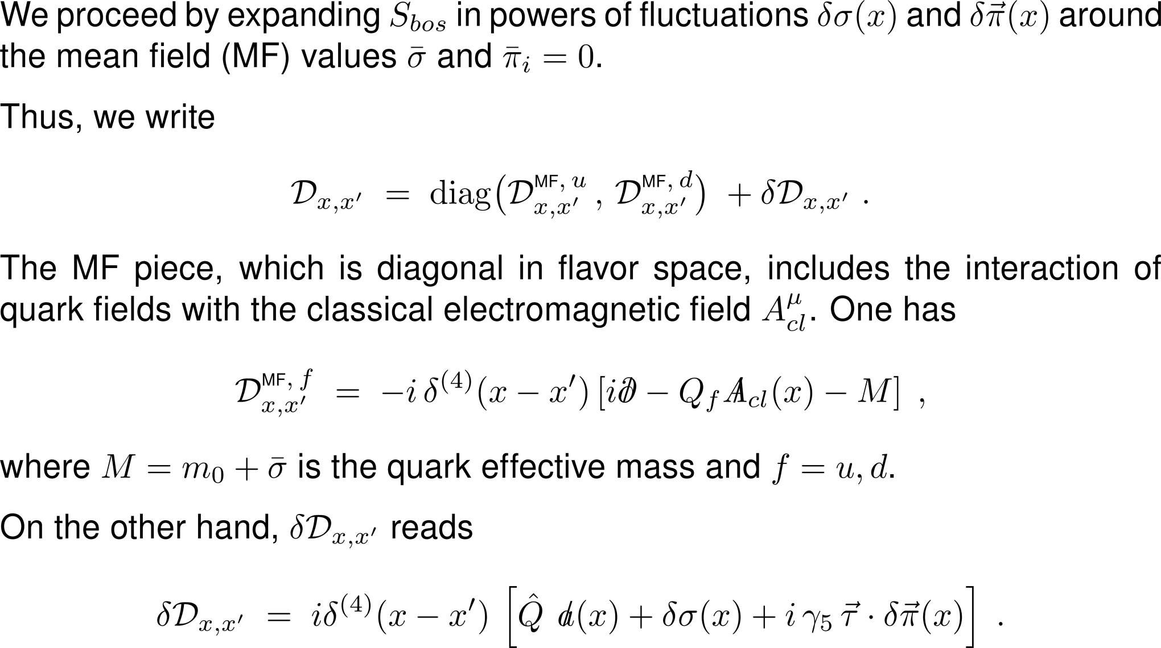
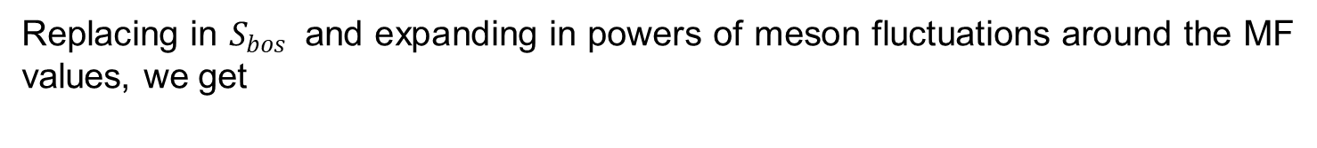
Replacing in $S_{bos }$ and expanding in powers of meson fluctuations around the MF values, we get

Slide 5
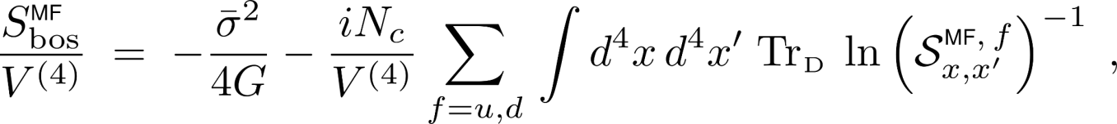
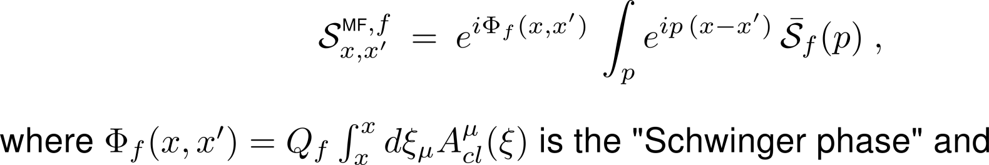
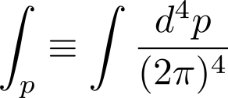
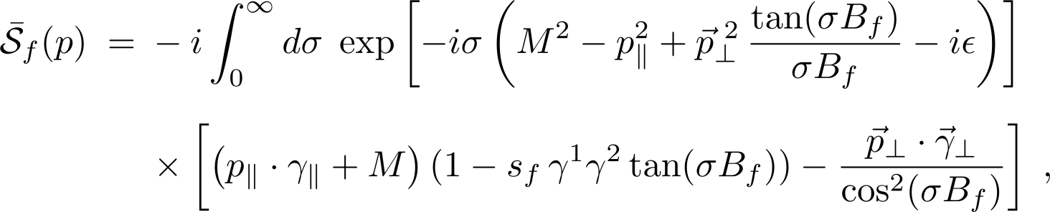
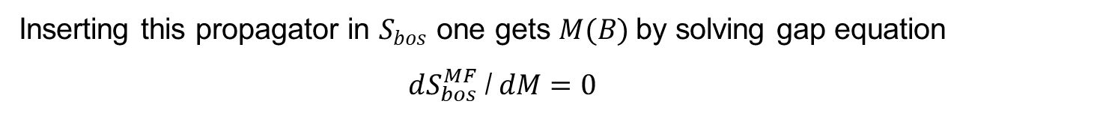
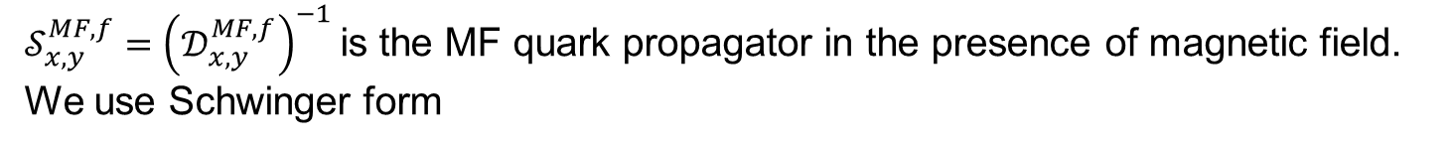
The MF action per unit volume is given by
$𝒮_{x,y}^{MF,f}={\left(𝒟_{x,y}^{MF,f}\right)}^{−1}$ is the MF quark propagator in the presence of magnetic field. We use Schwinger form
Inserting this propagator in $S_{bos}$ one gets $M(B)$by solving gap equation
$dS_{bos}^{MF}$ / $dM=0$

Slide 6

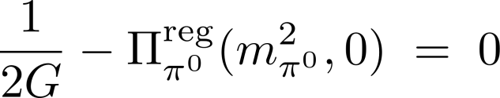
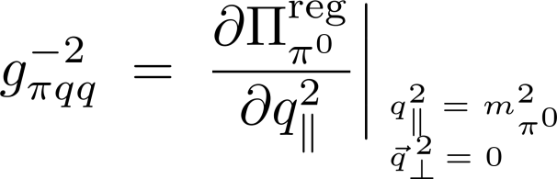
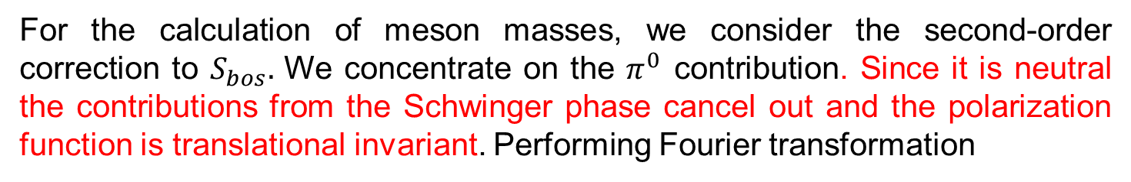
For the calculation of meson masses, we consider the second-order correction to $S_{bos}.$ We concentrate on the $π^{0}$ contribution. Since it is neutral the contributions from the Schwinger phase cancel out and the polarization function is translational invariant. Performing Fourier transformation
where
Choosing the frame in which the $π^{0}$ is at rest, $m_{π^{0}}\left(B\right)$can be obtained by solving the equation
The $π^{0}qq$ coupling is defined by fixing the residue of the inverse propagator at the pion pole,

Slide 7
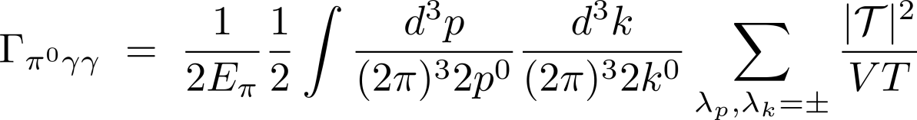
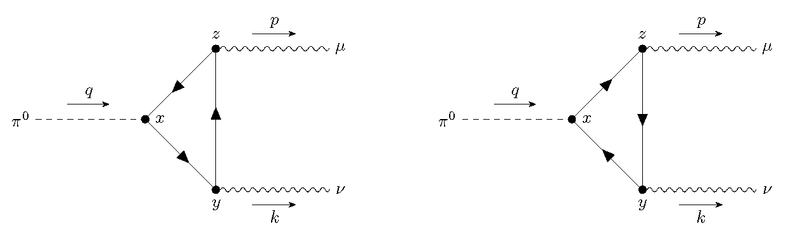
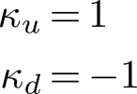

$π^{0}→2γ$ width at finite B
For $π^{0}$ of momentum $q$ decaying into two photons of momenta $p$ and $k$, the decay width is
The contributions to the decay amplitude correspond to the diagrams
which imply
with

Slide 8
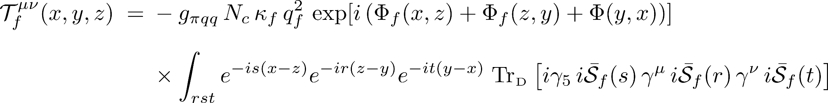
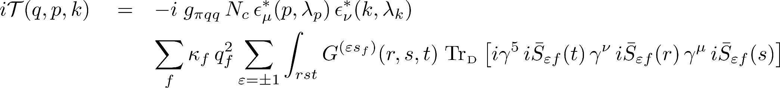

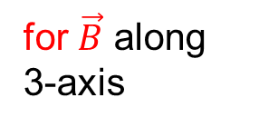
Taking into account the form of the magnetized quark propagators we get
Sum of Schwinger phases appearing in the amplitude is such that gauge-dependent pieces cancel out.
for $\vec{B}$ along 3-axis
Next, we note that the contributions of two diagrams are related by a charge conjugation $\hat{𝒞 }$
Thus, we can write
$s_{f}$ $⟶ε s_{f}$

Slide 9
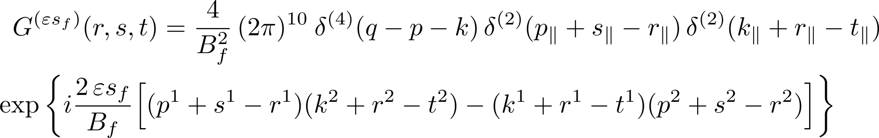
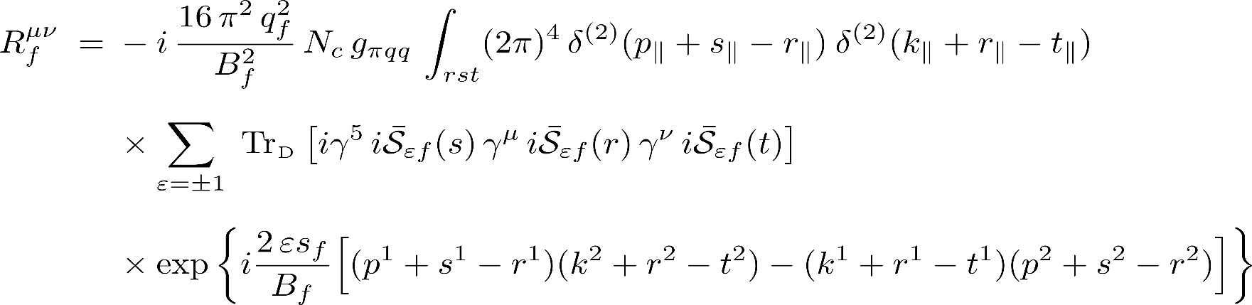
$G^{(εs_{f})}$ contains integral over coordinates. After some work one gets
Parallel momentum is conserved at each vertex but the conservation of perpendicular momenta gets broken owing to Schwinger phases.
Using that total momentum is conserved we write
where
where

Slide 10
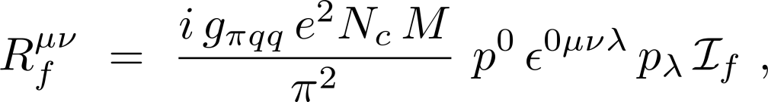
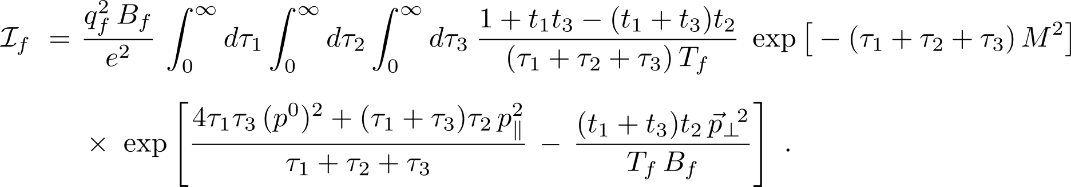
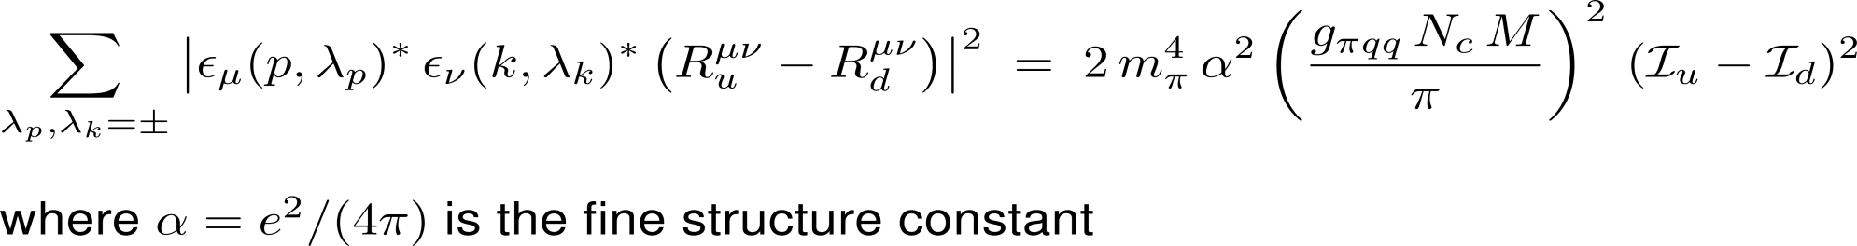
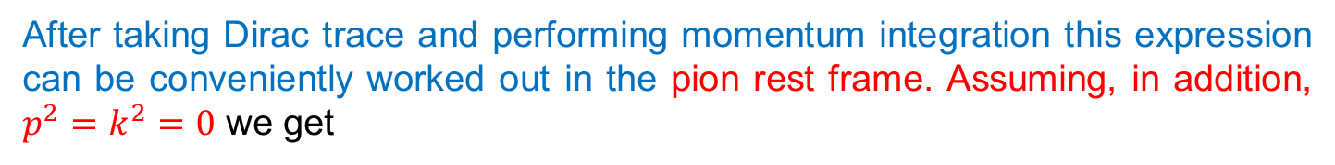
after taking Dirac trace and performing momentum integration
After taking Dirac trace and performing momentum integration this expression can be conveniently worked out in the pion rest frame. Assuming, in addition, $p^{2}=k^{2}=0$ we get
with
Next we perform the sum over photon polarizations. We obtain

Slide 11
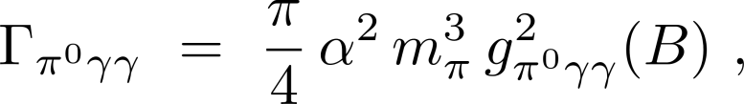
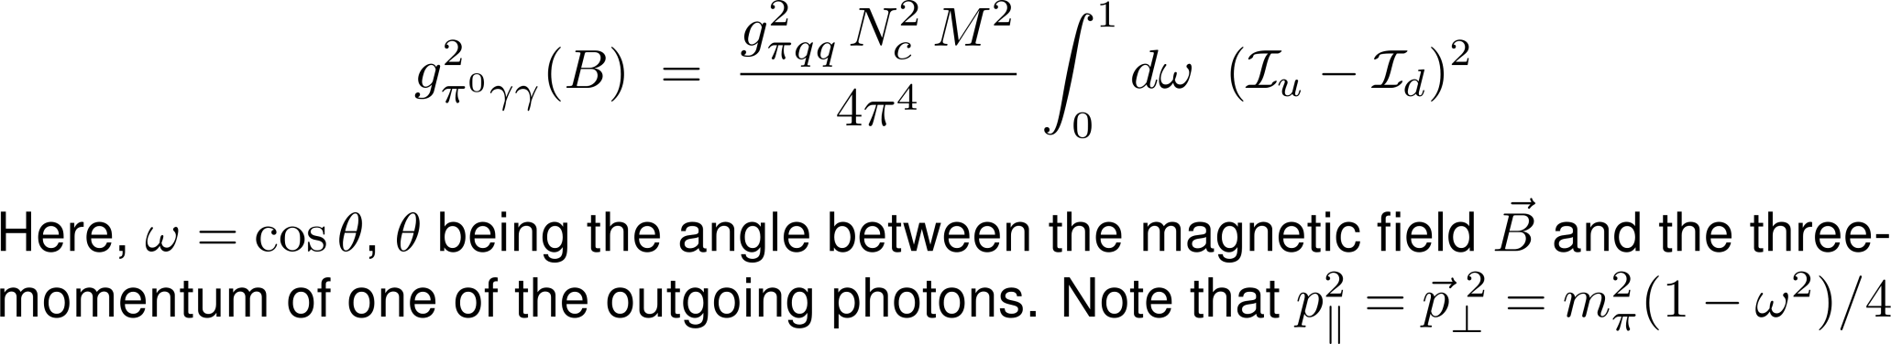
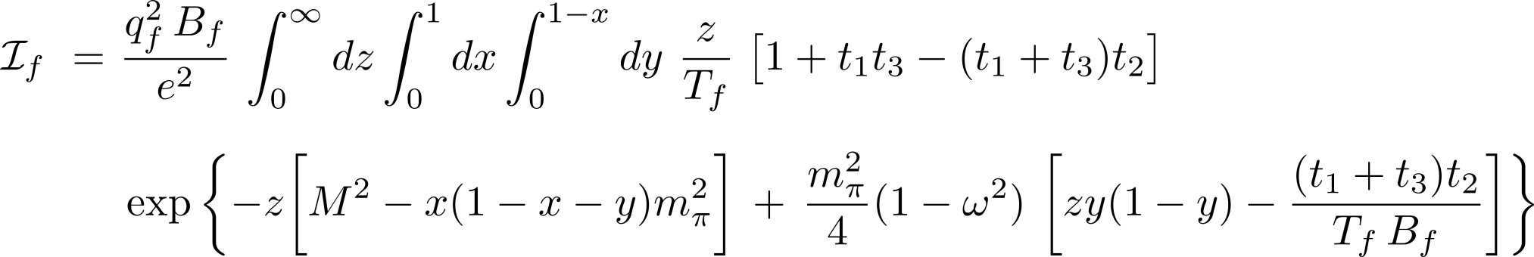
Finally,
where,
Introducing $x,y,z$ such that $τ_{1}=x z$ , $τ_{2}=y z$ , $τ_{3}=\left(1−x−y\right) z$
Recall that $M(B)$, $m_{π}(B)$ and $g_{πqq}(B)$ are all calculable in NJL model

Slide 12

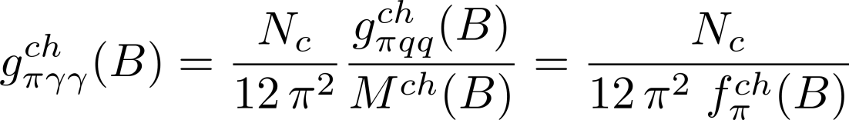
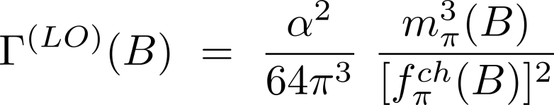
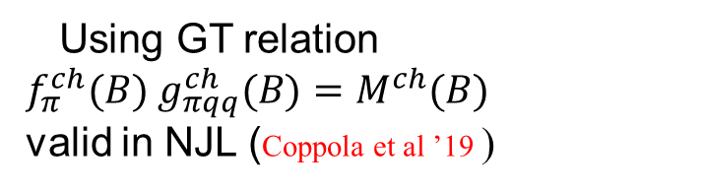


In the limit $m_{π}=0$ we have
Using GT relation $f_{π}^{ch}(B) g_{πqq}^{ch}(B)=M^{ch}(B)$
valid in NJL (Coppola et al ’19 )
which
implies
Consistent with anomalous Wess-Zumino-Witten action [ChPT to LO]
Finally, to LO in $m_{π}$

Slide 13
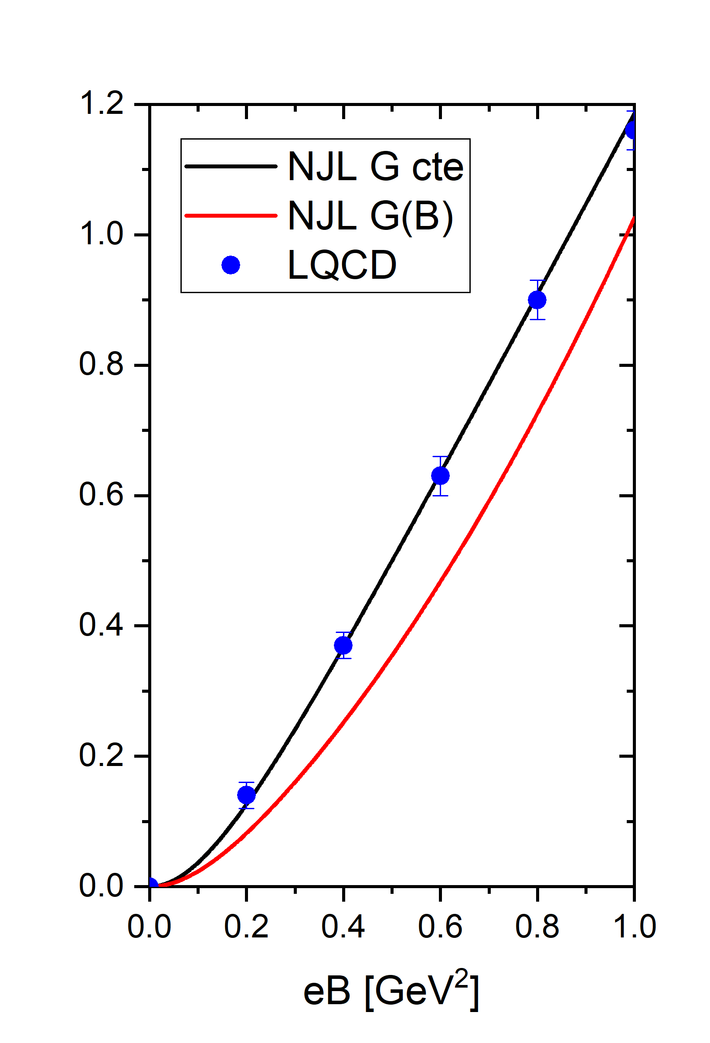
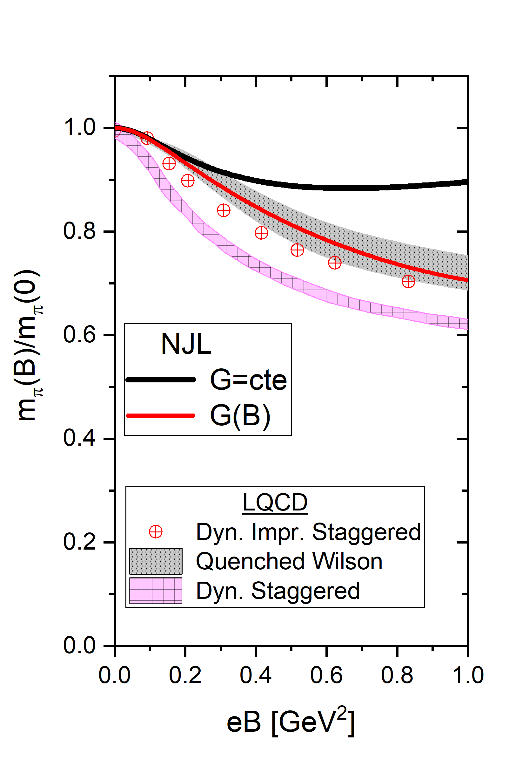

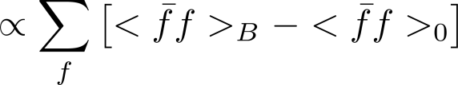
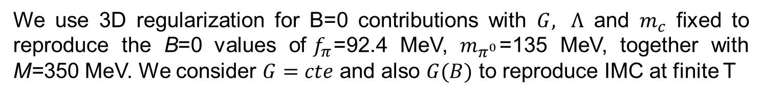
Results
We use 3D regularization for B=0 contributions with $G, Λ$ and $m_{c}$ fixed to reproduce the B=0 values of${ f}_{π}$=92.4 MeV, $m_{π^{0}}$=135 MeV, together with M=350 MeV. We consider $G=cte$ and also $G(B)$ to reproduce IMC at finite T
Magnetic catalysis

Slide 14
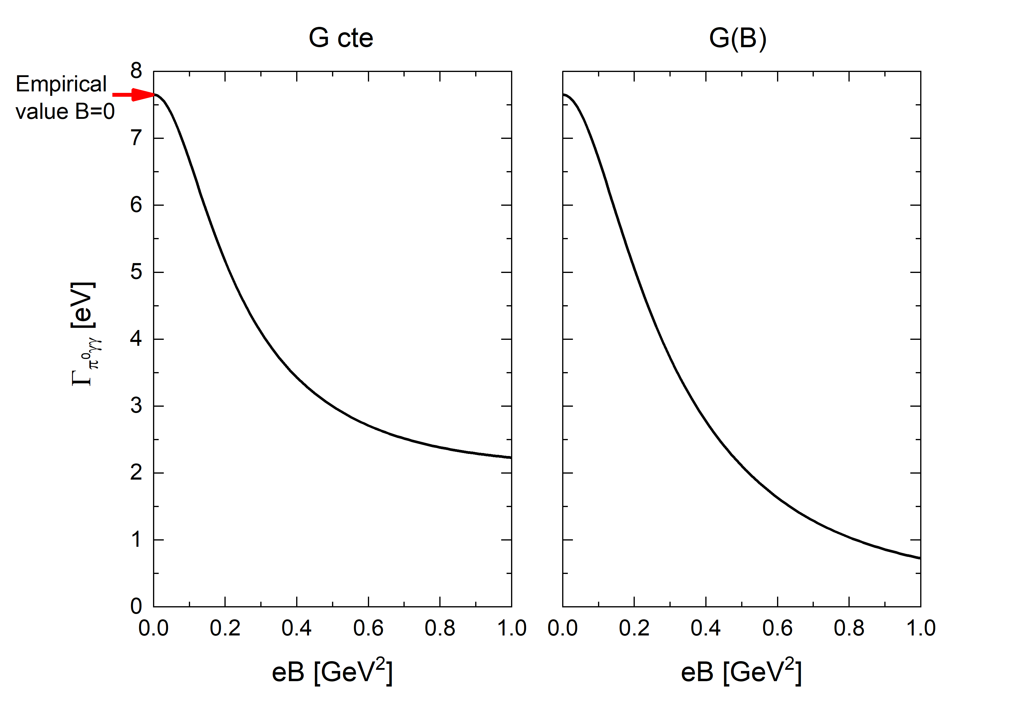
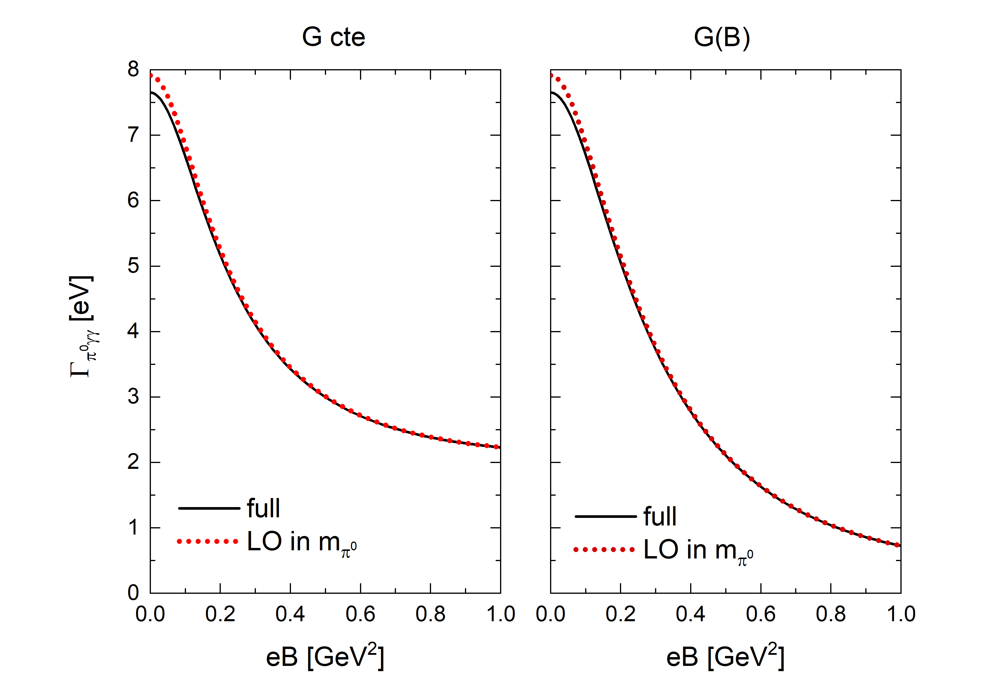
Small difference (about 4%) at B=0. Agreement improves as B increases

Slide 15
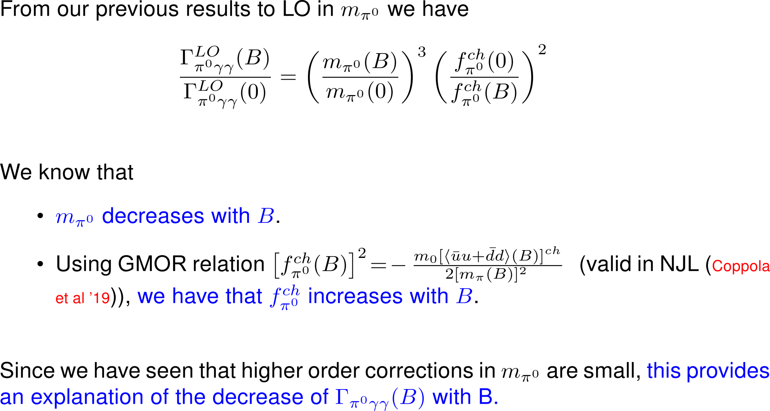

Slide 16
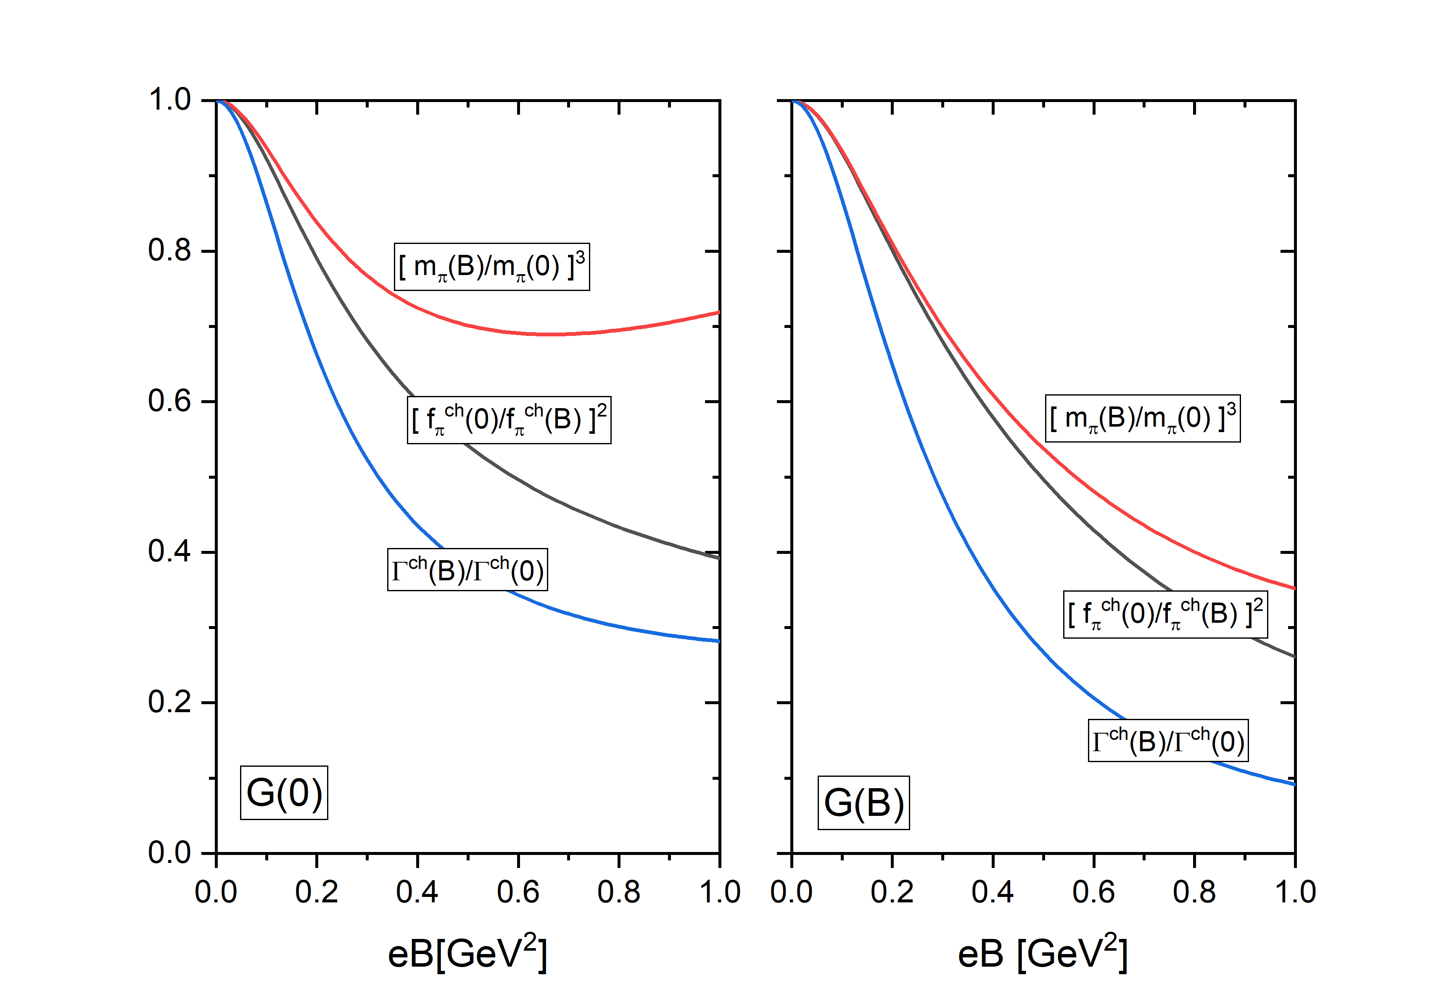
In a more quantitative way

Slide 17
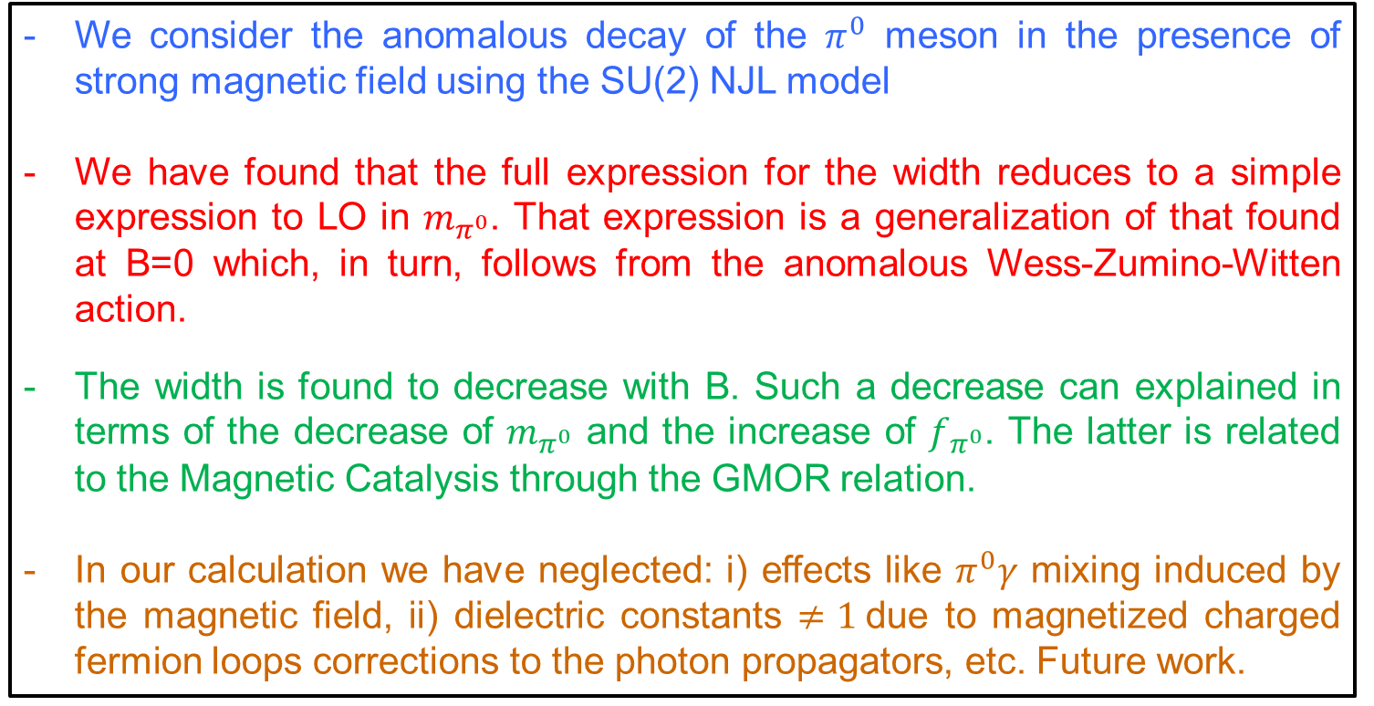
Summary and Conclusions
We consider the anomalous decay of the $π^{0}$ meson in the presence of strong magnetic field using the SU(2) NJL model
We have found that the full expression for the width reduces to a simple expression to LO in $m_{π^{0}}$. That expression is a generalization of that found at B=0 which, in turn, follows from the anomalous Wess-Zumino-Witten action.
The width is found to decrease with B. Such a decrease can explained in terms of the decrease of $m_{π^{0}}$ and the increase of $f_{π^{0}}$. The latter is related to the Magnetic Catalysis through the GMOR relation.
In our calculation we have neglected: i) effects like $π^{0}γ$ mixing induced by the magnetic field, ii) dielectric constants $≠1$due to magnetized charged fermion loops corrections to the photon propagators, etc. Future work.

Slide 18
